Slide 1

Hamilton Township, Mercer County, NJ
Hydrologic Evaluation and
Water Resources Recommendations
For Planning and Implementation
Rutgers Cooperative Extension Water Resources Program
Christopher C. Obropta, Ph.D., P.E.
Phone: 732-932-9800 x 6209
Email: Obropta@envsci.rutgers.edu
Jeremiah D. Bergstrom, LLA, ASLA
Phone: 732-932-9800 x 6126
Email: Jbergstrom@envsci.rutgers.edu
www.water.rutgers.edu

Slide 2

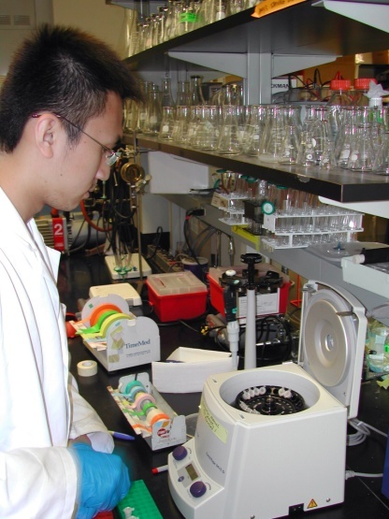
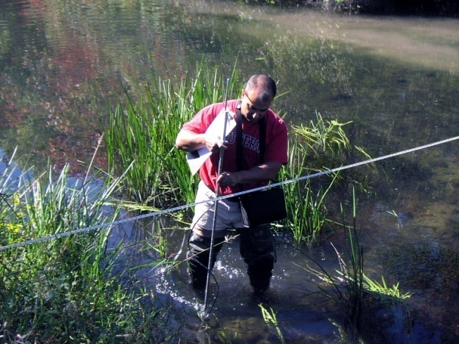
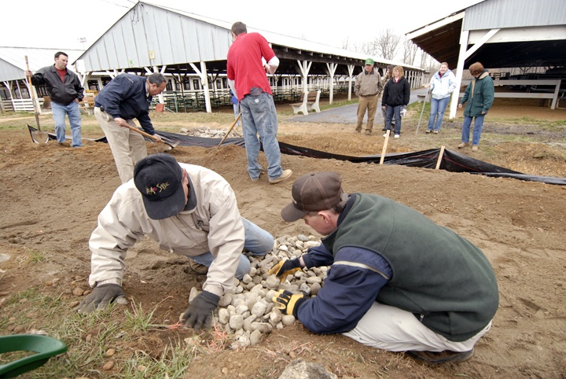
Rutgers Cooperative Extension
Who are We?
Rutgers Cooperative Extension (RCE) helps the diverse population of New Jersey adapt to a rapidly changing society and improves their lives through an educational process that uses science-based knowledge.

Slide 3
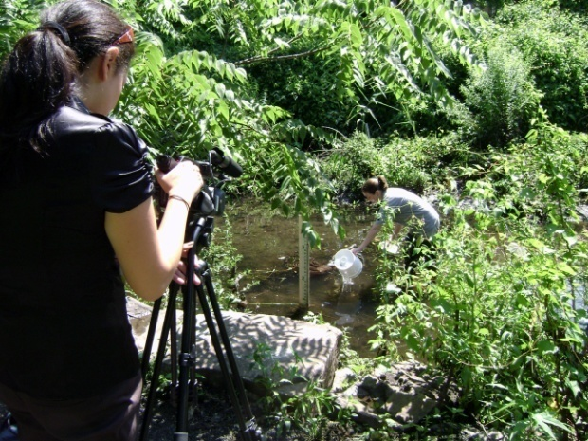
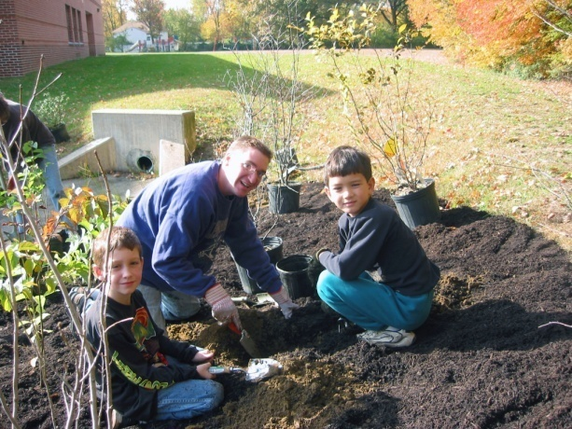
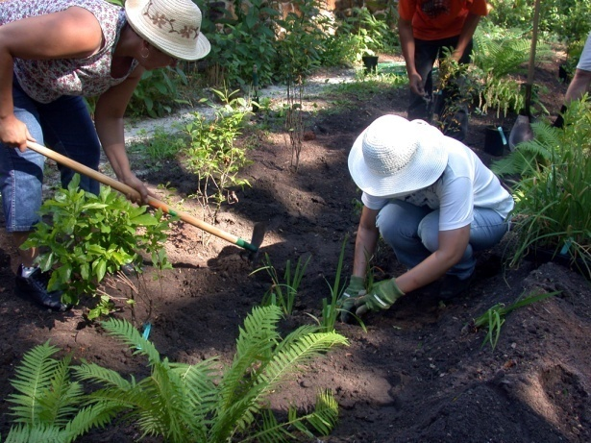
Water Resources Program
Who are We?
The Water Resources Program is one of many specialty programs under Rutgers Cooperative Extension. The goal of the Program is to provide solutions for many of the water quality and quantity issues that New Jersey faces today. This is accomplished through research, education, and outreach.

Slide 4
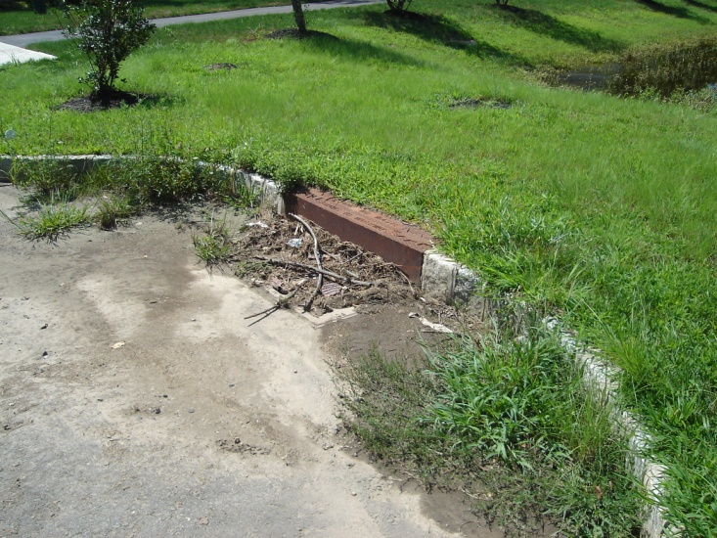
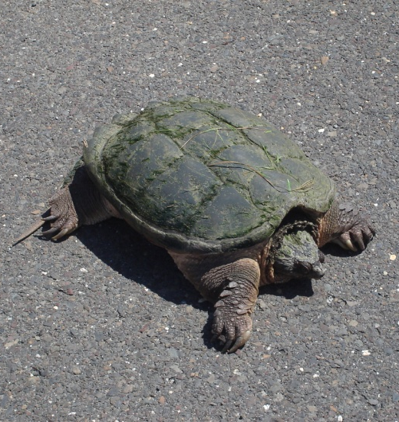
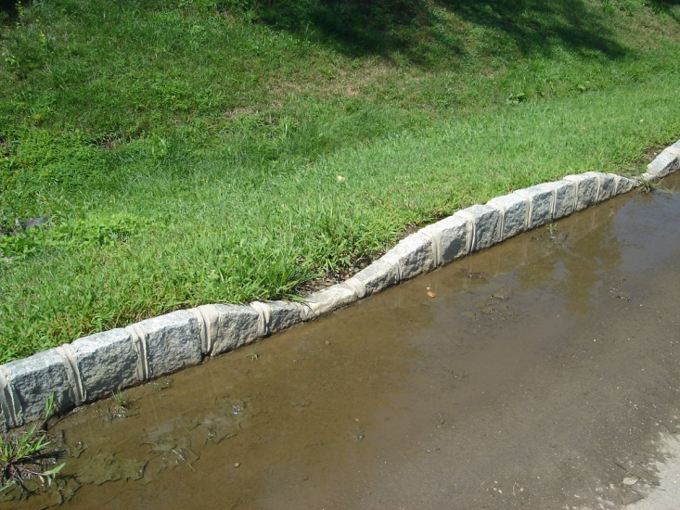
What have we done?
Rutgers Cooperative Extension Water Resources Program has worked with Hamilton Township to evaluate existing stormwater infrastructure, localized flooding issues, watershed drainage, and stormwater management strategies. The Rutgers team has reviewed the Township’s maintenance practices and responsibilities for stormwater management facilities. A series of recommended actions and strategies have been developed and proposed that will improve and protect water resources in Hamilton Township helping the community maintain compliance with Phase II Stormwater Regulations.
Notes:
4

Slide 5
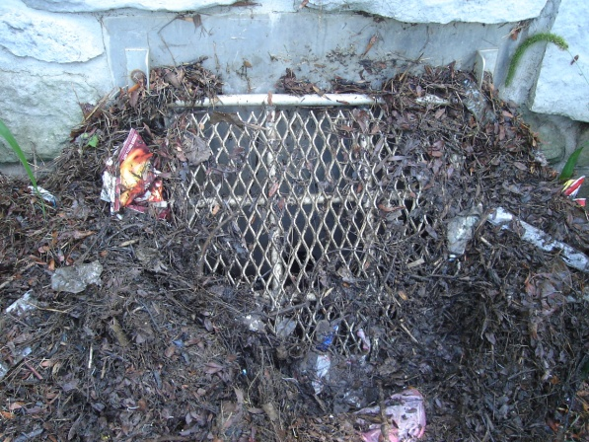
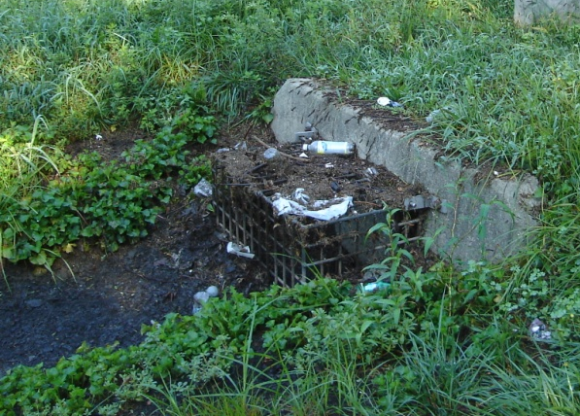
The Stormwater Problem
Localized flooding (QUANTITY)
Aging infrastructure
Increased maintenance costs
Nutrients and sediment (QUALITY)
Failing systems & property damage
Mosquitoes
Resident waterfowl (QUALITY)
The current estimate to repair the wastewater infrastructure throughout the State of NJ is $15 billion.
- Fiscal 2008 Budget in Brief. NJ State Office of Management and Budget, Chapter 2, pg 42, Feb 22, 2007, http://www.state.nj.us/treasury/omb

Slide 6
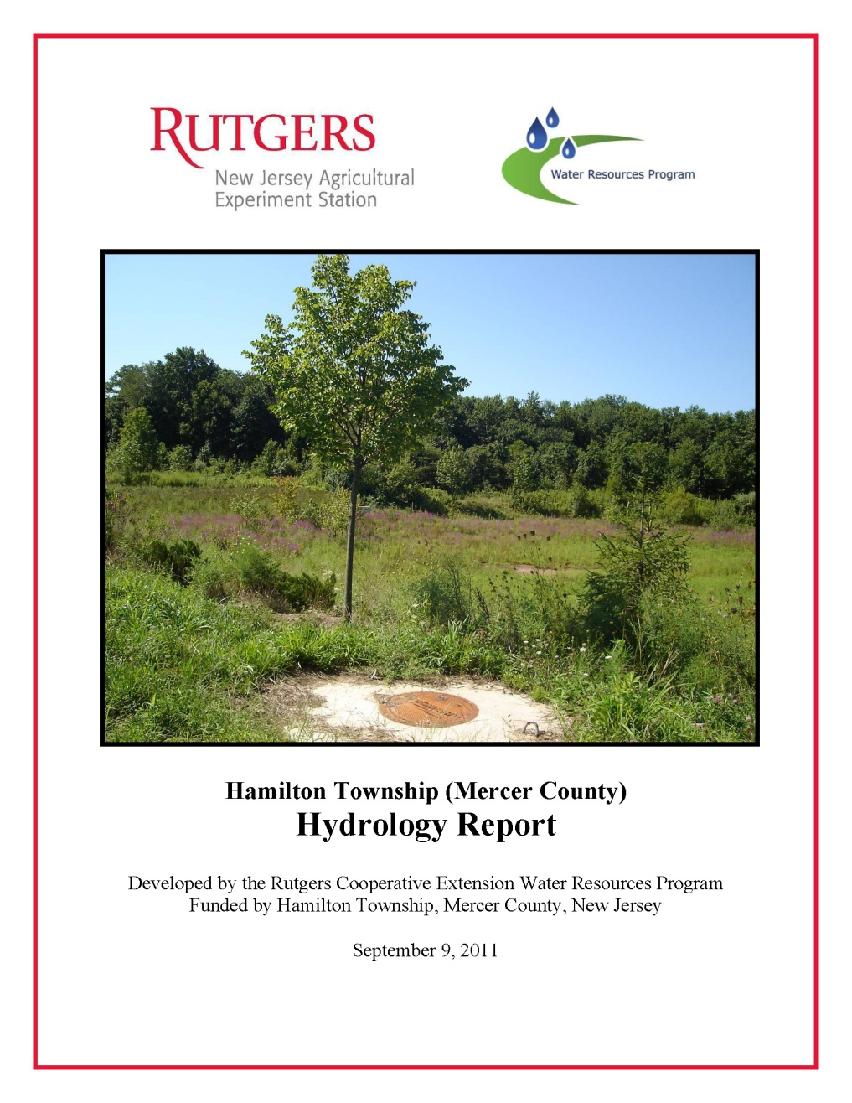
Task 1: Inventory and Review
Compile existing data
  Stormwater infrastructure, including; inlets, outlets, detention basins, piping, etc.
  Water resources overlays, including; rivers, streams, and ponds, flood plain, hydric soils, groundwater recharge areas, wellhead protection areas, riparian corridors, wetlands, etc.
  Surface water quality sampling results
Review current policies and plans
Develop mapping
Prepare evaluation
Notes:
6

Slide 7
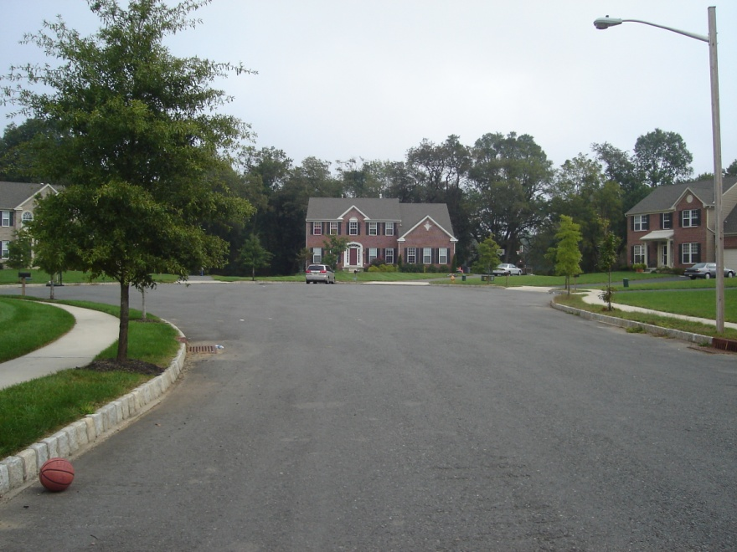
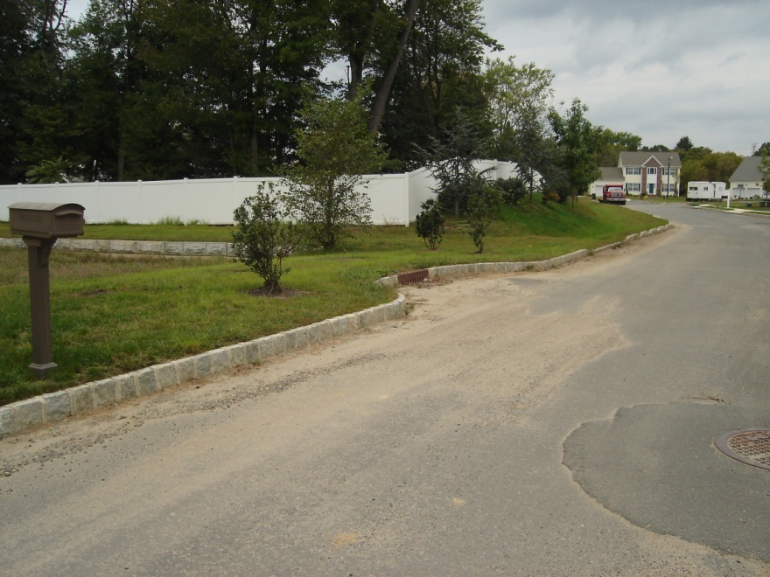
Task 1: Summary and Conclusions
Stormwater problems facing Hamilton Township are related to the increase in developed areas and the associated impervious cover that accompanies it
New development areas will only exacerbate water quality problems by increasing the frequency and intensity of storm flows and flooding, while also increasing pollution
Notes:
7

Slide 8
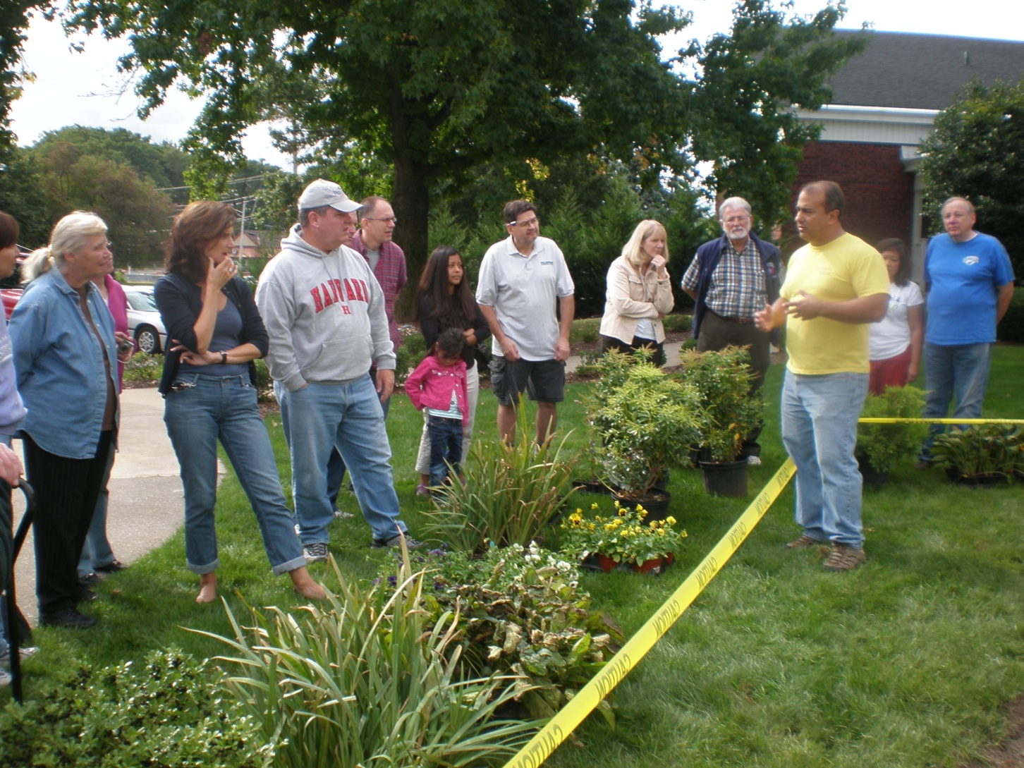
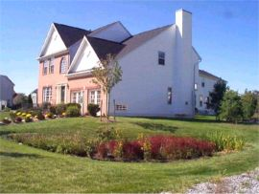
Task 1: Recommendations
Reduce the amount of impervious cover on new developments through green building techniques
Disconnect existing impervious areas through rain gardens, rain barrels, or pervious pavements
Educate residents of the municipality on their role in improving runoff water quality
Retrofit existing detention basins, replace and disconnect existing impervious areas, and maintain natural lands (forests and wetlands) as open spaces
Notes:
8

Slide 9
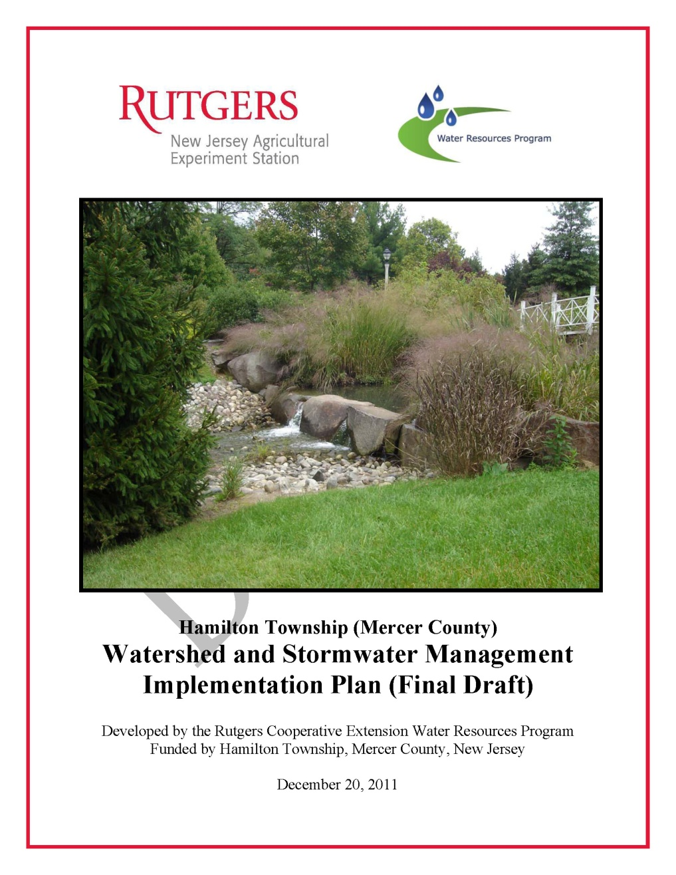
Task 2: Implementation Plan
Township Water Resources Goals
  Engage the community in water resource protection
  Manage water quality
  Minimize localized flooding
  Implement Phase II stormwater controls
  Improve stormwater facility maintenance
Site surveys and investigations
  Conduct evaluation of representative detention basin facilities for function and water quality retrofits
  Provide preliminary recommendations for corrective actions, maintenance, and enhancements
Outline actions and opportunities
Notes:
9

Slide 10
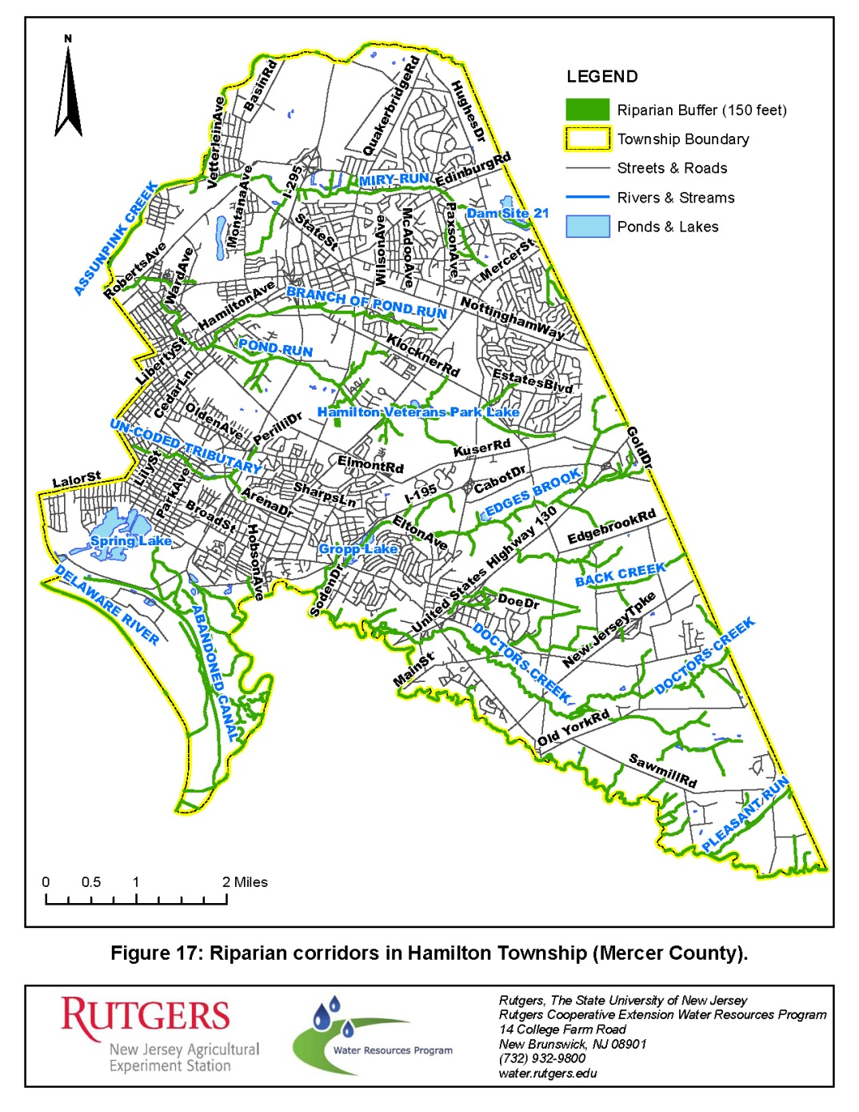
Goal 1: Engage the community in water resource protection
ACTION
Conduct riparian area investigations
Conduct vernal pool habitat surveys and certification
Notes:
10

Slide 11
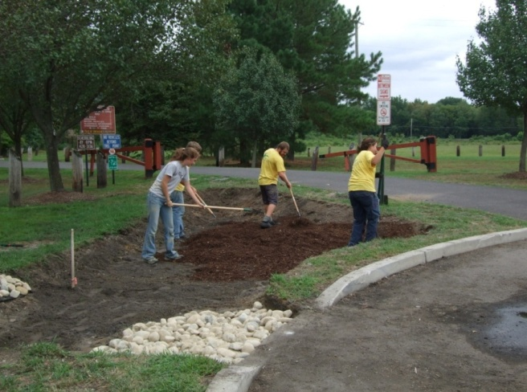
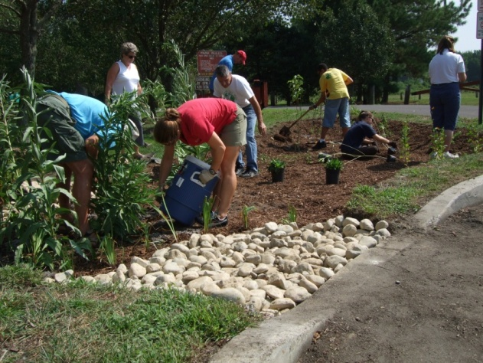
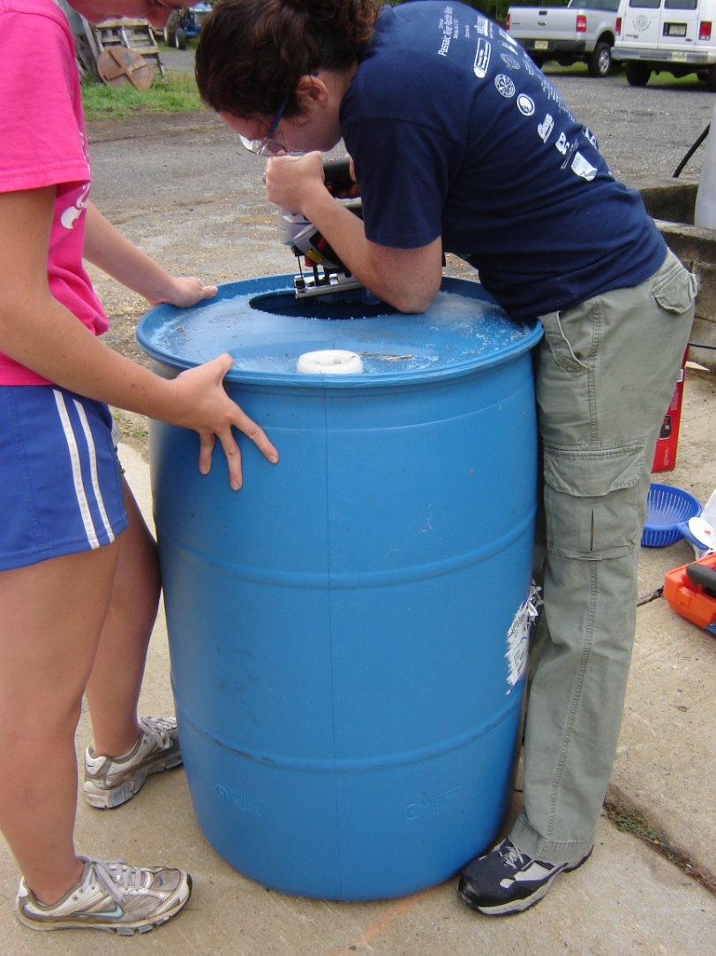
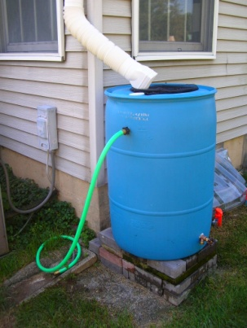
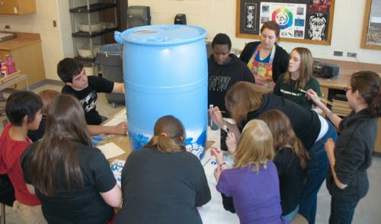
Goal 1: Engage the community in water resource protection
ACTION
Implement property owner education programs
Implement rain garden and downspout disconnection demonstration projects
Notes:
11

Slide 12
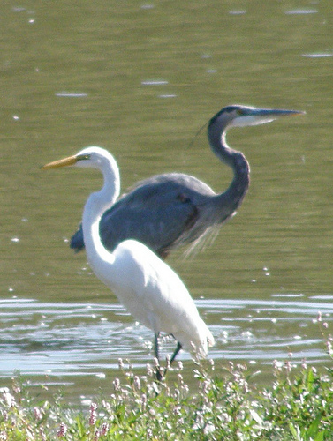

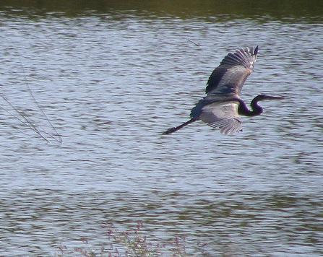
Goal 2: Manage water quality
ACTION
Develop and implement a water quality monitoring program for lakes and impoundments.
SOURCE: flickr.com by HeronThere
SOURCE: flickr.com by HeronThere
Notes:
12

Slide 13
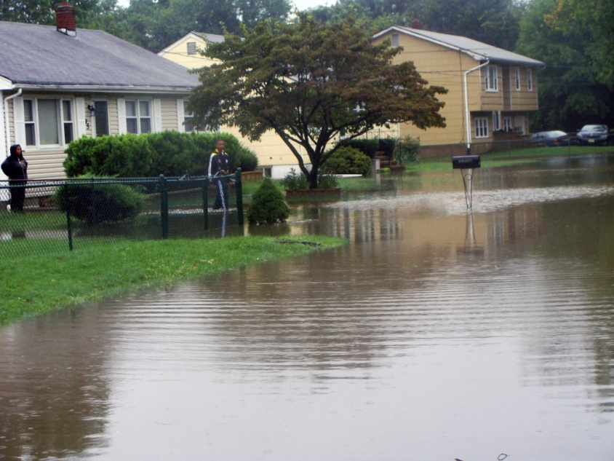
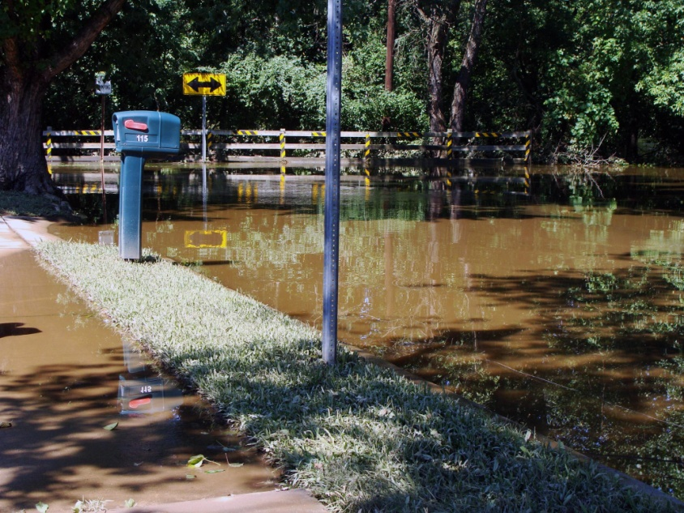
Goal 3: Minimize localized flooding
ACTION
Develop a hydrologic model for Hamilton Township
SOURCE: trentonian.com September 2011
Notes:
13

Slide 14
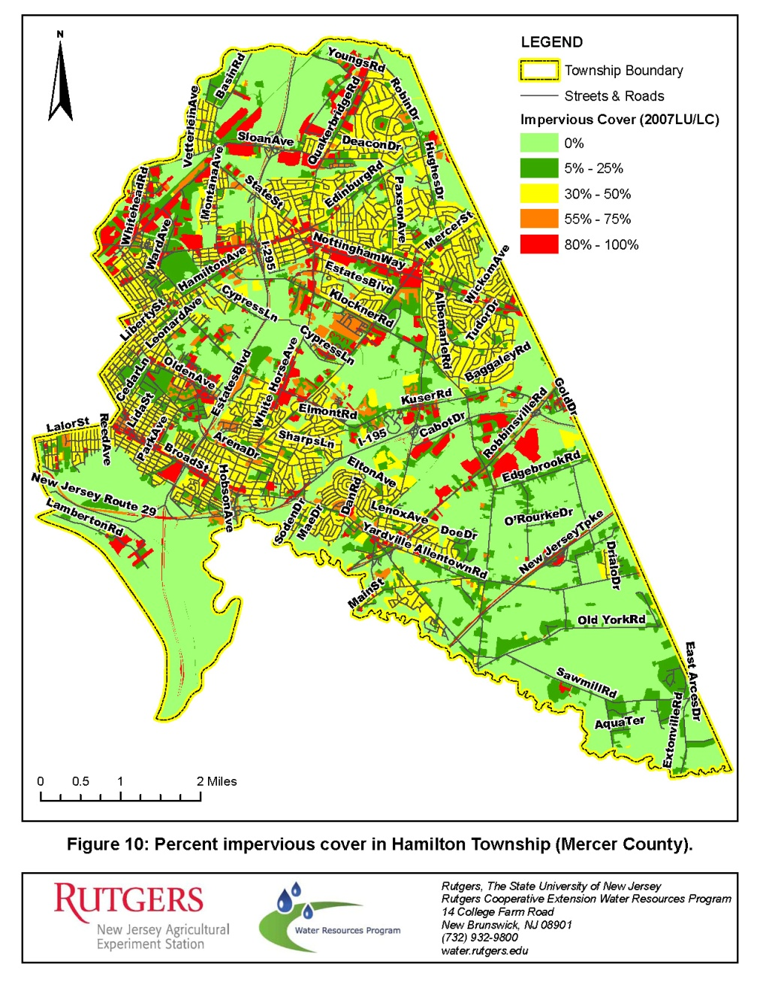
Goal 4: Implement Phase II stormwater controls
ACTION
Complete impervious cover analysis and develop a community disconnection program
Develop a ‘site suitability’ map for advanced stormwater management facilities
Notes:
14

Slide 15
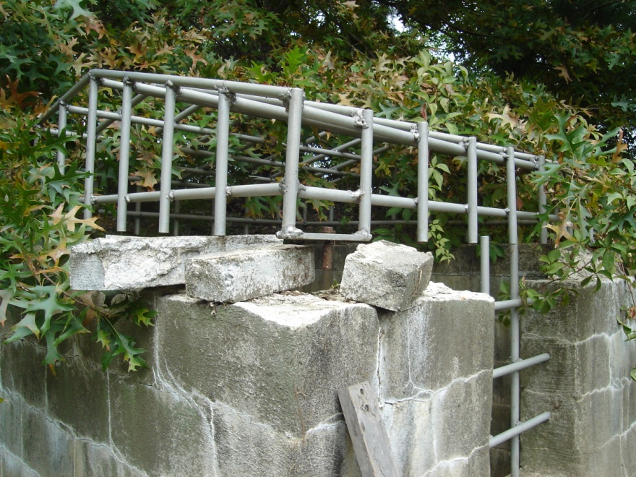
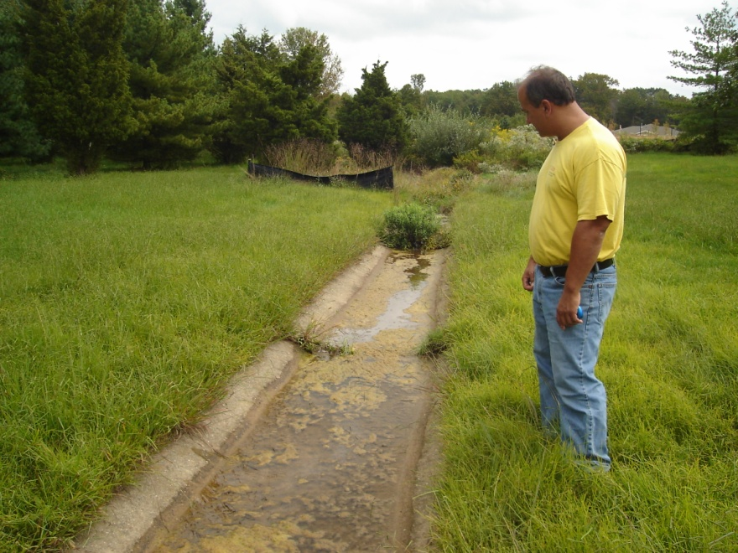
Goal 5: Improve stormwater facility maintenance
ACTION
Conduct complete inventory and assessment of stormwater management basins in Hamilton Township
Prepare a comprehensive GIS database of stormwater infrastructure
Implement detention basin maintenance training, inspection, and monitoring program
Execute detention basin repair, rehabilitation, and enhancement projects
Notes:
15

Slide 16
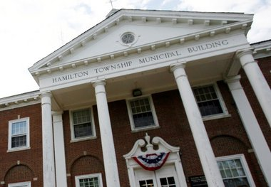
Task 3: Public Presentation
Conduct public presentation to present findings and inform the community
Deliver all work products in digital format suitable for distribution through online media and municipal website
Notes:
16

Slide 17
Next Steps
Review/Comment and Finalize Implementation Plan
Schedule and Conduct Public Presentation
Finalize Scope of Work and Budget for 2012
Begin efforts to implement Priority Action Items
    Develop Hydrologic Model for Hamilton Township
    Conduct Inventory and Assessment of Stormwater Management Basins
    Prepare Comprehensive GIS Database of Stormwater Infrastructure
    Implement Rain Garden Demonstration Project
    Implement Detention Basin Maintenance Training, Inspection, and Monitoring Program

Slide 18
Rutgers Cooperative Extension
Water Resources Program
Christopher C. Obropta, Ph.D., P.E.
Phone: 732-932-9800 x 6209
Email: Obropta@envsci.rutgers.edu
Jeremiah D. Bergstrom, LLA, ASLA
Phone: 732-932-9800 x 6126
Email: Jbergstrom@envsci.rutgers.edu
www.water.rutgers.edu
Notes:
18

