Slide 1
Assessment of the Use of Green Stormwater Infrastructure for Flood Mitigation At Berry Brook and impacts of Climate Change
Thomas P. Ballestero, James Houle, Rachel Hastings
University of New Hampshire Stormwater Center
24 February 2022

Slide 2
Objective
How does implementation of green stormwater infrastructure at the watershed scale address watershed hydrology and urban flooding?
In the context of infrastructure planning and design, which is more consequential: the increase in impervious area or climate change?

Slide 3
Extreme Precipitation
Extreme precipitation events over most mid-latitude land masses and
over wet tropical regions will very likely become more intense and
more frequent as global mean surface temperature increases.
IPCC, 2014: Climate Change 2014: Synthesis Report. Contribution of Working Groups I, II and III to the Fifth Assessment Report of the
Intergovernmental Panel on Climate Change [Core Writing Team, R.K. Pachauri and L.A. Meyer (eds.)]. IPCC, Geneva, Switzerland, 151 pp.

Slide 4
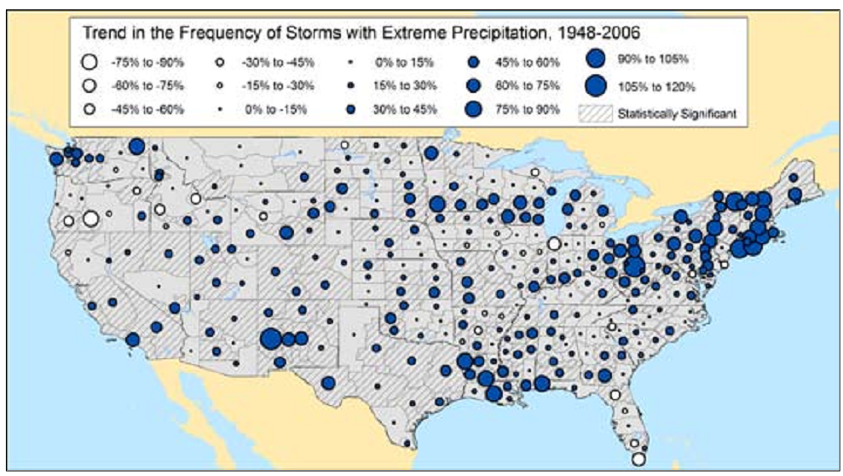
Changing Trends
The frequency and intensity of heavy precipitation events has likely increased in North America and Europe.
IPCC, 2014: Climate Change 2014: Synthesis Report. Contribution of Working Groups I, II and III to the Fifth Assessment Report of the
Intergovernmental Panel on Climate Change [Core Writing Team, R.K. Pachauri and L.A. Meyer (eds.)]. IPCC, Geneva, Switzerland, 151 pp.

Slide 5
Annual Northeast USA Extreme Precipitation
Total Precipitation (mm)
Huang, et al, 2017

Slide 6
What About New Hampshire?
Numbers of days per year with rainfall - about the same
Average daily rainfall - about the same
(mean =0.35 in = 8.9 mm; median = 0.2 in = 5.1 mm)
Daily rainfall value exceeded 90% of the days when it rains increased ~ 14%
Extreme precipitation is increasing

Slide 7
New Hampshire Extreme Precipitation
1960
2021
2021
(+4.3%)
(+4.2%)
(+7.7%)
(+15%)
(+26%)
(+32%)

Slide 8
Common “Design” Life for Our Structures
20 to 50 years (looking out to 2040 to 2060)
Precipitation increase of ~10-30%
Flood peak increase of ~10 – 80%
Temperature increase of 1-2 degrees F
Present guidance in New Hampshire is to increase extreme precipitation estimates of today by 15% to account for the anticipated climate changes to extreme precipitation by the end of the century (2100)

Slide 9
Hydrology and Flooding

Slide 10
More Frequent Floods?
Date | Flow (cfs)
4/16/2007 | 1320
10/21/1996 | 1160
5/14/2006 | 873
2/26/2010 | 864
9/11/1954 | 862
3/19/1983 | 709
2/27/1981 | 615
4/2/1973 | 610
4/6/1987 | 600
6/14/1998 | 595
Of the top 10 historic
floods on the
Oyster River, only one
was before 1970. Period of record 1934 - 2021

Slide 11
Trend in Floods – Oyster River

Slide 12
Oyster River Flood Series (1934 – 2019) LPIII Estimates
Return Period (years) | 1934 - 1969 | 1934 - 1979 | 1934 - 1989 | 1934 - 1999 | 1934 - 2009 | 1934 - 2019 | 1970-2019
2 | 296 | 290 | 301 | 304 | 307 | 296 | 300
10 | 521 | 520 | 544 | 581 | 625 | 609 | 664
25 | 623 | 631 | 665 | 734 | 821 | 813 | 941
50 | 693 | 711 | 754 | 853 | 984 | 988 | 1199
100 | 758 | 788 | 841 | 976 | 1160 | 1182 | 1507
% Increase in 100-year over 1969 | - | 4 | 11 | 29 | 53 | 56 | 99

Slide 13
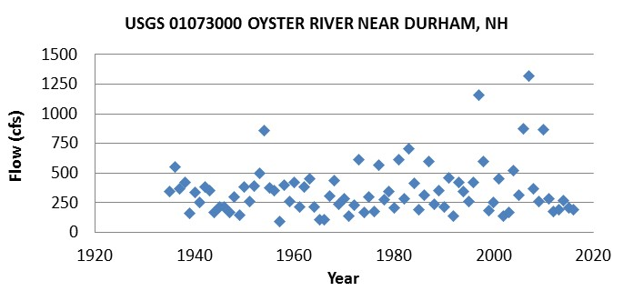
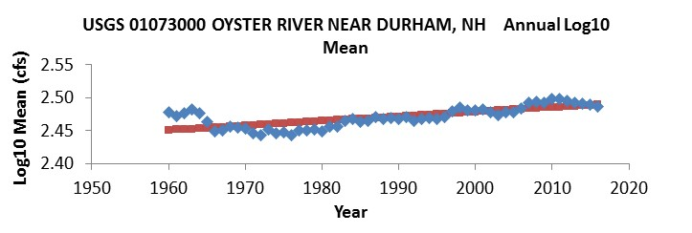
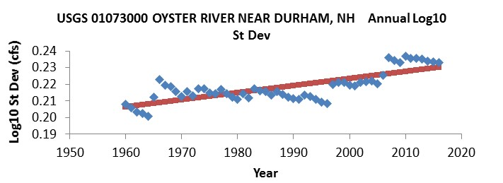
Annual (a) and annually computed log 10 mean (b), standard deviation (c), and skew (d) for the Oyster River annual peak flow series. Red dots are a least-squares-fitted trendline.

Slide 14
Watershed Hydrology and GSI Methodology
Monitor hydrology of an urbanized watershed, calibrate a hydrologic numerical model for the monitored hydrology, then adjust the model to reflect various levels of GSI Implementation and the effects of GSI on hydrology and flood characteristics

Slide 15
Common Terms
GSI - Green Stormwater Infrastructure (bioretention, subsurface gravel wetland, etc.)
BMP – Best Management Practice
IC - Impervious Cover
EIC – Effective Impervious Cover: impervious cover unmanaged by GSI
SWMM – Stormwater Management Model
DEM – Digital Elevation Model
LiDAR – Light Detection and Ranging

Slide 16
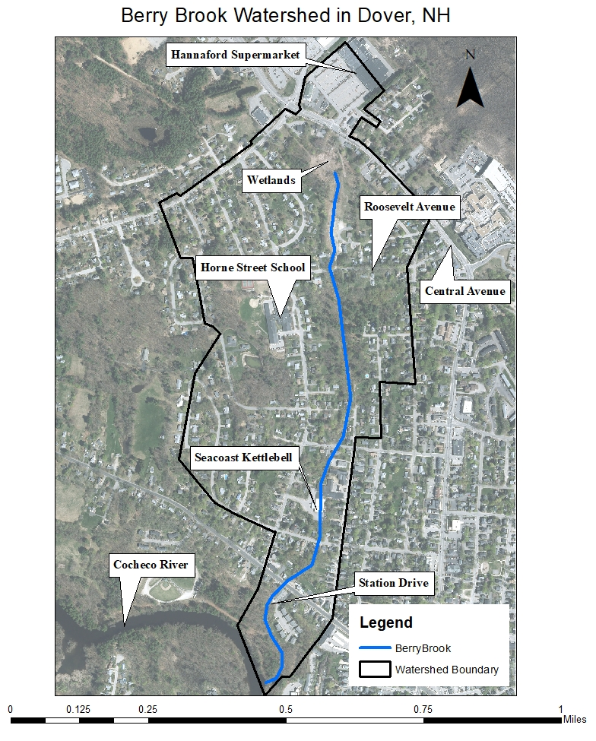
Berry Brook Watershed
200-acre (81 ha) watershed in Dover, NH
0.9-mile (1.5 km) 1st order stream
2006 – Listed as impaired by EPA
2007 – Management Project
Urbanized (30% EIC) prior to use of GSI

Slide 17
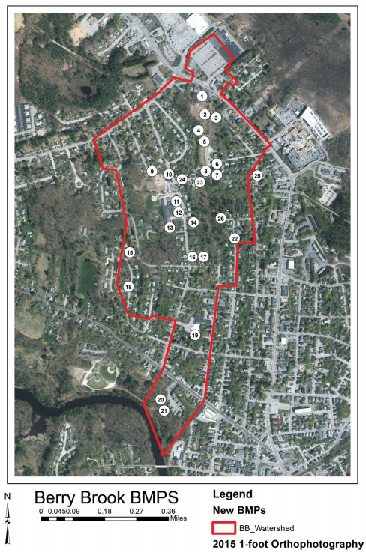
Restoration Efforts
Daylight 1,100 feet (335 m)of stream
Restore 500 feet (152 m) of stream
Create 1-acre (0.4 ha)of new wetland headwaters
Add multiple GSI systems to reduce watershed EIC from 30% to 10%
Image from City of Dover & UNH, 2017

Slide 18
GSI Installations at Berry Brook
12 bioretention systems,
1 tree filter,
1 subsurface gravel wetland,
3 grass-lined swales
2 subsurface gravel filters
1 infiltration trench system
3 innovative filtering catch basin designs

Slide 19
Model Scenarios and Comparison Variables
Event-based model (2-year through 100-year events
Long term model (10 years of precipitation)
Watershed Modeling – Pre GSI (30% EIC) and Post GSI (10% EIC)
Simulate reducing impervious cover (Pre GSI: 0% and 15% EIC)
Simulate climate change (event-based, present precipitation, increase 15%)
Compare and contrast impacts
Peak flow
Time to peak flow
Runoff depth
Total runoff volume

Slide 20
Software Selection - PCSWMM
SRTC Calibration Tool - calibrate using parameter sensitivity
Bulk edit capabilities - review all parameters at once
Kinematic Wave Equation - how water moves over the ground
Green-Ampt Equation - how water infiltrates the ground
Compatible with ArcMap - process data over geospatial area
Compatible with SWMM - Stormwater management model supported by the EPA

Slide 21
Initial Parameter Estimation
Subcatchment Area – ArcMap
Conduit Lengths - ArcMap
Subcatchment Width – Longest Flowpath
Elevations – 2011 LiDAR Survey
Subcatchment Slope – 2011 LiDAR Survey
Impervious Cover – 2010 Survey
Catch Basin Depths – Assumed to be 8 feet
Conduit Roughness – EPA SWMM User’s Manual
Soil Parameters - EPA SWMM User’s Manual, Web Soil Survey

Slide 22
Impervious surface cover in the Berry Brook Watershed

Slide 23
Model Development
Pre
Post

Slide 24
Model Calibration
Hlas (2011 – Pre GSI) and Johnson (2017-2018 – Post GSI) Data
UNH Morse Hall precipitation gage 7 miles (11 km) from site
Major calibration parameters:
Subcatchment width
Conduit roughness
Conduit length
Manning’s n

Slide 25
Event-Based Calibration
Pre-Improvements
Post-improvements
Rainfall: 0.23 inches (5.8 mm)
Rainfall: 0.85 inches (21.6 mm)

Slide 26
Long-Term Analysis
Notes:
– Keep it short. No Snowfall!

Slide 27
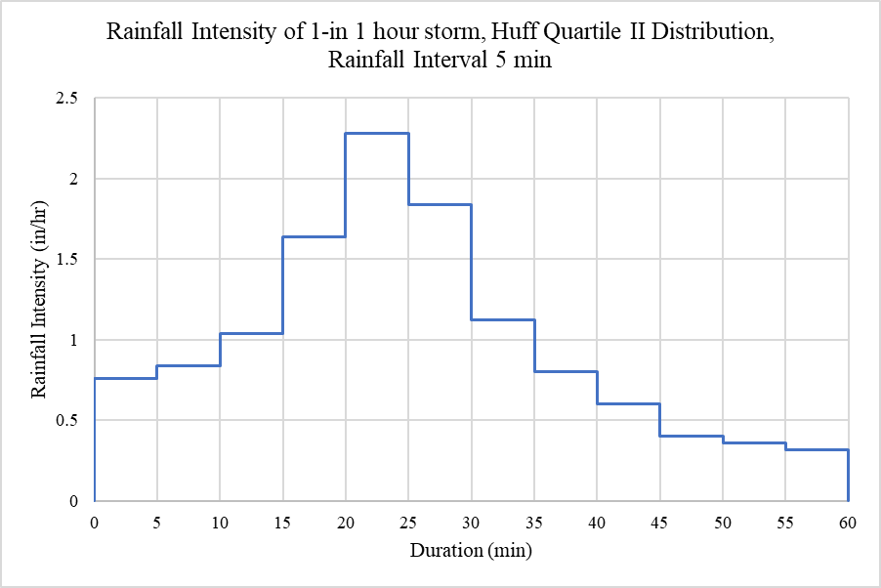
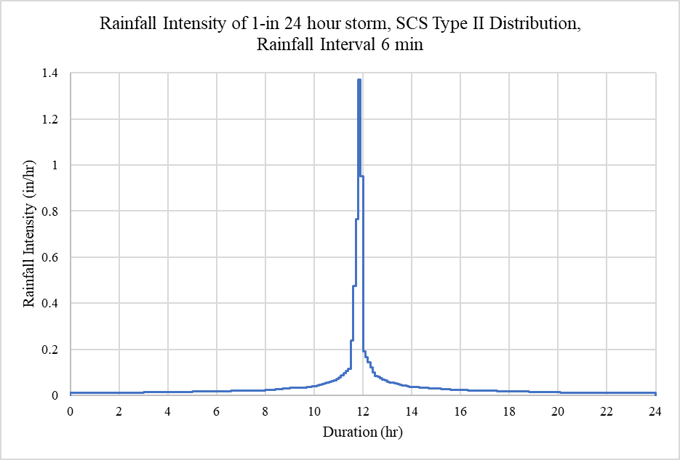
Precipitation
Atlas 14 Precipitation Data
Storm Duration | 2-yr | 10-yr | 50-yr | 100-yr
1 hr | 0.98 | 1.49 | 2.04 | 2.28
24 hr | 3.23 | 5.18 | 7.29 | 8.29
Climate-Adjusted Precipitation Data
Storm Duration | 2-yr | 10-yr | 50-yr | 100-yr
1 hr | 1.13 | 1.71 | 2.34 | 2.63
24 hr | 3.71 | 5.95 | 8.38 | 9.51

Slide 28
The Models

Slide 29
Pre GSI Watershed (30% EIC) Peak Flow Calibration
Event-Based

Slide 30
Pre GSI Watershed (30% EIC) Hydrograph Volume Calibration

Slide 31
Post GSI Watershed (10% EIC) Peak Flow Calibration

Slide 32
Post GSI Watershed (10% EIC) Hydrograph Volume Calibration

Slide 33
Extreme Precipitation Event Analysis of the Berry Brook Watershed

Slide 34
Example: Extreme Precipitation Events

Slide 35
Percent Change in Runoff Depth, Total Flow, and Peak Flow Caused by GSI Implementation to 10% EIC in a 30% IC Watershed

Slide 36
GSI Effect on Peak Flows
Event | Duration | Rain (in) | Peak Flow (cfs) |  |  |  | Time to Peak (hr)
 |  |  | Pre | Post | Change | % Change | Pre | Post | Change
2-yr storms | 1 hr | 0.98 | 22 | 13 | 9 | -40.9% | 0.78 | 1.08 | 38.5%
 | 24 hr | 3.23 | 34 | 27 | 7 | -20.6% | 12.05 | 12.45 | 3.3%
10-yr storms | 1 hr | 1.49 | 28 | 20 | 8 | -28.6% | 0.65 | 1.05 | 61.5%
 | 24 hr | 5.18 | 44 | 35 | 9 | -20.5% | 12.03 | 12.27 | 2.0%
50-yr storms | 1 hr | 2.04 | 35 | 25 | 9 | -28.6% | 0.60 | 1.05 | 75.0%
 | 24 hr | 7.29 | 55 | 45 | 10 | -18.2% | 12.02 | 12.22 | 1.7%
100-yr storms | 1 hr | 2.28 | 37 | 28 | 9 | -24.3% | 0.57 | 1.03 | 80.7%
 | 24 hr | 8.27 | 61 | 50 | 11 | -18.0% | 12.02 | 12.20 | 1.5%

Slide 37
Percent Change Caused by Alteration to the Berry Brook Watershed
Pre₃₀ to Post₁₀
Pre₃₀ to Pre₁₅
Pre₃₀ to Pre₀
Pre₃₀ to Pre_{30 climate}
Post₁₀ to Post_{10 climate}
Climate change is not as important an issue in flooding as impervious cover

Slide 38
Extreme Precipitation Events- Conclusions
Reduce IC to 15% without GSI
Peak Flow reduced 43%
Runoff depth reduced 30%
Reduce IC to 0% without GSI
Peak Flow reduced 68%
Runoff depth reduced 58%
Increase Precipitation by 15% without GSI
Peak Flow increased 11%
Runoff depth increased 18%
Increase Precipitation by 15% with GSI
Peak Flow increased 8%
Runoff depth increased 17%
GSI Implementation
Peak Flow reduced 24%
Runoff depth reduced 11%
Reductions decrease with return period

Slide 39
Long-Term Analysis of the Pre-Improvements and Post-Improvements Watersheds

Slide 40
Long-Term Analysis: Frequency-Duration Curves
Notes:
Don’t need the numbers. Show example. Talk about left-hand side more. SWMM is not built to do groundwater

Slide 41
Long-Term Analysis: Annual Maximum Wet Weather Flows
Average Decrease: 40%
Median Annual Maximum Rainfall: 1.8 in
Water Year | Maximum Flow (cfs) |  | Decrease
 | Pre | Post | Peak Flow (cfs) | Peak Flow (%)
2000 | 21 | 11 | 9 | 45
2001 | 17 | 6 | 11 | 64
2002 | 21 | 9 | 12 | 58
2003 | 15 | 5 | 10 | 66
2004 | 23 | 16 | 7 | 32
2005 | 25 | 20 | 5 | 20
2006 | 22 | 15 | 6 | 29
2007 | 19 | 7 | 12 | 64
2008 | 26 | 24 | 1 | 5
2009 | 23 | 13 | 10 | 43
2010 | 25 | 22 | 3 | 10

Slide 42
Long-Term Analysis: Infiltration and Surface Runoff
 | Inches of Water |  | Change | Change | Type
 | Pre | Post | inches | %
Total Rainfall | 211 | 211 | 0 | 0 | N/A
Infiltration | 148 | 180 | 32 | 22 | Increase
Surface Runoff Depth | 58 | 29 | 29 | 50 | Decrease
Notes:
– Where’s the rest of the precipitation? Snow alone doesn’t cover it. Add the calculated baseflow from storm infiltration. For the 11-year period

Slide 43
GSI / BMP Implementation
Extreme Precipitation Events
Peak Flow reduced 24% - Reduction decreases with return period
Runoff depth reduced 11% - Reduction decreases with return period
Long-Term Analysis – Wet Weather Flows
40% decrease in peak flow
22% increase in infiltration
50% decrease in storm runoff depth

Slide 44
Research Questions
What are the effects of green stormwater infrastructure on reducing flooding in urban areas?
GSI reduces peak flow and total runoff depth in extreme precipitation events and in a long-term analysis.
Which is more extreme: effect on flooding caused by impervious cover or the effect on flooding expected by climate change?
Reducing impervious cover in the watershed reduces peak flow and total runoff depth in extreme precipitation events, with more reduction in more frequent events. Decreasing IC or EIC has a greater impact than climate change an urbanized with or without GSI.

Slide 45
References
Ballestero, T. (2012). University of New Hampshire Stormwater Center 2012 Biennial Report. Durham, NH: UNH Stormwater Center, 36pp.
Ballestero, T. P., Houle, J. J., & Puls, T. A. (2016). Breaking Through: University Of New Hampshire Stormwater Center 2016 Report.
Ballestero, T. P., Houle, J. J., & Macadam, D. (2020). Taking Root: University of New Hampshire Stormwater Center 2017-2019 Triennial Report.
Baek, S., Ligaray, M., Pyo, J., Park, J., Kang, J., Pachepsky, Y., Chun, J., & Cho, K. (2020). A novel water quality module of the SWMM model for assessing low impact development (LID) in urban watersheds. Journal of Hydrology (Amsterdam), 586, 124886–. https://doi.org/10.1016/j.jhydrol.2020.124886
Barnhart, B., Pettus, P., Halama, J., McKane, R., Mayer, P., Djang, K., Brookes, A., & Moskal, L. (2021). Modeling the hydrologic effects of watershed-scale green roof implementation in the Pacific Northwest, United States. Journal of Environmental Management, 277, 111418–111418. https://doi.org/10.1016/j.jenvman.2020.111418
Beach, D. (2003). Coastal sprawl: The effects of urban design on aquatic ecosystems. In of the United States, Pew Oceans Commission 2002.
Bisht, D., Chatterjee, C., Kalakoti, S., Upadhyay, P., Sahoo, M., & Panda, A. (2016). Modeling urban floods and drainage using SWMM and MIKE URBAN: a case study. Natural Hazards (Dordrecht), 84(2), 749–776. https://doi.org/10.1007/s11069-016-2455-1
City of Dover & The University of New Hampshire (2017). Berry Brook Watershed Management Plan – Implementation Projects Phase III. University of New Hampshire Stormwater Center. https://www.unh.edu/unhsc/sites/default/files/media/berry_brook_wag_iii_final-only.pdf
Ebrahimian, A., Gulliver, J., & Wilson, B. (2018). Estimating effective impervious area in urban watersheds using land cover, soil character and asymptotic curve number. Hydrological Sciences Journal, 63(4), 513–526. https://doi.org/10.1080/02626667.2018.1440562

Slide 46
References
Ely, E. (2019). Infiltration Characteristics of Subsurface Gravel Filtration Systems for Stormwater Management.
Hlas, V. (2013). An examination of the reduction of effective impervious cover and ecosystem and watershed response. ProQuest Dissertations & Theses.
Hopton, M., Simon, M., Borst, M., Garmestani, A., Jacobs, S., & Lye, D. (2015). Green infrastructure for stormwater control: Gauging its effectiveness with community partners. Environmental Protection Agency.
Jang, S., Cho, M., Yoon, J., Yoon, Y., Kim, S., Kim, G., Kim, L., & Aksoy, H. (2007). Using SWMM as a tool for hydrologic impact assessment. Desalination, 212(1), 344–356. https://doi.org/10.1016/j.desal.2007.05.005
Jayasooriya, V., & Ng, A. (2014). Tools for Modeling of Stormwater Management and Economics of Green Infrastructure Practices: a Review. Water, Air, and Soil Pollution, 225(8), 1–20. https://doi.org/10.1007/s11270-014-2055-1
Lee, J., Nietch, C., & Panguluri, S. (2018). Drainage area characterization for evaluating green infrastructure using the Storm Water Management Model. Hydrology and Earth System Sciences, 22(5), 2615–2635. https://doi.org/10.5194/hess-22-2615-2018
Macadam, D. (2018). An Improved Infiltration Model And Design Sizing Approach For Stormwater Bioretention Filters Including Anisotropy And Infiltration Into Native Soils (Doctoral dissertation, University of New Hampshire).
Nile, B. K., Hassan, W. H., & Esmaeel, B. A. (2018). An evaluation of flood mitigation using a storm water management model [SWMM] in a residential area in Kerbala, Iraq. MS&E, 433(1), 012001.

Slide 47
References
Peterson, J., Stone, A., & Houle, J. (2010). Protecting Water Resources and Managing Stormwater: A Bird's Eye View for New Hampshire Communities.
Press, W. E. F. (2012). Design of urban stormwater controls. ASCE.
Rawls, W. J., Brakensiek, D. L., & Miller, N. (1983). Green-Ampt infiltration parameters from soils data. Journal of hydraulic engineering, 109(1), 62-70.
Rossman, L. (2015). Storm Water Management Model User’s Manual Version 5.1. US. Environmental Protection Agency. https://www.epa.gov/sites/production/files/2019-02/documents/epaswmm5_1_manual_master_8-2-15.pdf
Schueler, T. R., Fraley-McNeal, L., & Cappiella, K. (2009). Is impervious cover still important? Review of recent research. Journal of Hydrologic Engineering, 14(4), 309-315.
Task, N. H. C. C. P. (2009). The New Hampshire climate action plan: a plan for New Hampshire's energy, environmental and economic development future.
Tsai, L. Y., Chen, C. F., Fan, C. H., & Lin, J. Y. (2017). Using the HSPF and SWMM models in a high pervious watershed and estimating their parameter sensitivity. Water, 9(10), 780.
EPA. (2011). "Estimating Change in Impervious (IA) and Directly Connected Impervious Areas (DCIA) for New Hampshire Small MS4 Permit."

Slide 48
References
US EPA. Office of Water Regulations, & United States. Environmental Protection Agency. Office of Water Planning. (2017). National Water Quality Inventory: Report to Congress. Office of Water Regulations and Standards.
US EPA (2020a). NPDES Stormwater Program. National Pollutant Discharge Elimination System (NPDES). https://www.epa.gov/npdes/npdes-stormwater-program
US EPA (2020b). National Water Quality. How’s My Waterway?. https://mywaterway.epa.gov/national
US EPA (2020c). New Hampshire Water Quality. How’s My Waterway?. https://mywaterway.epa.gov/state/NH/water-quality-overview
Vietz, G., Rutherfurd, I., Fletcher, T., & Walsh, C. (2016). Thinking outside the channel: Challenges and opportunities for protection and restoration of stream morphology in urbanizing catchments. Landscape and Urban Planning, 145, 34–44. https://doi.org/10.1016/j.landurbplan.2015.09.004
Wake, C. P., Burakowski, E. A., Wilkinson, P., Hayhoe, K., Stoner, A., Keeley, C., & LaBranche, J. (2014). Climate change in southern New Hampshire: past, present and future.
Wang, K., & Altunkaynak, A. (2012). Comparative Case Study of Rainfall-Runoff Modeling between SWMM and Fuzzy Logic Approach. Journal of Hydrologic Engineering, 17(2), 283–291. https://doi.org/10.1061/(ASCE)HE.1943-5584.0000419
Westra, S., Mehrotra, R., Sharma, A., & Srikanthan, R. (2012). Continuous rainfall simulation: 1. A regionalized subdaily disaggregation approach: CONTINUOUS RAINFALL: REGIONALIZED DISAGGREGATION. Water Resources Research, 48(1). https://doi.org/10.1029/2011WR010489
Yazdi, M. N., Ketabchy, M., Sample, D. J., Scott, D., & Liao, H. (2019). An evaluation of HSPF and SWMM for simulating streamflow regimes in an urban watershed. Environmental Modelling & Software, 118, 211-225.
Zhu, Z., & Chen, X. (2017). Evaluating the Effects of Low Impact Development Practices on Urban Flooding under Different Rainfall Intensities. Water (Basel), 9(7), 548–. https://doi.org/10.3390/w9070548

Slide 49
Questions?

