Slide 1
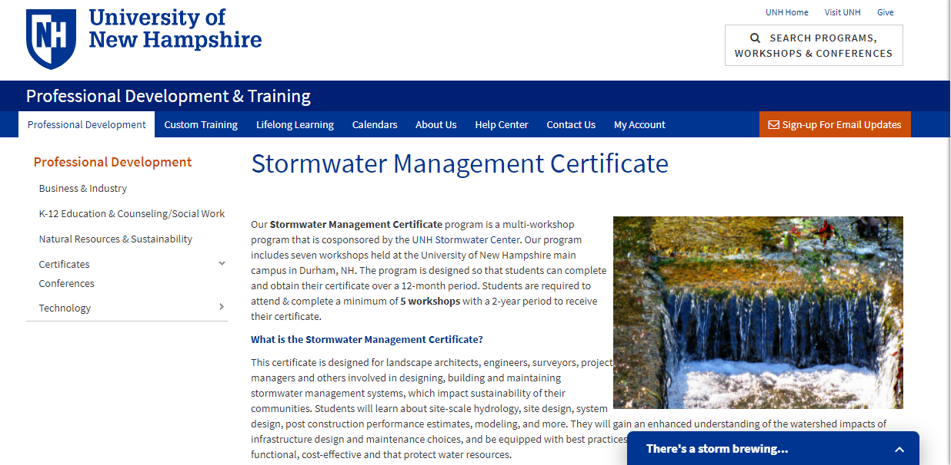
UNH Stormwater Management Certificate
James Houle, PhD. Director of the UNH Stormwater Center

Slide 2
Structural BMP’s
Appropriate Design
Installation
Maintenance

Slide 3
Design Certification Course
Target Market:
Engineers
Landscape Architects
Designers
Regulatory reviewers
Other stormwater management professionals.

Slide 4
Stormwater Certification Course
Objective: to create a more uniform certification program for stormwater engineering. The course focuses on the following topics:
Class 1: Stormwater Hydrology.
Class 2: Stormwater Site Design –
Class 3: Filtration Treatment System Design & Post Construction Performance Estimates,
Class 4: Infiltration Treatment System Design & Post Construction Performance Estimates, Part II
Class 5: Stormwater Construction: Erosion and Sediment Controls
Class 6: Stormwater System Modeling

Slide 5

Now Using Digital Badges

Slide 6

Additional Targeted Training and Audiences:
Installation and Oversite Certification Course: Contractors, municipal works staff and project oversite personnel and green stormwater infrastructure installers
Inspection, Operation and Maintenance Certification Course: Operation and maintenance staff and inspectors

Slide 7
Origin of the course
Stormwater despite it’s relative compliance with physics continues as a nascent science.
Historical approaches are inadequate with respect to water quality and are playing catch up with land use changes and precipitation patterns.
Site specific designs often fail to address watershed issues
Regulations are slow to adapt innovations that more effectively and address flooding and water quality issues in a more economical way.

Slide 8
Common Problems with Design Review
Delineating and maintaining predevelopment subcatchment areas
Calculating Time of Concentration
Options for Site Investigations:
  Geotechnical
  Hydrologic Soil Group
Innovative stormwater controls and up-to-date design specifications
Site inspection and erosion control plans

Slide 9

Results
UNH Stormwater Center has educated over two thousand nine hundred and fourteen (2,914) graduate and undergraduate students in water resource engineering
Trained four thousand four hundred and thirty (4,430) water resource and stormwater design professionals.
To date, eighty five (85) regional stormwater professionals have received certification through the stormwater design certificate course.

Slide 10
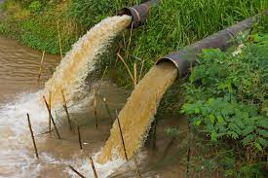
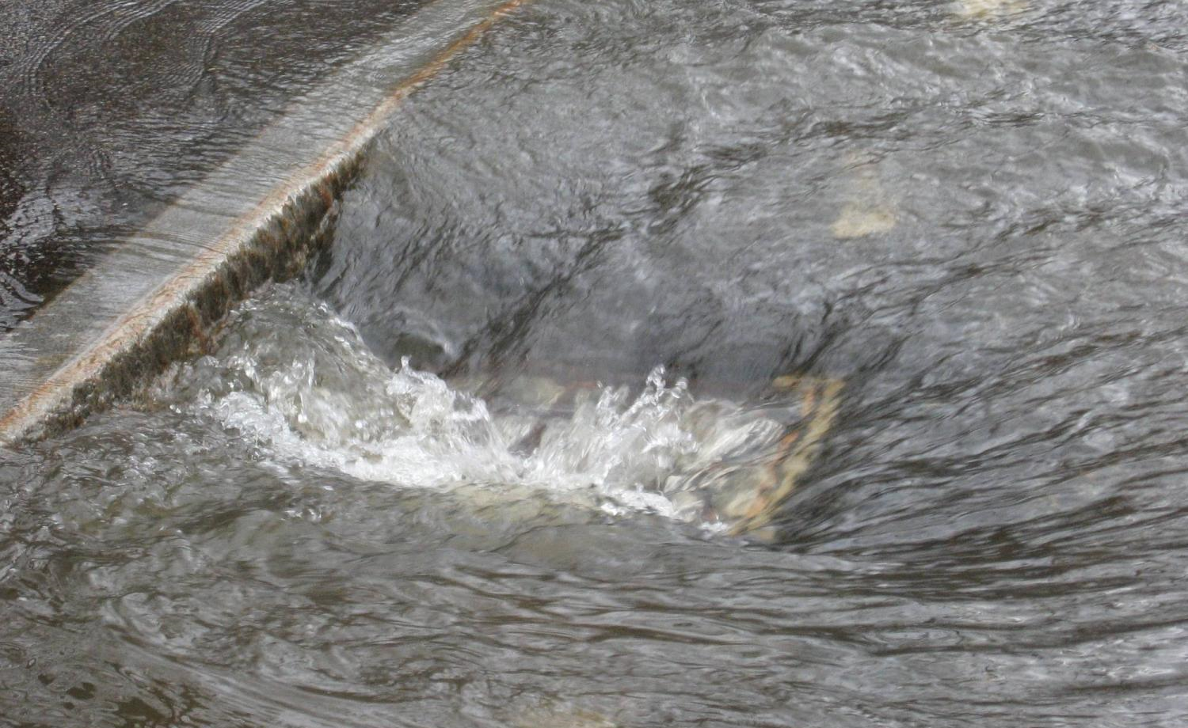
Emergent and Innovative Stormwater Controls
Point Source Pollution: any single identifiable source of pollution from which pollutants are discharged, such as a pipe, ditch, ship or factory smokestack (USEPA).
Non-point Source Pollution: pollution generally results from land runoff, precipitation, atmospheric deposition, drainage, seepage or hydrologic modification (USEPA).

Slide 11
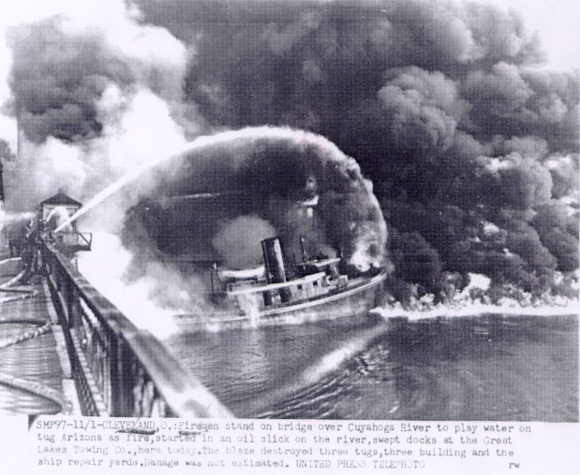
Part of the Problem – Point Source Pollution

Slide 12
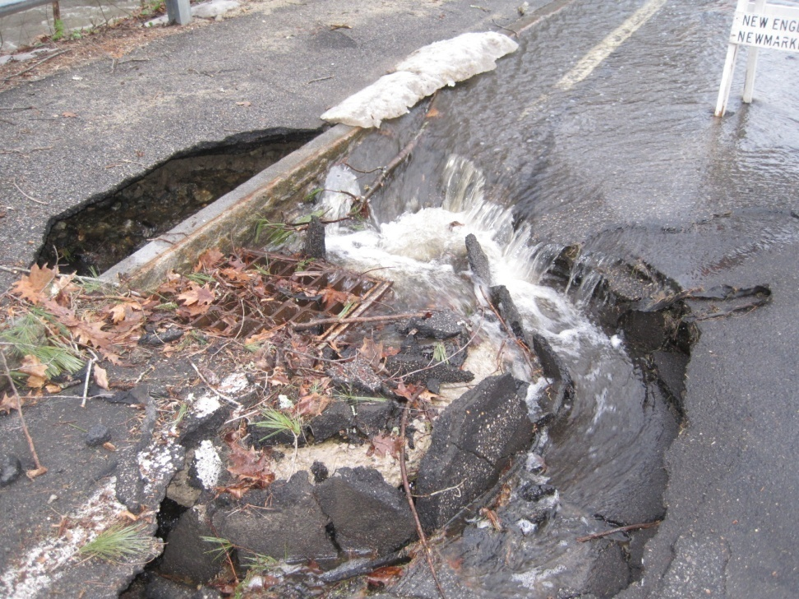
NPS is Part of the Problem and managing it is part of the solution
90%
NH DES 2008, 303(d) List of Impaired Waters Requiring restoration
Notes:
NH DES 2008, 303(d) List of Impaired Waters Requiring restoration
83% of surface water quality impairments in NH are due, at least in part, to stormwater.

Slide 13
Study Found That…
Systems failed
2/3 of the time!
34%
Of the time
systems offered some kind of treatment
40%
Of the time systems exported more pollutants
26%
Of the time systems did nothing
Notes:
Purpose: Display as trainer reviews highlights of study. Slow cueing of animation. Start with pie chart and work through percentages giving examples, then the big finale.
Notes: “What we found out…only 34% of the time did the systems offer
some kind of treatment…etc.,

Slide 14
Stormwater Control Requirements are Changing
20th Century Management
  Peak flow control
  80% Total Suspended Solids (TSS) reduction
21st Century Management
  Peak flow control
  80% TSS reduction
  50-60% Total Phosphorus (TP) reduction
  50% Total Nitrogen (TN) reduction
  Volume reduction (now considering a 1” retention requirement)
  Restoring altered urban hydrology

Slide 15
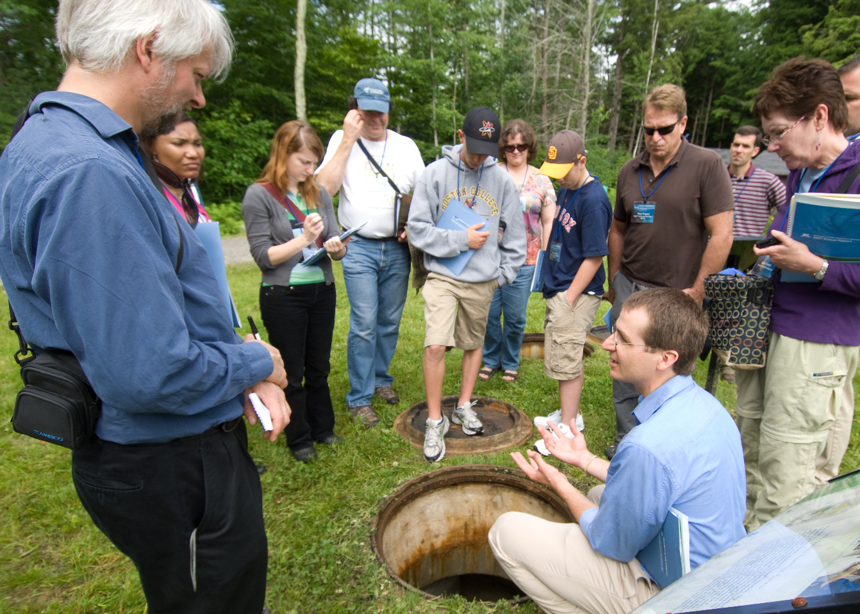
Evolving Research for Stormwater Management
James Houle and Tom Ballestero
UNH Stormwater Center
Providing Data to Protect Water Quality Since 2004
Notes:
Purpose: Backdrop slide for trainer to state simply what UNHSC is and its mission as it relates to the target audience, also to site primary sponsors of the center (not the course per say.)
Notes: Sample talking points… “We are a center for applied stormwater research, based in NH, but looking at issues that are relevant all over the country. Founded in 2004 in response to a need for research to help sw managers meet phase II Requirements and therefore protect water resources…

Slide 16
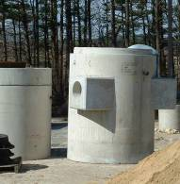
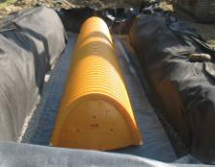
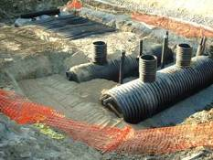
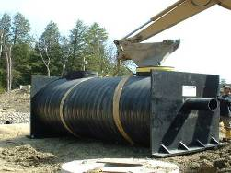
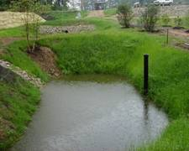




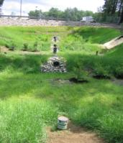
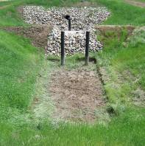
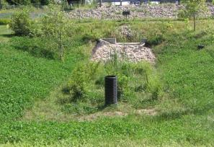
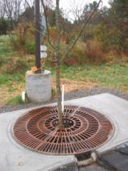
Hydrodynamic Separator
Isolator Row
Subsurface Infiltration
Filter Unit
Porous Asphalt
Pervious Concrete
Retention Pond
Stone Swale
Veg Swale
Gravel Wetland
Sand Filter
Bioretention Unit
Tree Filter

Slide 17
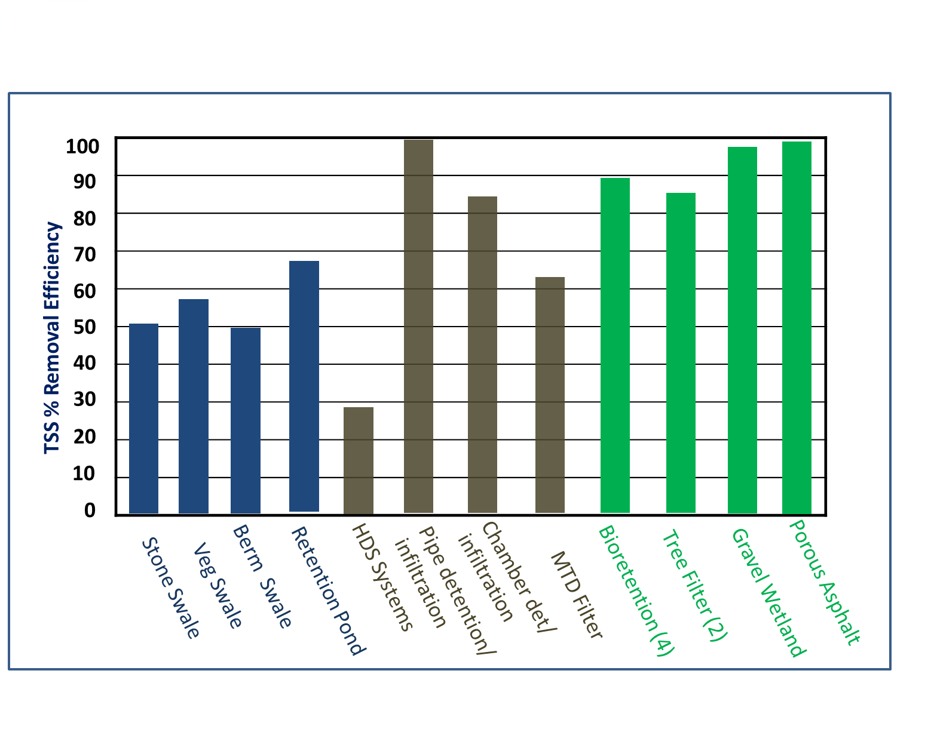
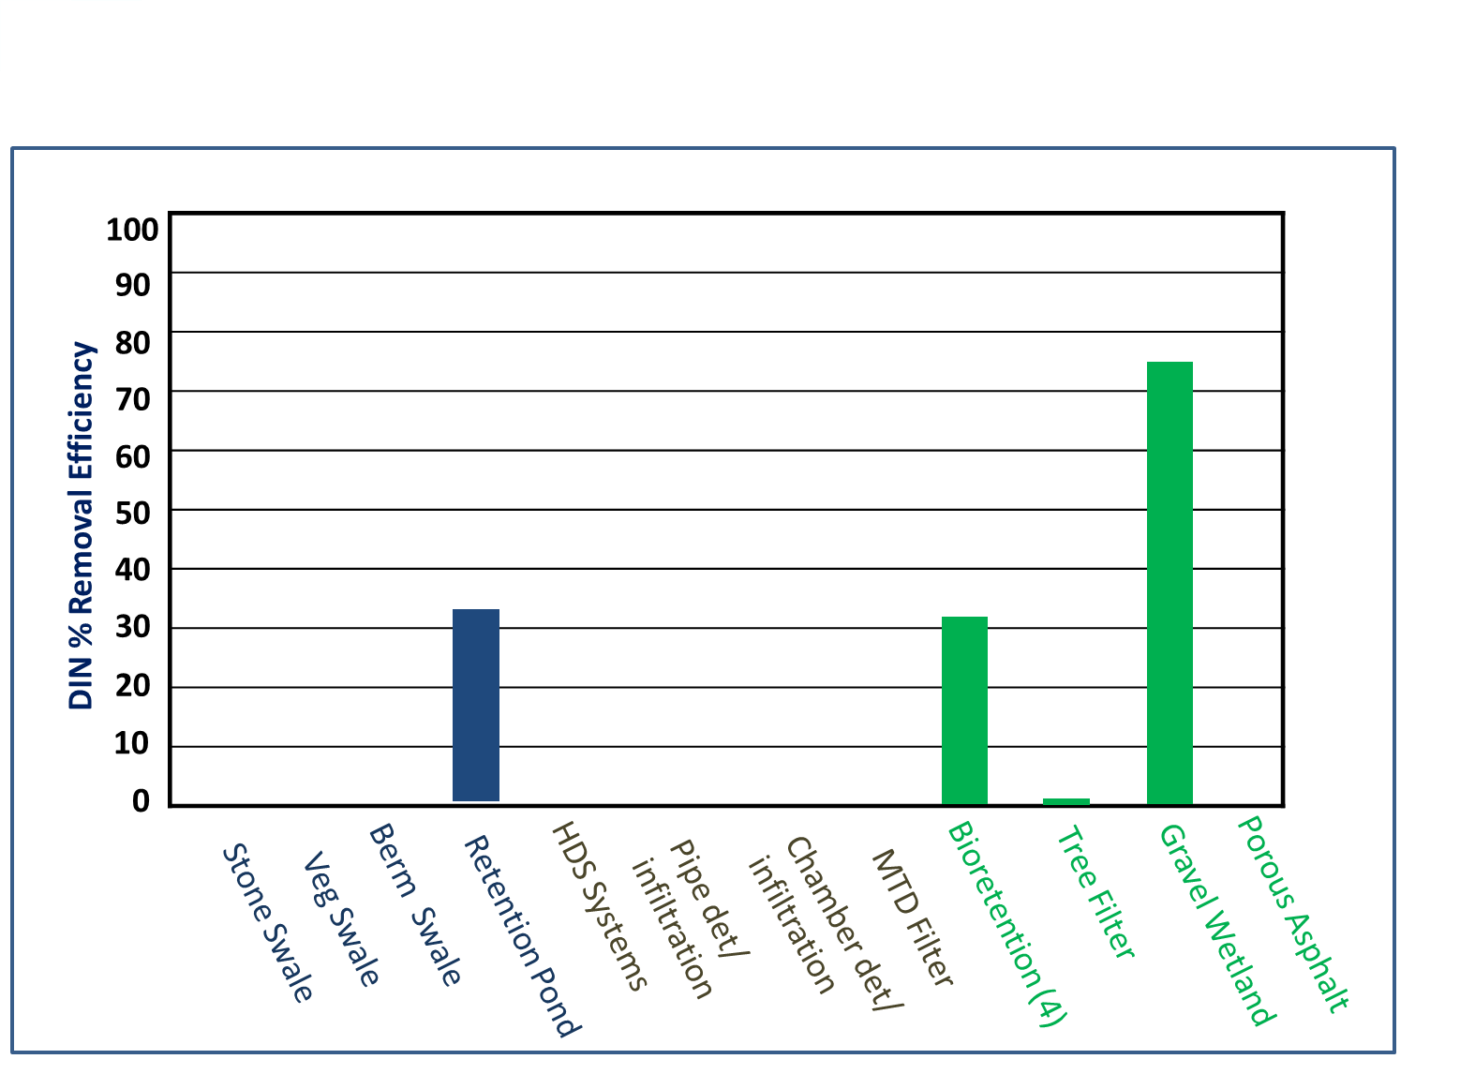
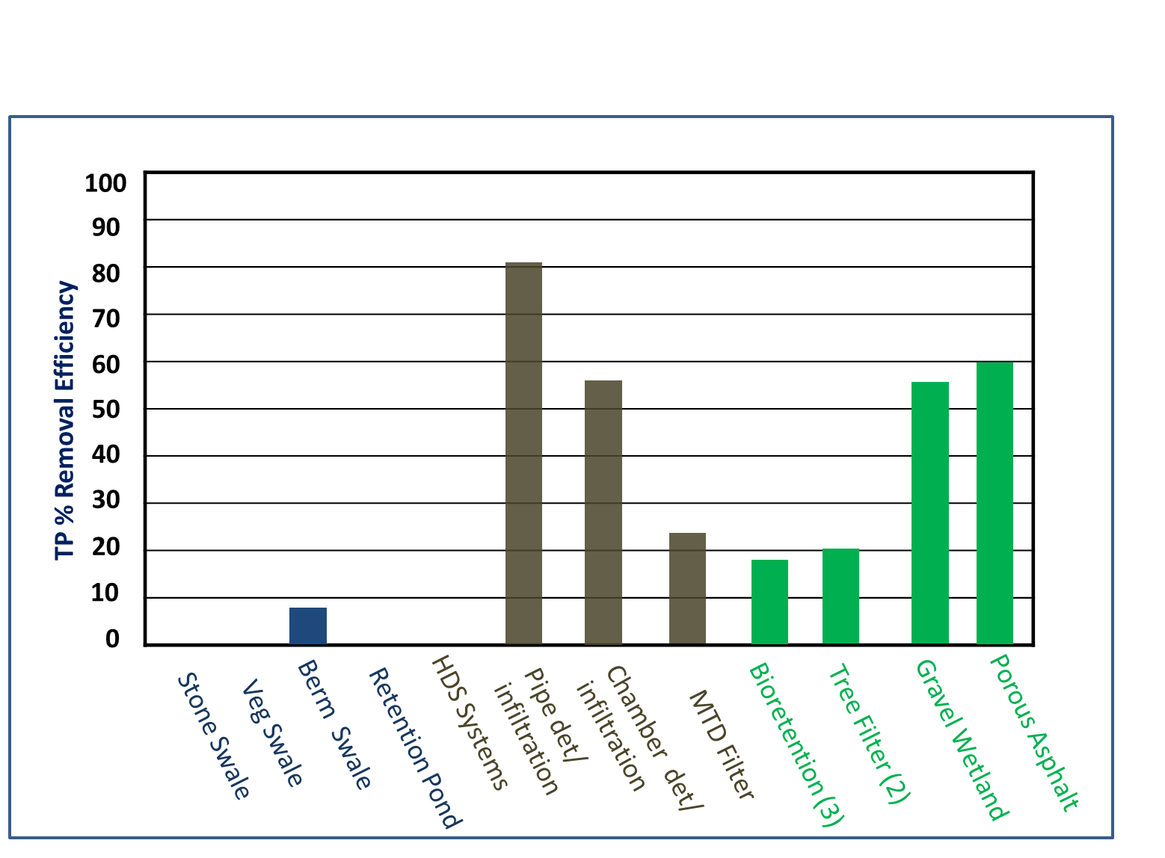
Common Pollutant RE’s

Slide 18
Total Suspended Solids (TSS)

Slide 19
Total Phosphorus (TP)

Slide 20
Dissolved Inorganic Nitrogen (DIN)

Slide 21
Other Design Targets
Storm volume control
Peak flow control
Fecal indicator bacteria control
Chloride and other dissolved parameters
Understanding system hydraulics
Emerging areas of concern

Slide 22
Big Picture
We are not going to BMP our way out of this
We need a growing toolbox of approaches
We need buy-in at all levels
We need your innovations
Innovations will reduce cost over time and increase effectiveness of controls

Slide 23

1975
IBM 5100 Portable Computer
Price tag: $8,975
Inflation adjusted price: $42,000
  16K to 64K main storage
  CPU 1.9MHz
  Storage Internal 200K tape

Slide 24

2022
Dell Inspiron 24 5000
Touch Screen All-in-one
Price Tag: $799.00
11th generation Intel Core i7
  16GB Memory
  256GB SSD + 1TB Hard drive
  4.7 GHz

Slide 25
Over the Long Term
Prices come down with competition
Many manufacturers enter business
Many manufacturers go out of business
Performance increases dramatically
Provided there is ownership and embrace of the science

Slide 26
1946 Prediction
“It is very possible that ... one machine would suffice to solve all the problems that are demanded of it from the whole country.”
Sir Charles Darwin (grandson of the famous naturalist), head of Britain's National Physical Laboratory
Copeland, Jack (2006). Colossus: The Secrets of Bletchley Park's Codebreaking Computers. Oxford University Press. p. 109

Slide 27
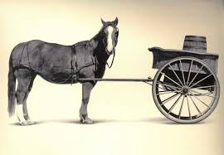
Decadal Reflections:
Cart Before the Horse
The expression cart before the horse is an idiom or proverb used to suggest something is done contrary to a conventional or culturally expected order or relationship.
也要馬兒好也要馬兒不吃草
Want the horse to prosper, but not want the horse to eat grass

Slide 28
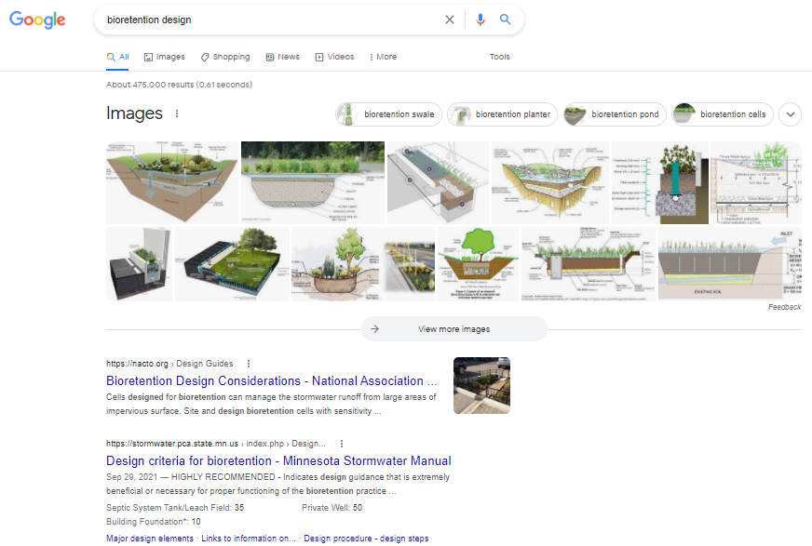
“Bioretention Design”
475,000 results!
Notes:
Where do all these come from?
99% opinion, 1% science?

Slide 29
Design Storms
Stormwater Modeling
Do we know what we are doing?
也要馬兒好也要馬兒不吃草
Want the horse to prosper, but not want the horse to eat grass

Slide 31
Sampling of Observed Hyetographs
Durham, NH NOAA Gage

Slide 32

Yes, climate change gives us pause to think, but IC is the 800-pound gorilla

Slide 33
Operation and Maintenance
Are we inadvertently modeling optimized system performance ahead of long term operation and maintenance?
也要馬兒好也要馬兒不吃草
Want the horse to prosper, but not want the horse to eat grass

Slide 34
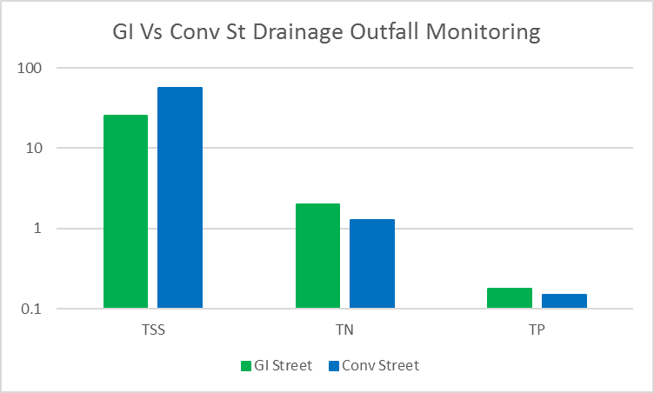
Maintenance Basics

Slide 35

Let’s use science and technology to get us back on track!

Slide 36
Structural BMP’s
Appropriate Design
Installation
Maintenance

Slide 37
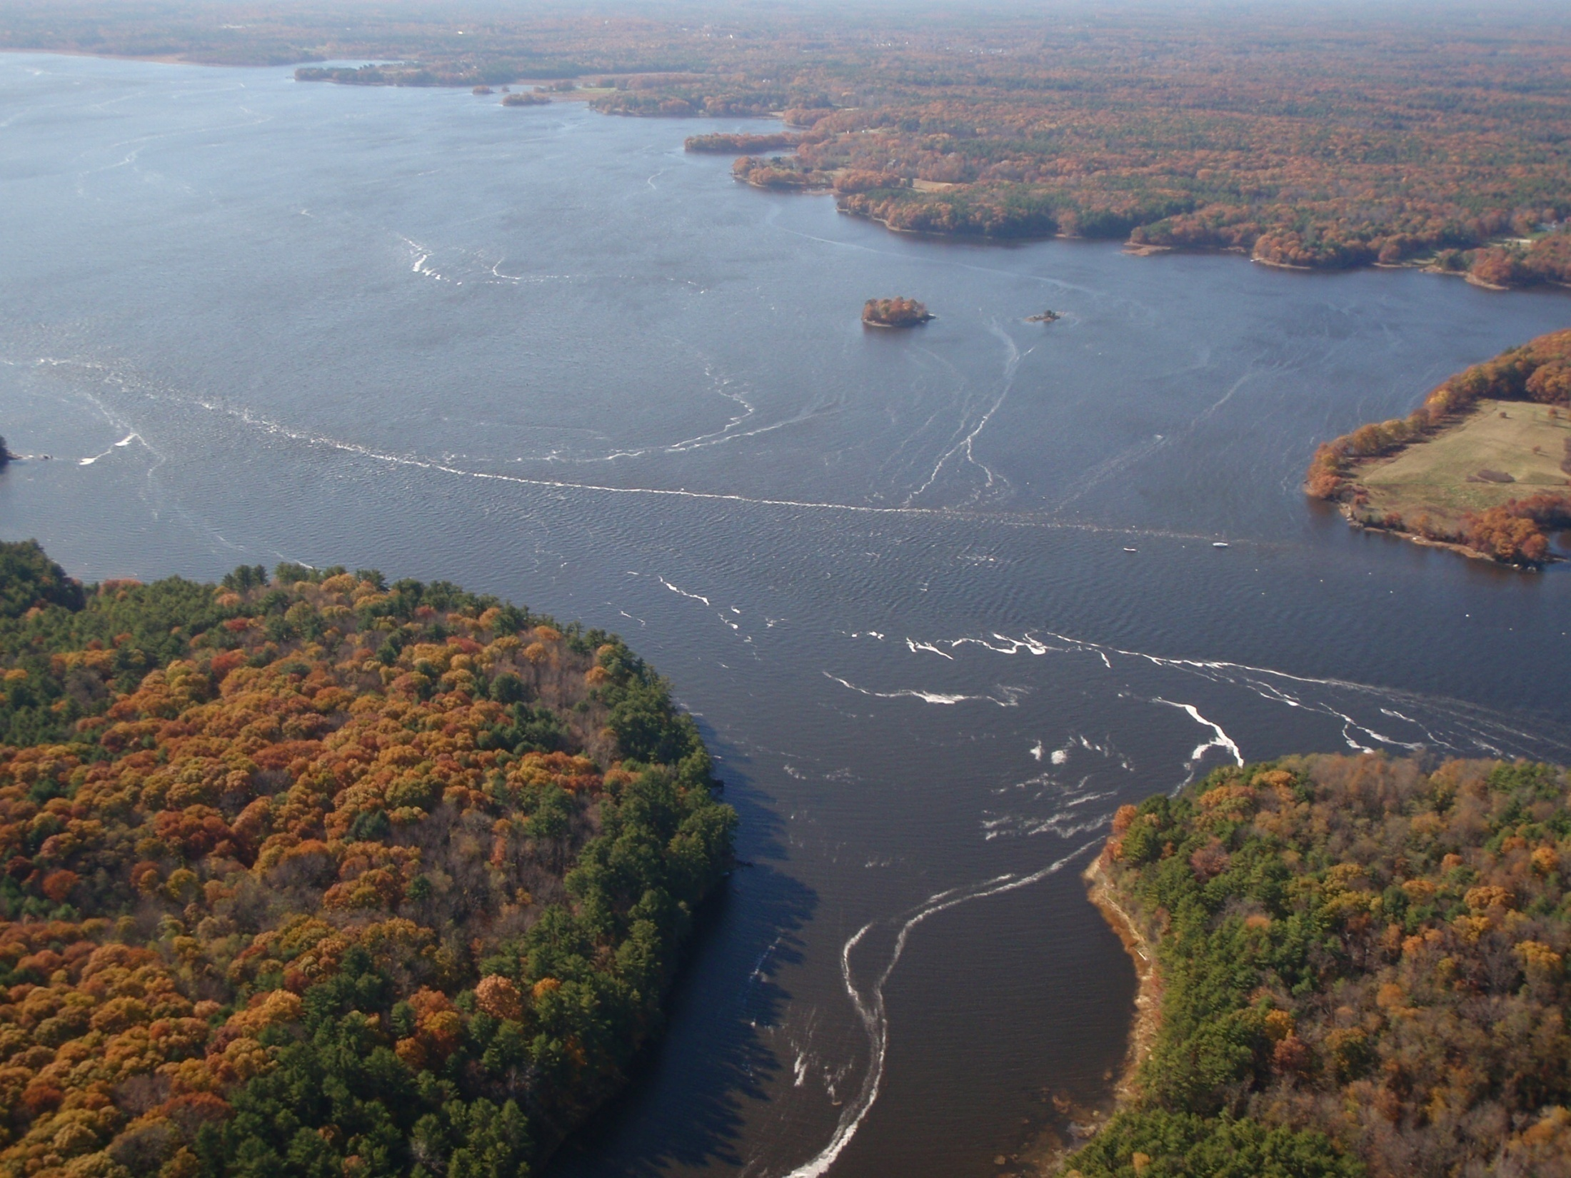
Questions???

