Slide 1
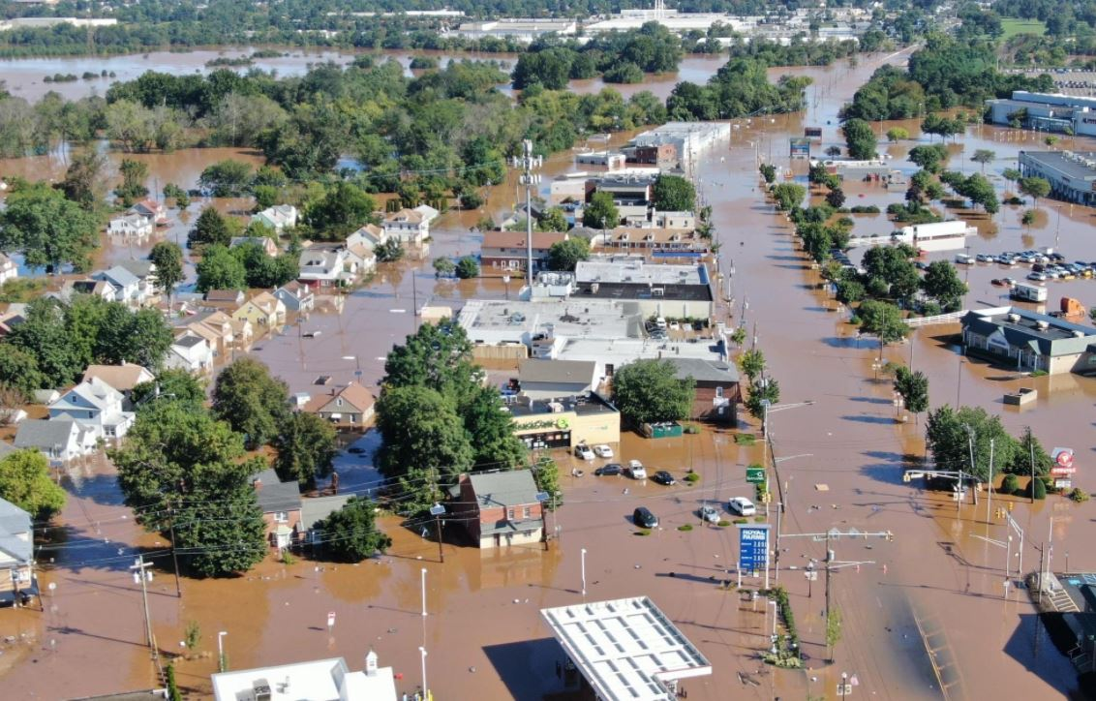
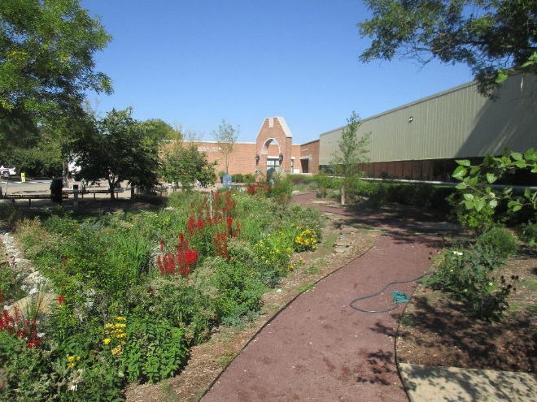
Coupling Green Infrastructure with Gray Infrastructure for Large Storms

Slide 2
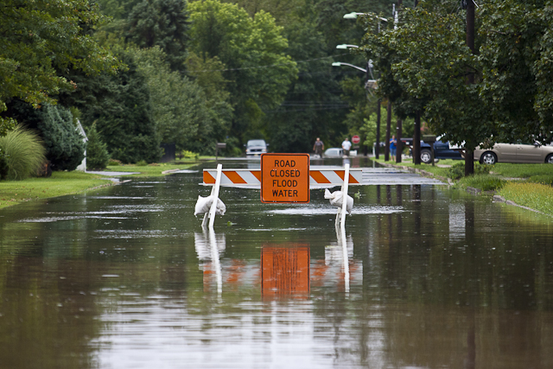
Water Quantity
Notes:
Stormwater runoff can cause localized flooding.

Slide 3
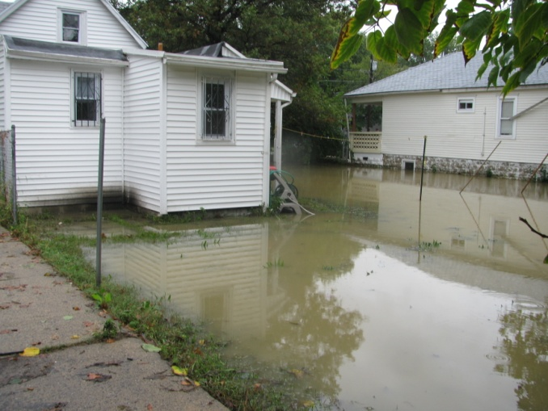
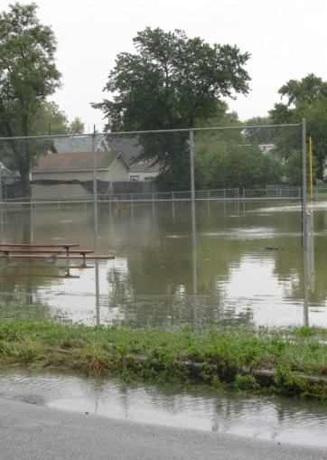
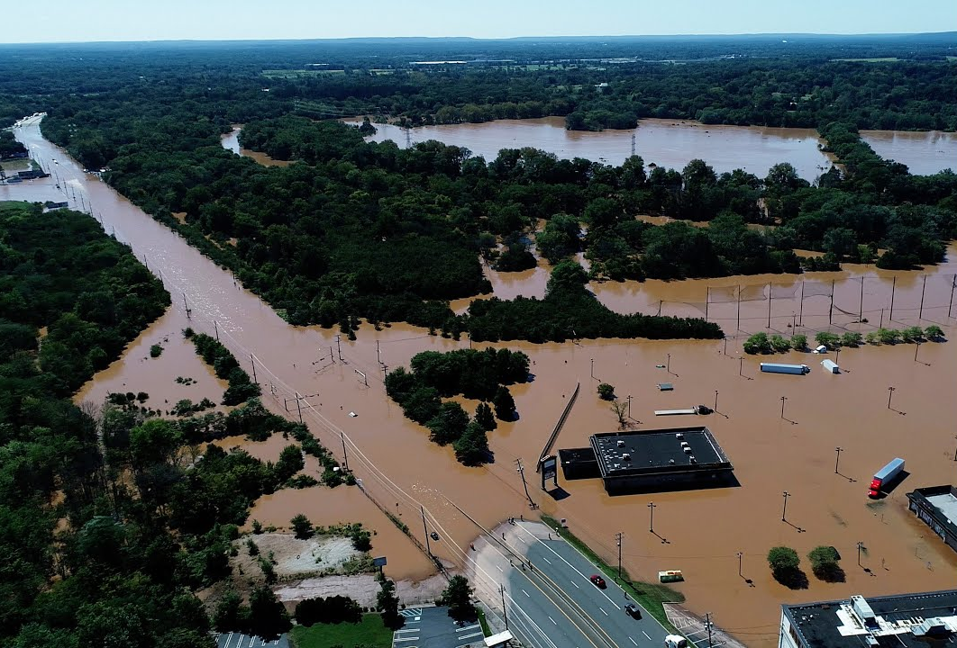
Notes:
Flooding of our urban and suburban communities

Slide 4
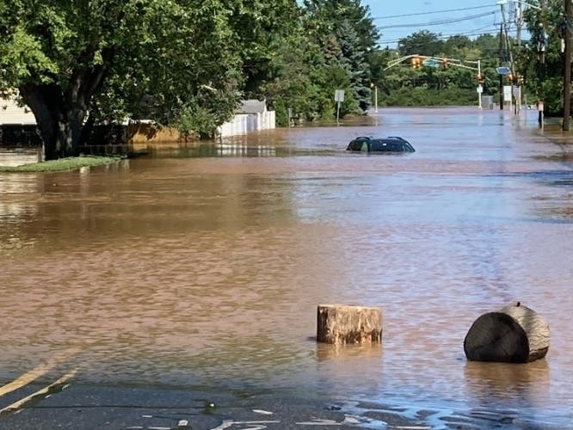

Slide 5
Notes:
And of course, major flooding of our cities and towns.

Slide 6
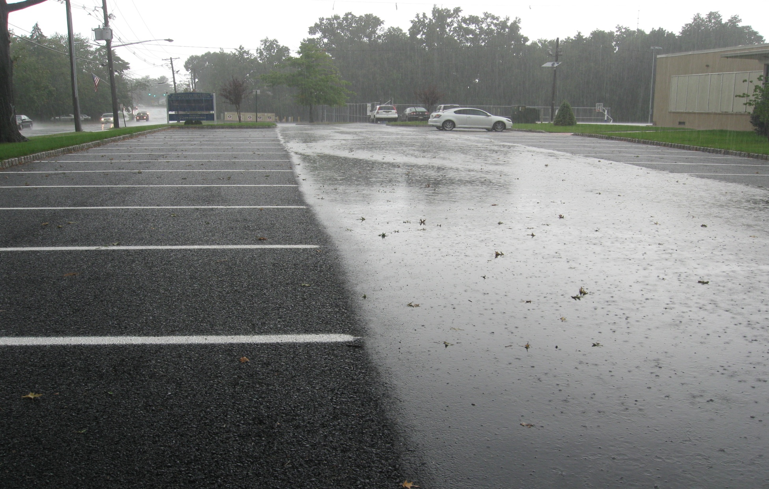
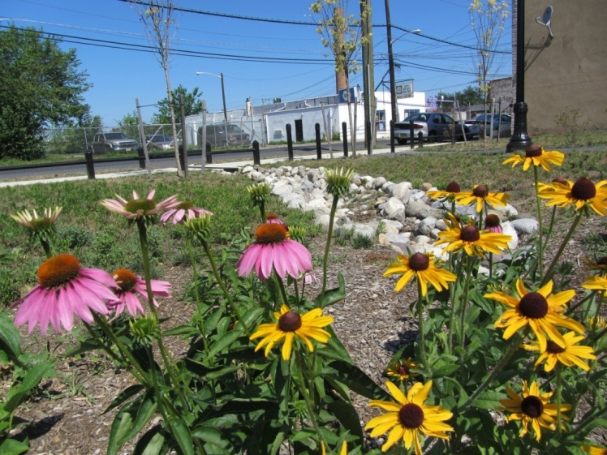
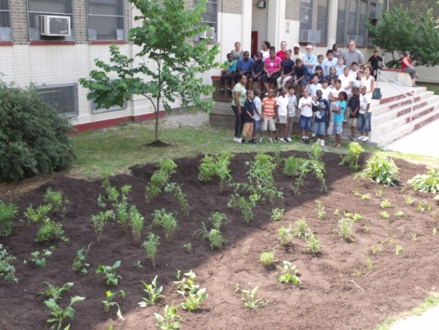
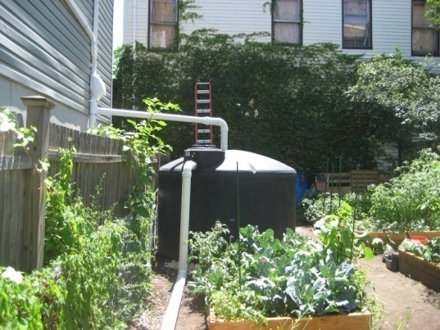
Is Green Infrastructure a solution?
…an approach to stormwater management that is cost-effective, sustainable, and environmentally friendly.
Green Infrastructure projects:
capture,
filter,
absorb, and
reuse
stormwater to maintain or mimic natural systems and treat runoff as a resource.
Notes:
We are here to talk about green infrastructure planning and implementation. What is green infrastructure? The idea is to capture the rainwater near its source before it becomes stormwater runoff.

Slide 7
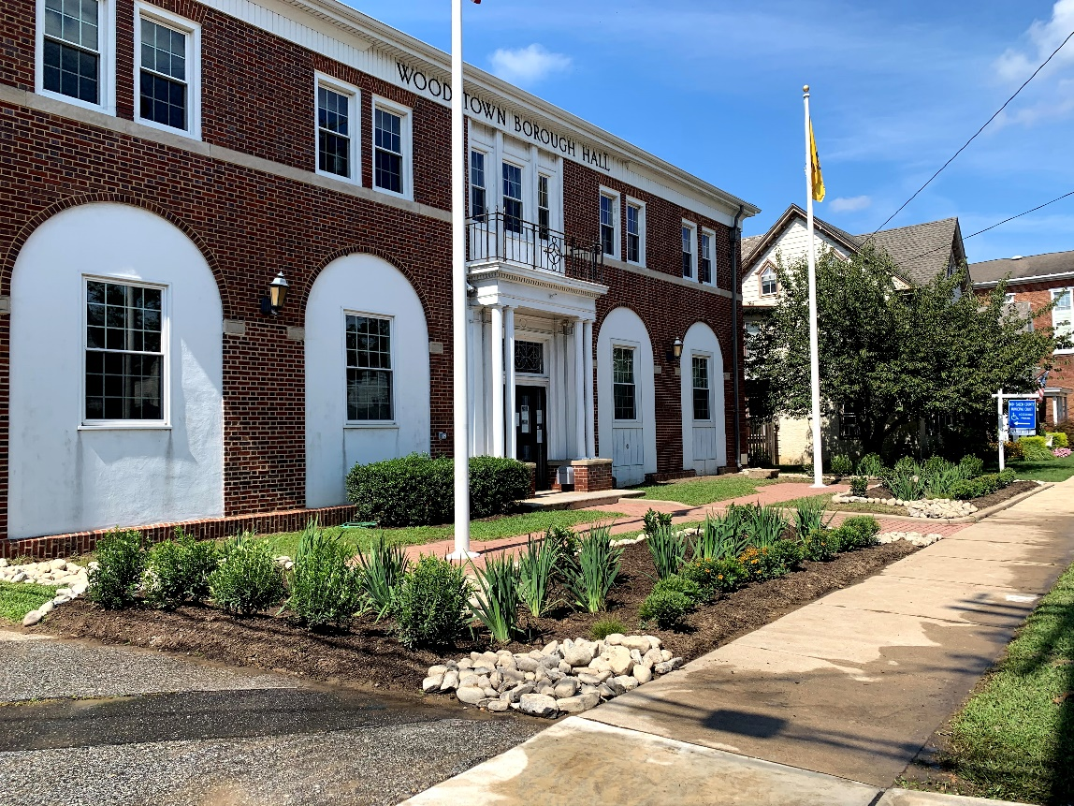
Green Infrastructure
Stormwater management practices that protect, restore, and mimic the native hydrologic condition by providing the following functions:
Infiltration
Filtration
Storage
Evaporation
Transpiration
Notes:
Green infrastructure practices helps restore the infiltration and evapotranspiration component of the water cycle and reduce the runoff component. GI practices provide one or more of these five functions.

Slide 8
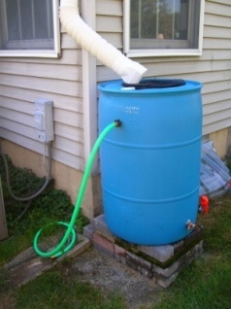
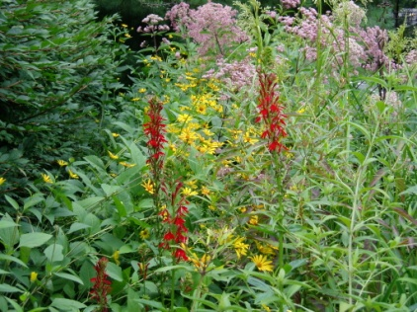
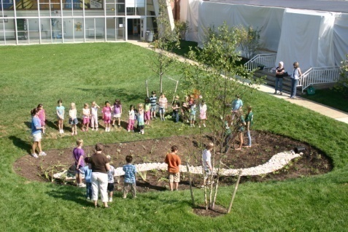
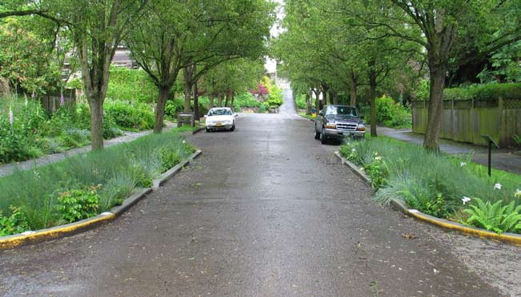
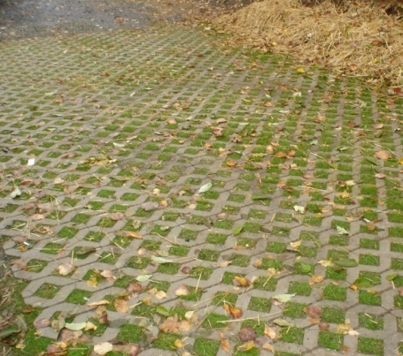
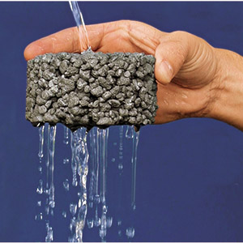
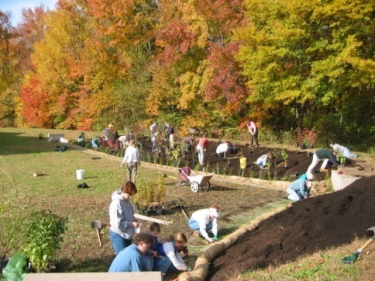
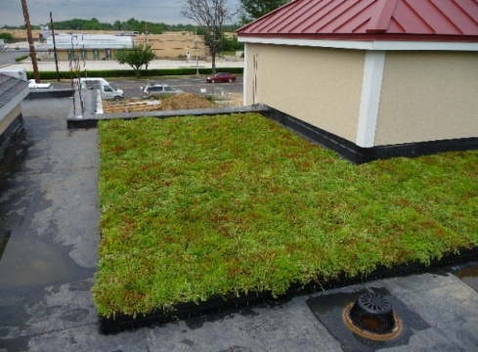
Green Infrastructure Practices
Bioretention Systems
Rain Gardens
Bioswales
Stormwater Planters
Curb Extensions
Tree Filter Boxes
Permeable Pavements
Rainwater Harvesting
Rain barrels
Cisterns
Dry Wells
Rooftop Systems
Green Roofs
Blue Roofs
Parker Urban Greenscapes. 2009.
Notes:
Most green infrastructure practices are designed to improve water quality, namely, to capture the first 1” (25 mm) of stormwater runoff, known as the first flush. During a storm event, a majority of the pollution washes off the land in the first 20 minutes. So, if you can capture and treat this first flush, we can go a long way to improving water quality and maybe eliminate some localize flooding from smaller storms but what about the infamous 100-Year storm (8.3 inches or 210 mm over 24 hours)? Let’s look at a few practices that could manage larger storms.

Slide 9
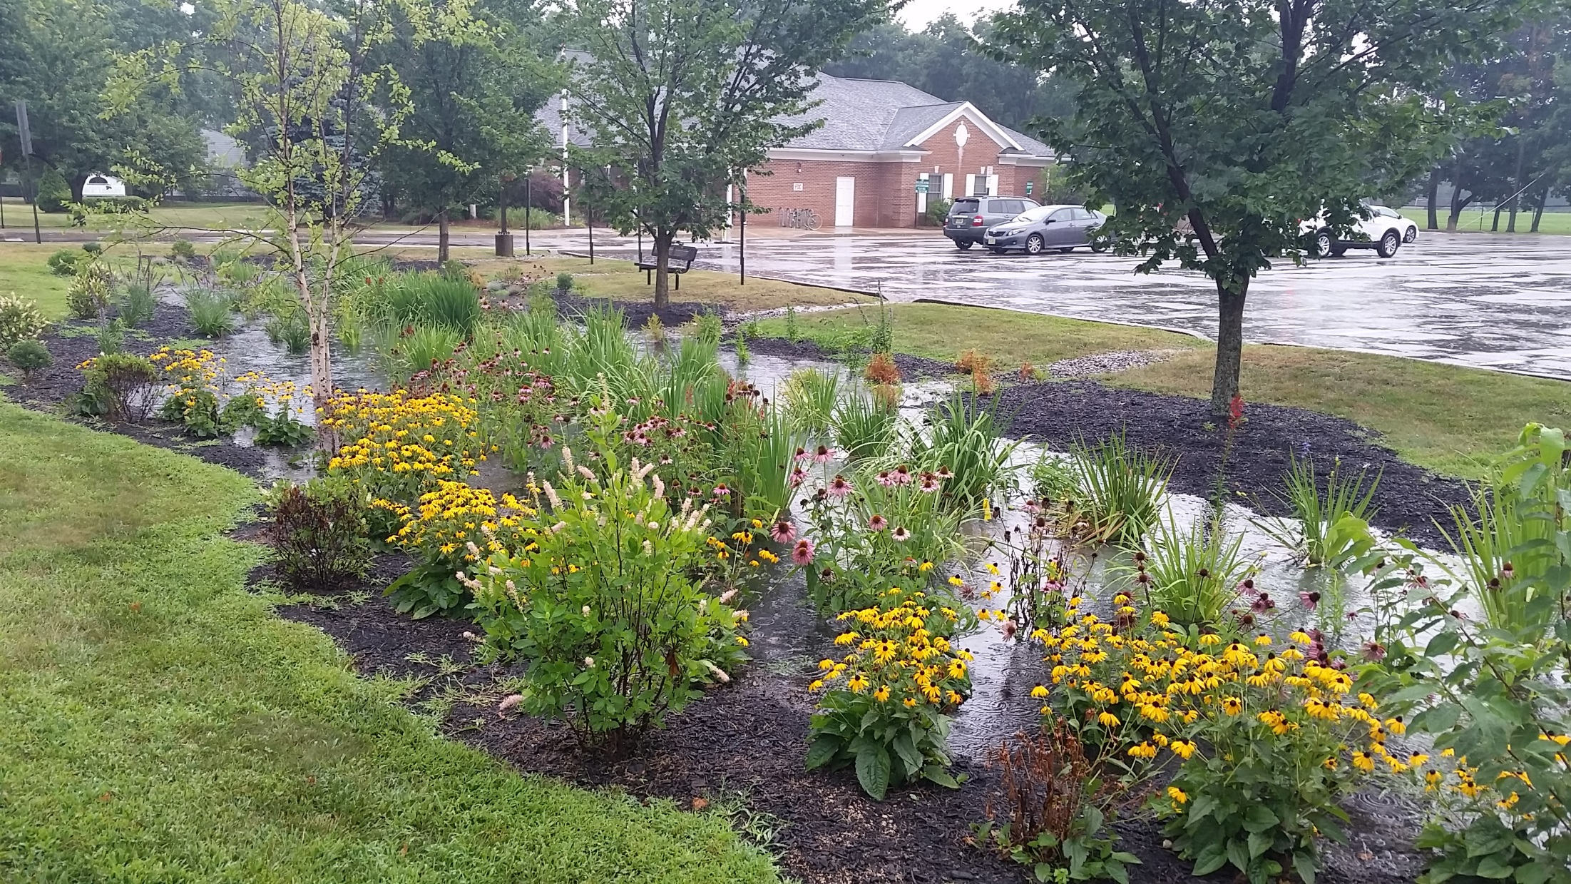
TYPES OF BIORETENTION
Larger Bioretention Systems
Rain Gardens
Bioretention Swales/ Bioswales/Vegetated Swales
Stormwater Planters & Planter Boxes
Vegetated Curb Extensions
Notes:
First let’s talk about some of these practices. Bioretention is one of the best practices. Very effective, lower cost, lots of ancillary benefits ( enhanced aesthetics, sequesters carbon, provide pollinator habitat). We often design these practices to capture, treat, and infiltration up to the 2-years storm, which is about 3.3 inches (84 mm) of rain over 24 hours.

Slide 10
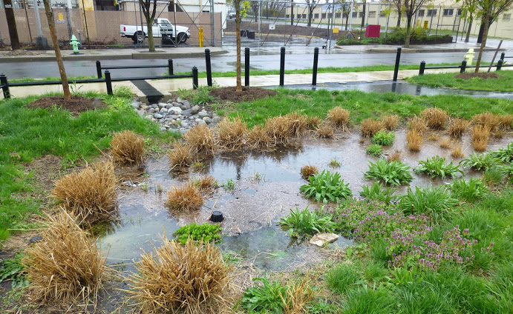
Larger Bioretention Systems
Larger housing developments
Commercial areas
Parking lots

Slide 11
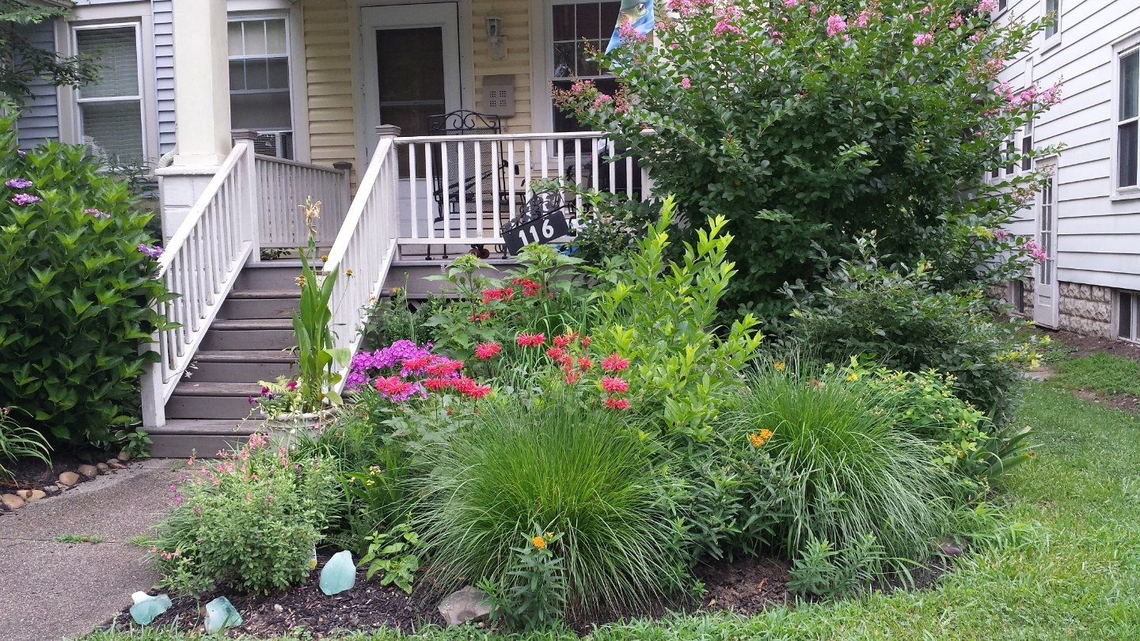
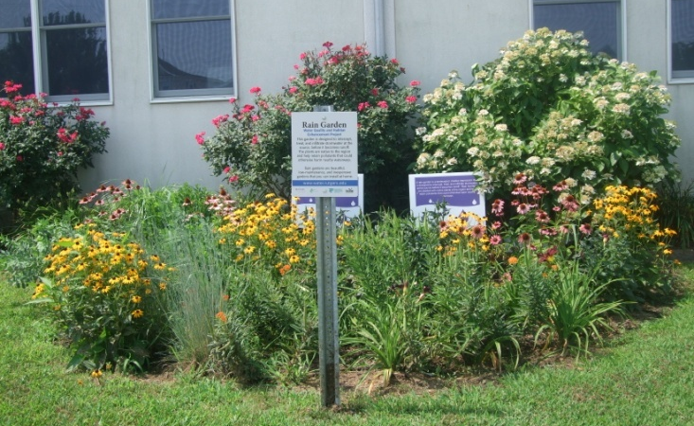
Rain Gardens
Single-family lots
Small commercial areas

Slide 12
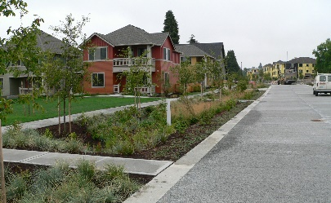
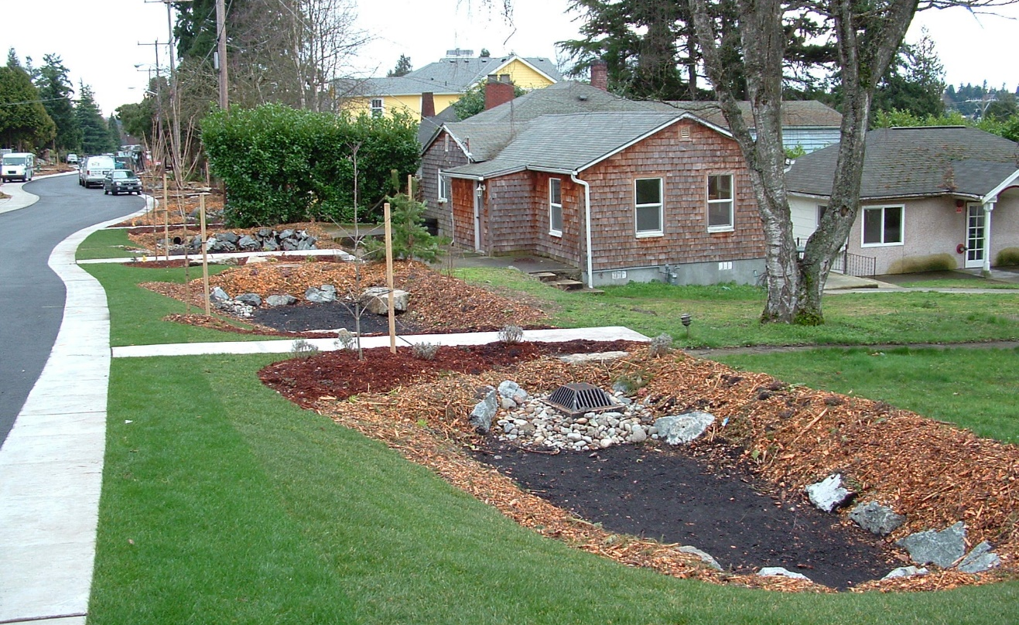
Bioretention Swales/ Bioswales/ Vegetated Swales
Roadside systems

Slide 13
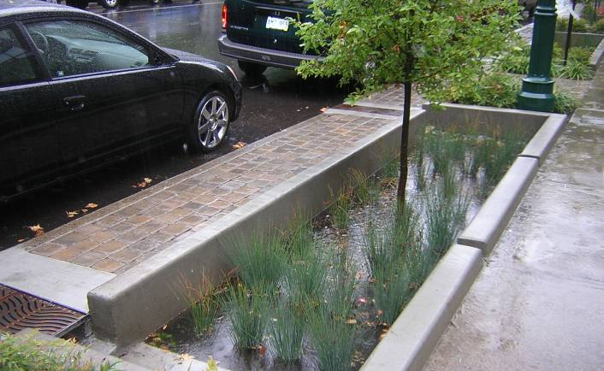
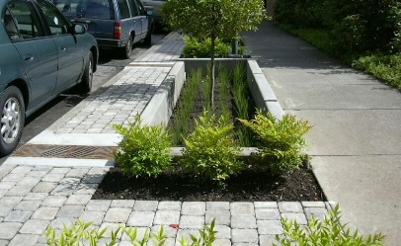
Stormwater Planters/ Planter Boxes
Highly urban areas
Roadside and adjacent to buildings

Slide 14
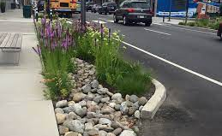
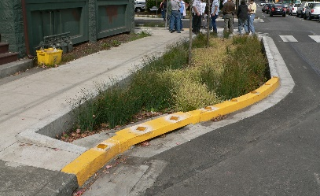
Vegetated Curb Extensions
Bioretention incorporated into road in urban and suburban areas

Slide 15
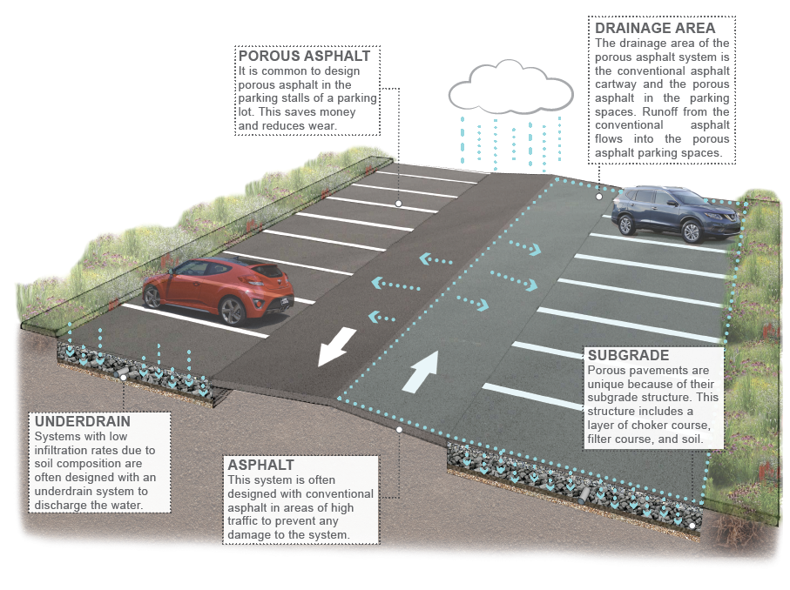
Permeable Pavement
Notes:
Another one of my favorite practices is permeable pavement.

Slide 16
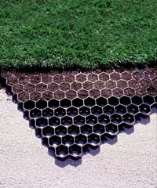
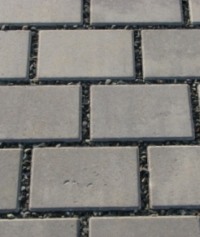
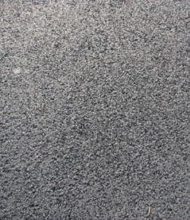
Permeable Pavements
Underlying stone reservoir
Porous asphalt and pervious concrete are manufactured without "fine" materials to allow infiltration
Grass pavers are concrete interlocking blocks with open areas to allow grass to grow
Permeable pavers systems are concrete pavers with infiltration between the spaces of the pavers
Ideal application for porous pavement is to treat a low traffic or overflow parking area
Notes:
Four main types of permeable pavements: porous asphalt, pervious concrete, permeable pavers, and grass (reinforced turf) pavers.

Slide 17
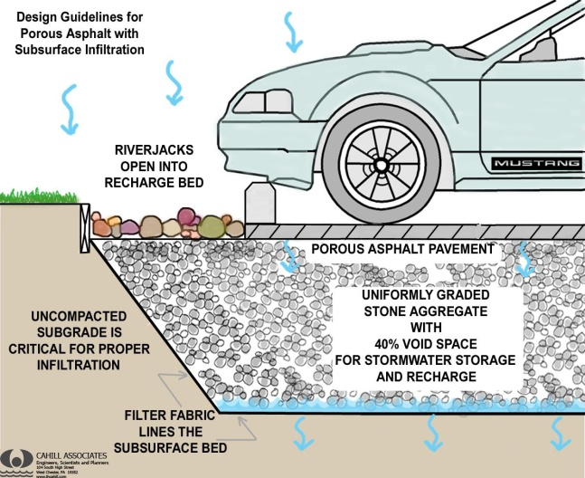
ADVANTAGES
COMPONENTS
Manage stormwater runoff
Minimize site disturbance
Promote groundwater recharge
Low life cycle costs, alternative to costly traditional stormwater management methods
Mitigation of urban heat island effect
Contaminant removal as water moves through layers of system
Notes:
And no black ice

Slide 18
Porous Asphalt
Notes:
Porous asphalt parking lot at the Clark municipal building. Porous asphalt in the parking spaces and traditional asphalt in the cartway.

Slide 19
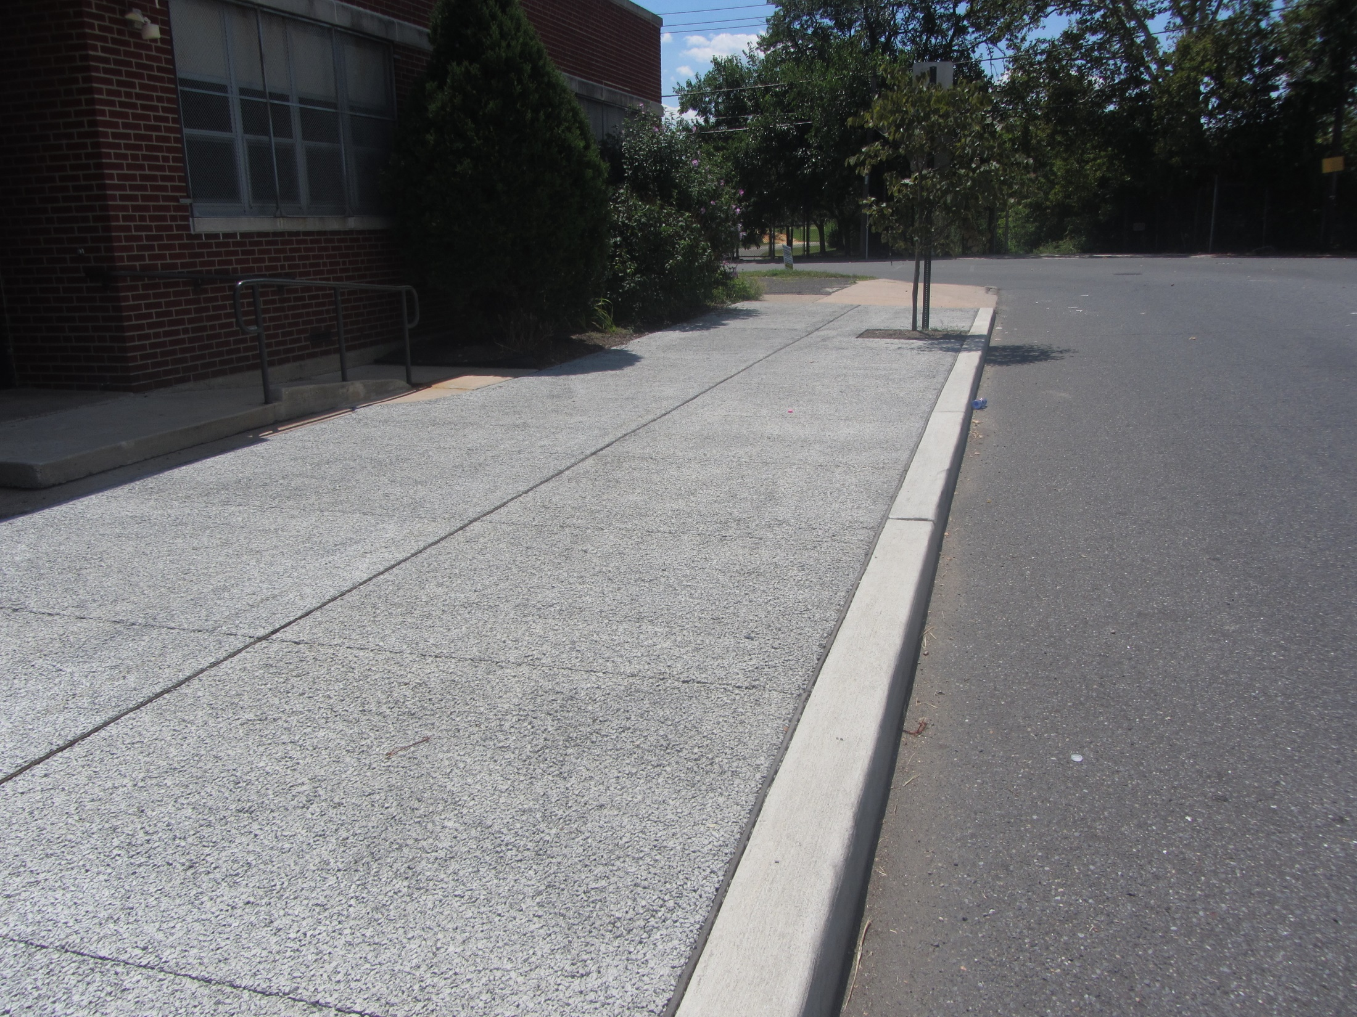
Pervious Concrete
Notes:
Pervious concrete

Slide 20
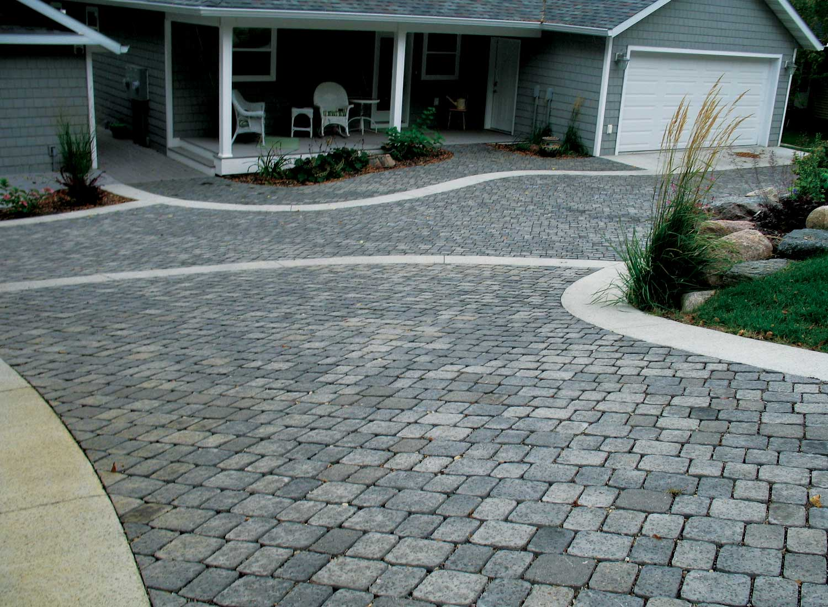
Permeable Pavers
Notes:
Permeable pavers

Slide 21
Grass Pavers
Notes:
Grass pavers (this one is called turfstone)

Slide 22
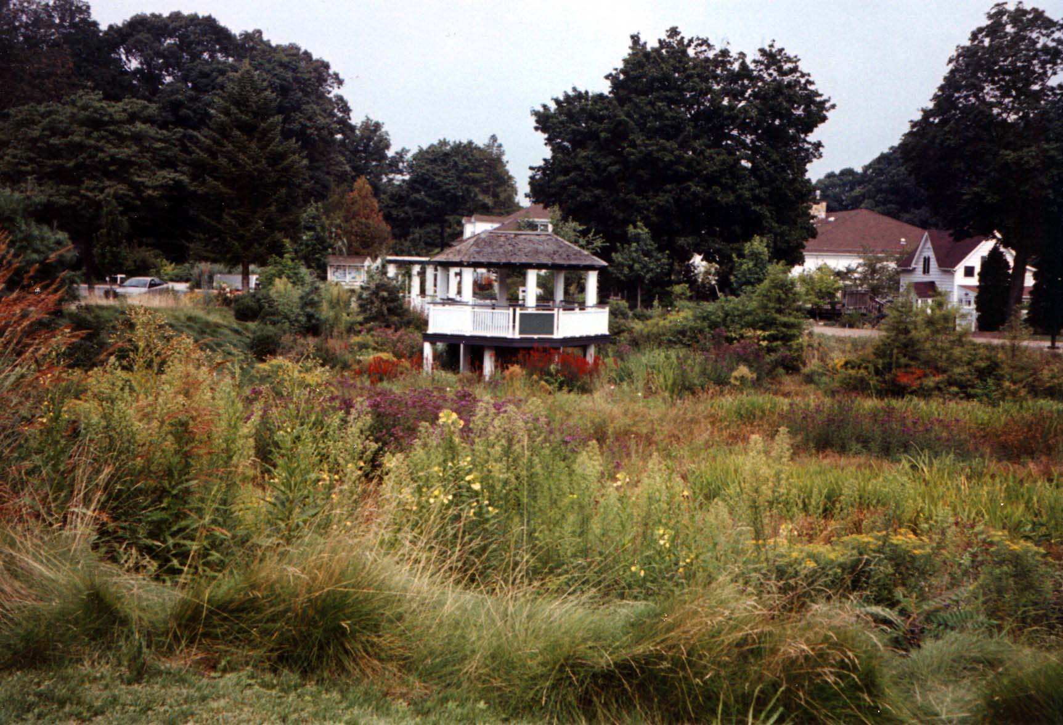
Let’s get back to flooding – bioretention is an option but does it take up too much space?
Notes:
What about flooding? How can GI be used to address flooding from bigger storms? This is the bioretention basin at the Frelinghuysen Arboretum. It captures stormwater runoff from the parking lot and the buildings.
.

Slide 23
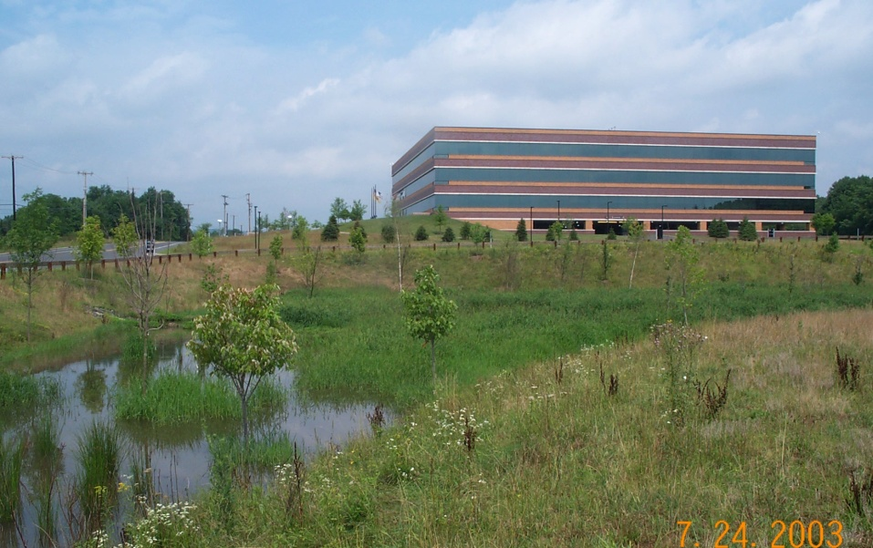
Notes:
This is one that was built at a office building in Readington. When it rains, these systems fill up with six inches of water that is allowed to infiltrate and the stormwater runoff from larger storms fills up the remaining 4 feet of basin and is slowly released over time. Now both of these larger bioretention basins were built as part of new construction but how do we go into developed areas and retrofit them with this level of stormwater management. Is bioretention still an option?

Slide 24
Notes:
This was a retrofit project but only designed to capture the first 1.25 inches of stormwater runoff from the parking lot. If we wanted to manage the 100-year storm we would have to make it 6.5 times deeper or about 3.25 feet deep. But this would only manage runoff from the parking lot not the surrounding buildings like the bioretention system at the Arboretum and Office Building does.

Slide 25
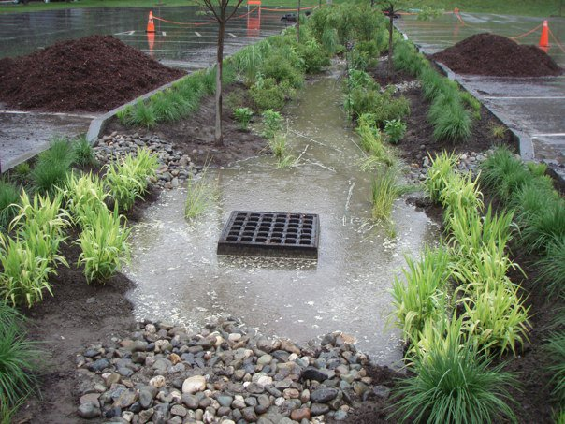
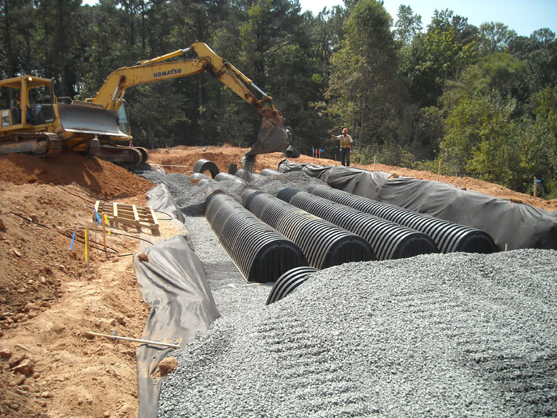
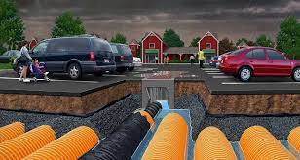
Notes:
We could leave the rain garden as is and install overflow drains in it as shown in this picture. Then these drains could carry the stormwater runoff from larger events to a storage/infiltration system under the parking lot. Only 20 to 25% of the area under the parking lot would be needed to manage runoff from the parking lot, leaving additional space for managing the stormwater runoff from the surrounding buildings or streets.

Slide 26
Notes:
Or we could just make the parking lot into permeable pavement and increase the stone storage reservoir under the parking lot. The porosity of the stone is 40% so for every foot of water you want to manage, you need 2.5 feet of stone. There are porous asphalt parking lots in Vermont with 8 feet stone storage layer.

Slide 27
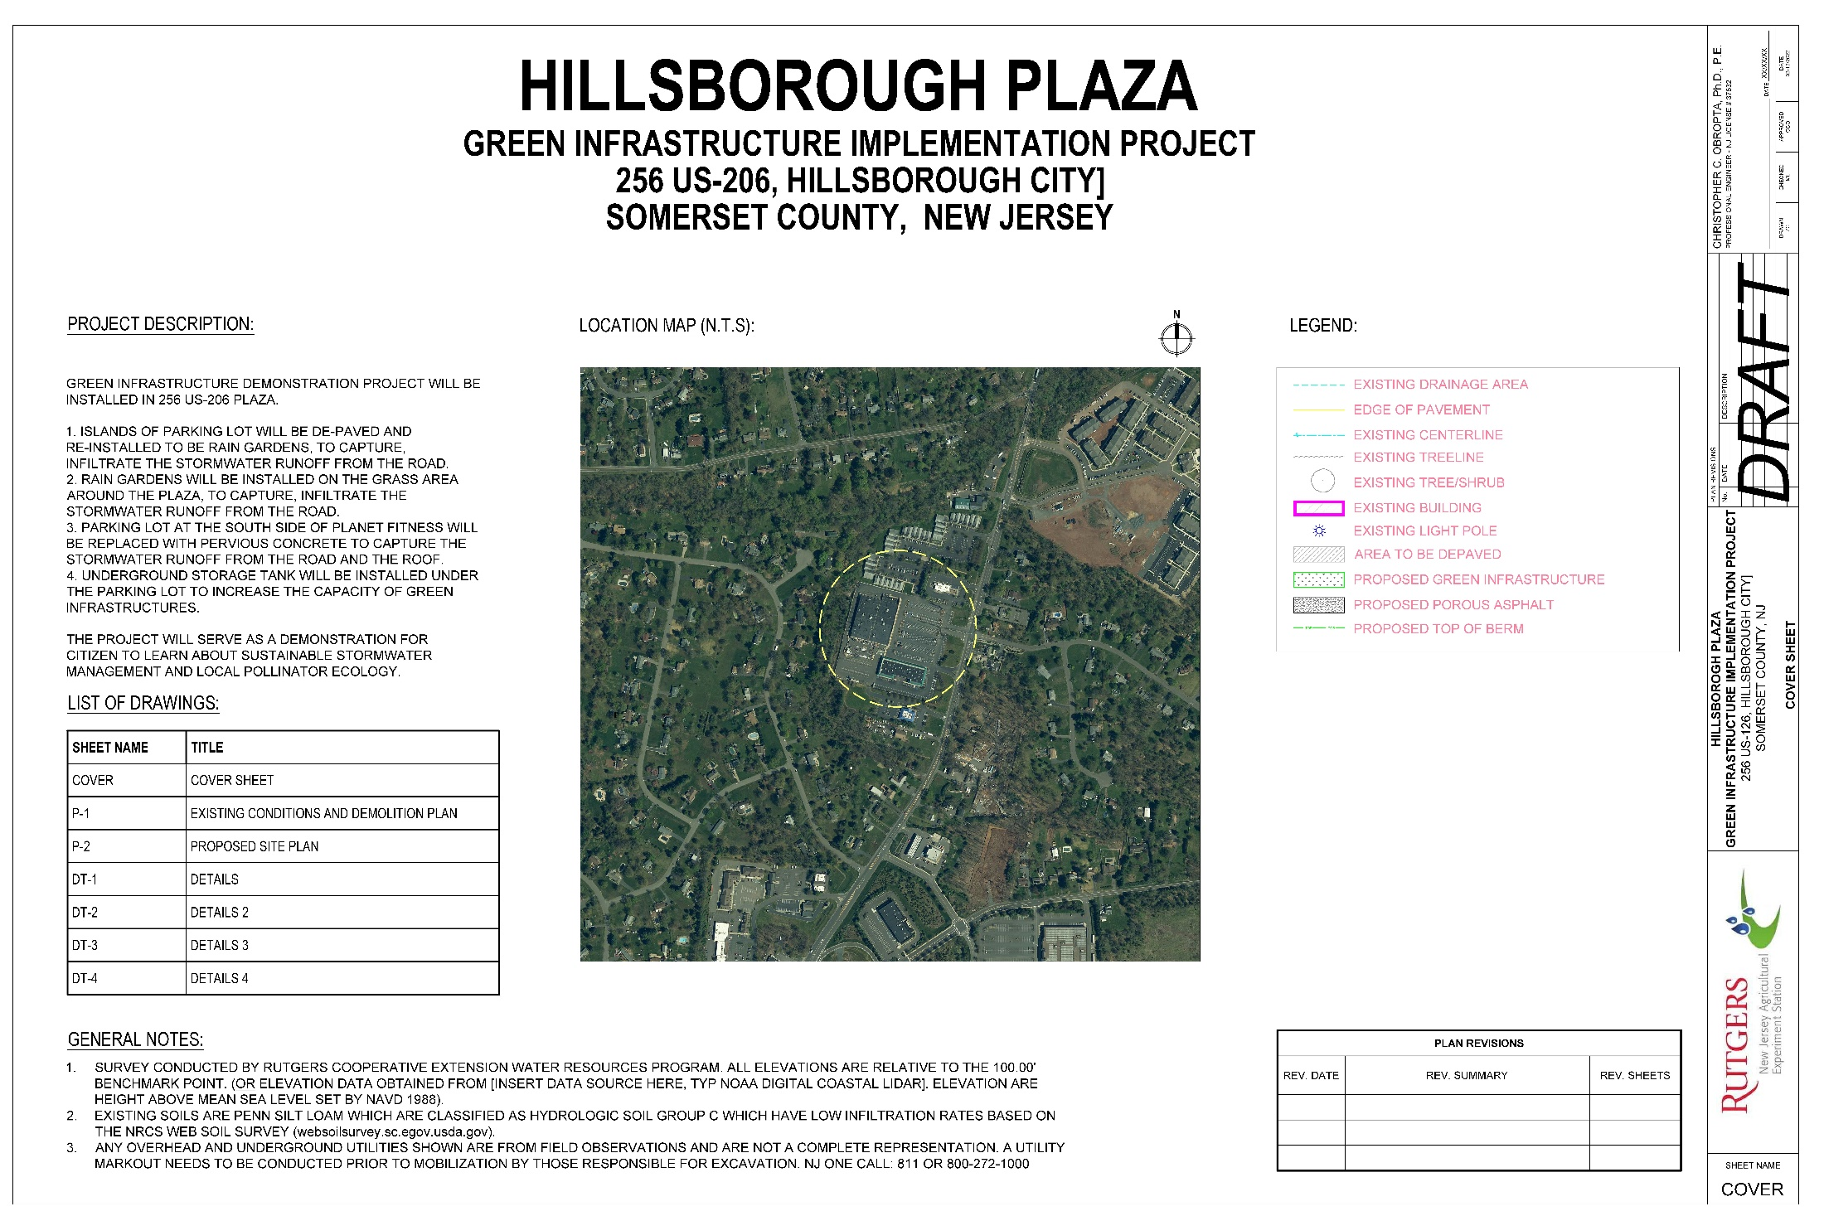

Slide 31
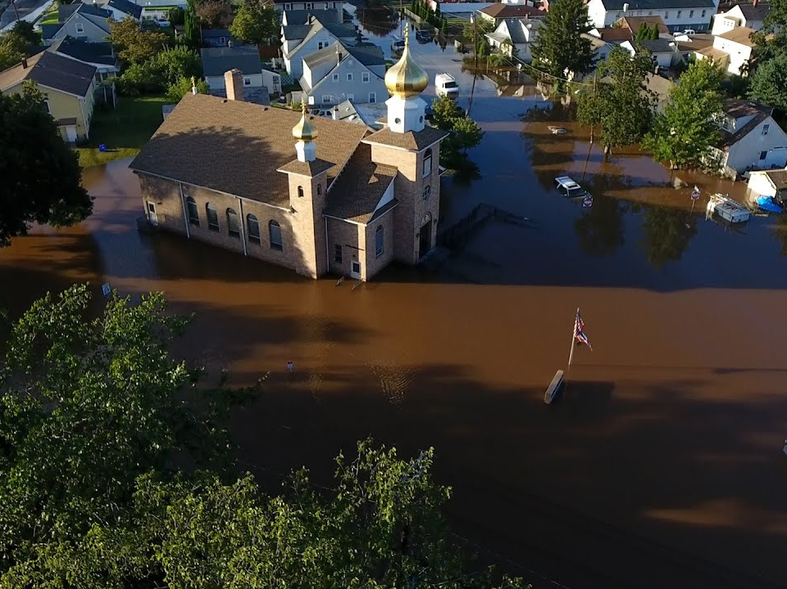

Slide 32
Hillsborough Plaza
256 Route 206
Hillsborough, New Jersey

Slide 36
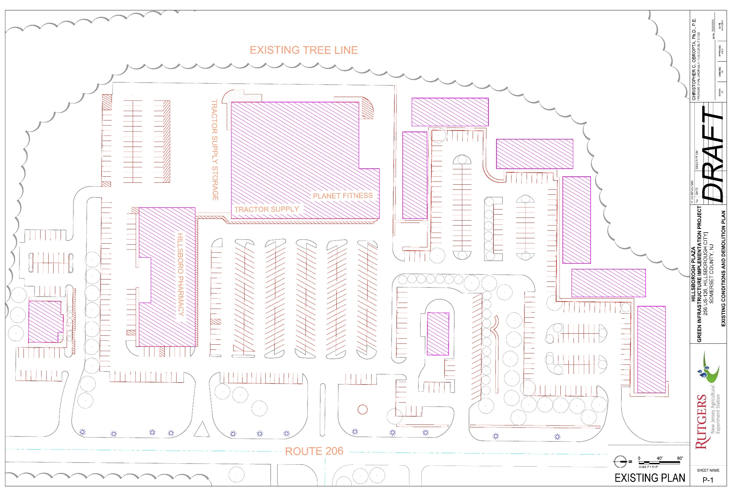

Slide 37
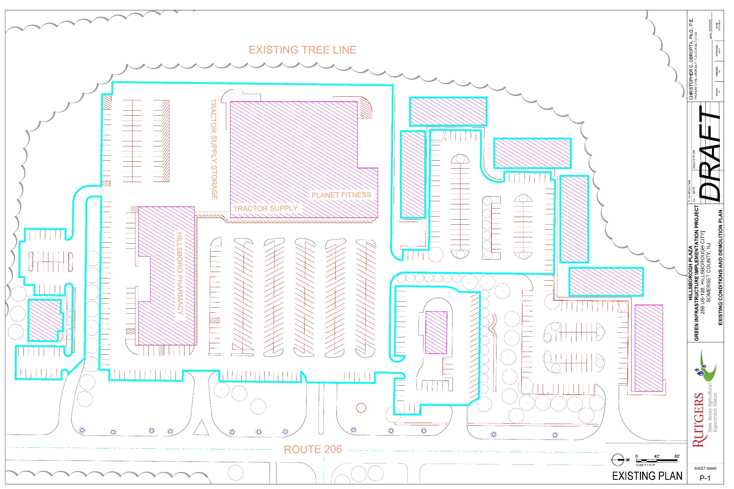
Water Quality Storm Analysis (1.25 inches)
11.6 acres
52,635 ft³ of runoff for 1.25 inch storm
46,834 m²
1,490 m³ of runoff for 31.8 mm storm

Slide 38
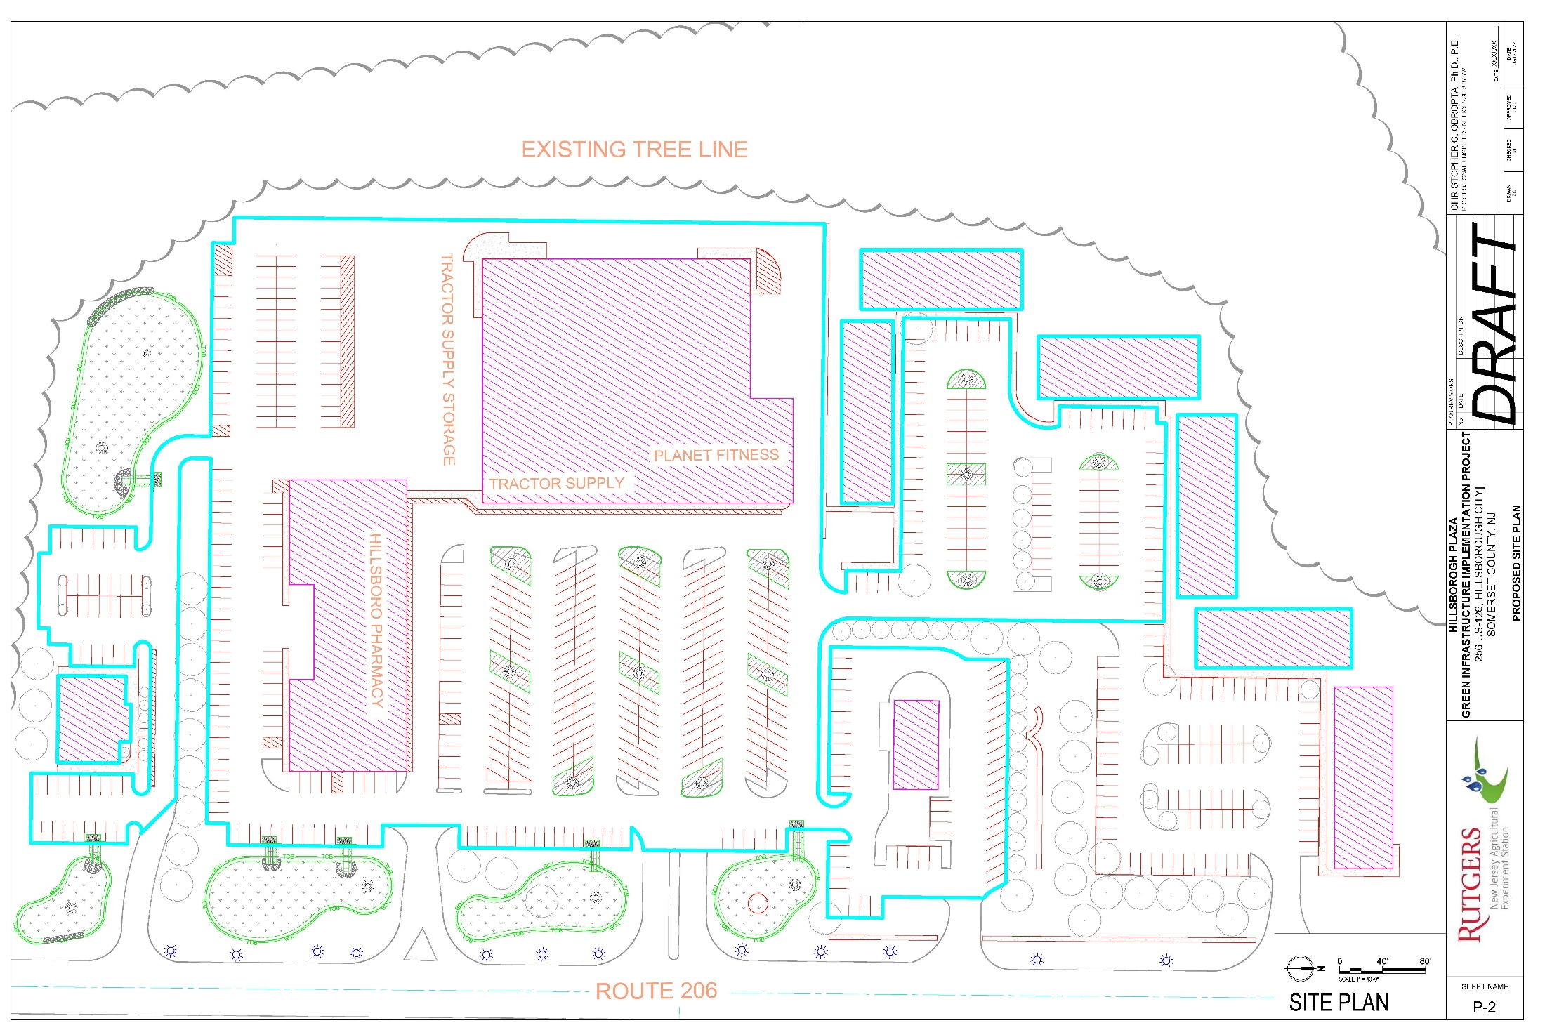
1.23 acres of rain gardens provides 45,611 ft³ of storage
4,960 m² of rain gardens provides
1,292 m³ of storage

Slide 39
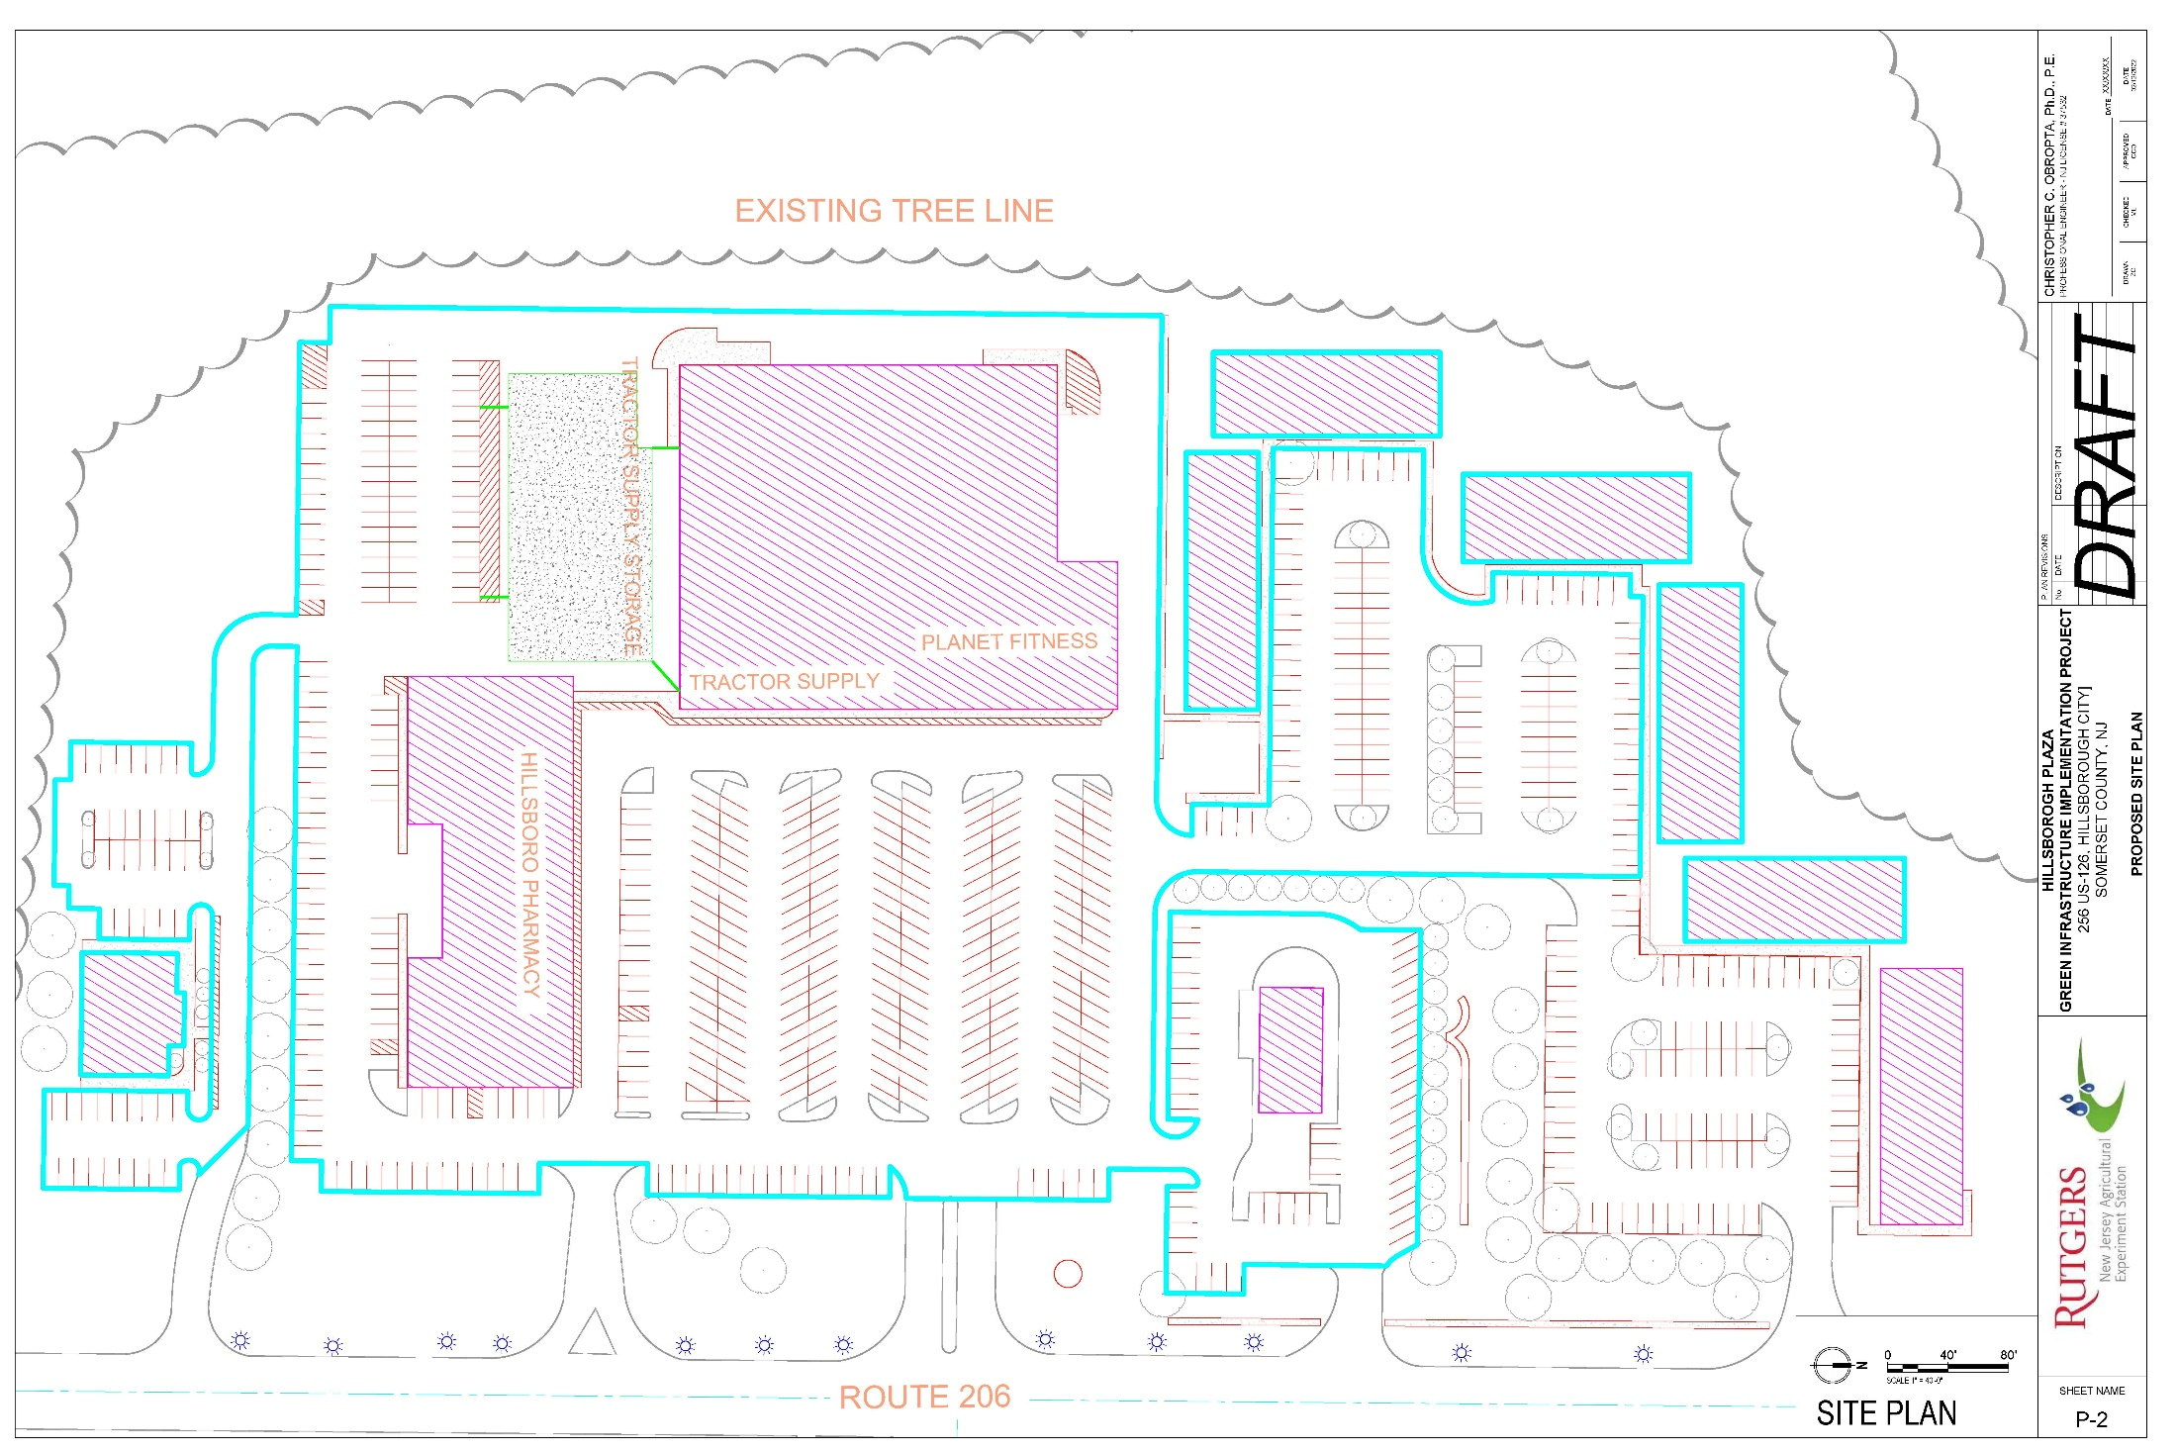
17,560 ft² of pervious concrete provides
7,024 ft³ of storage
1,631 m² of pervious concrete provides 199 m³ of storage

Slide 40
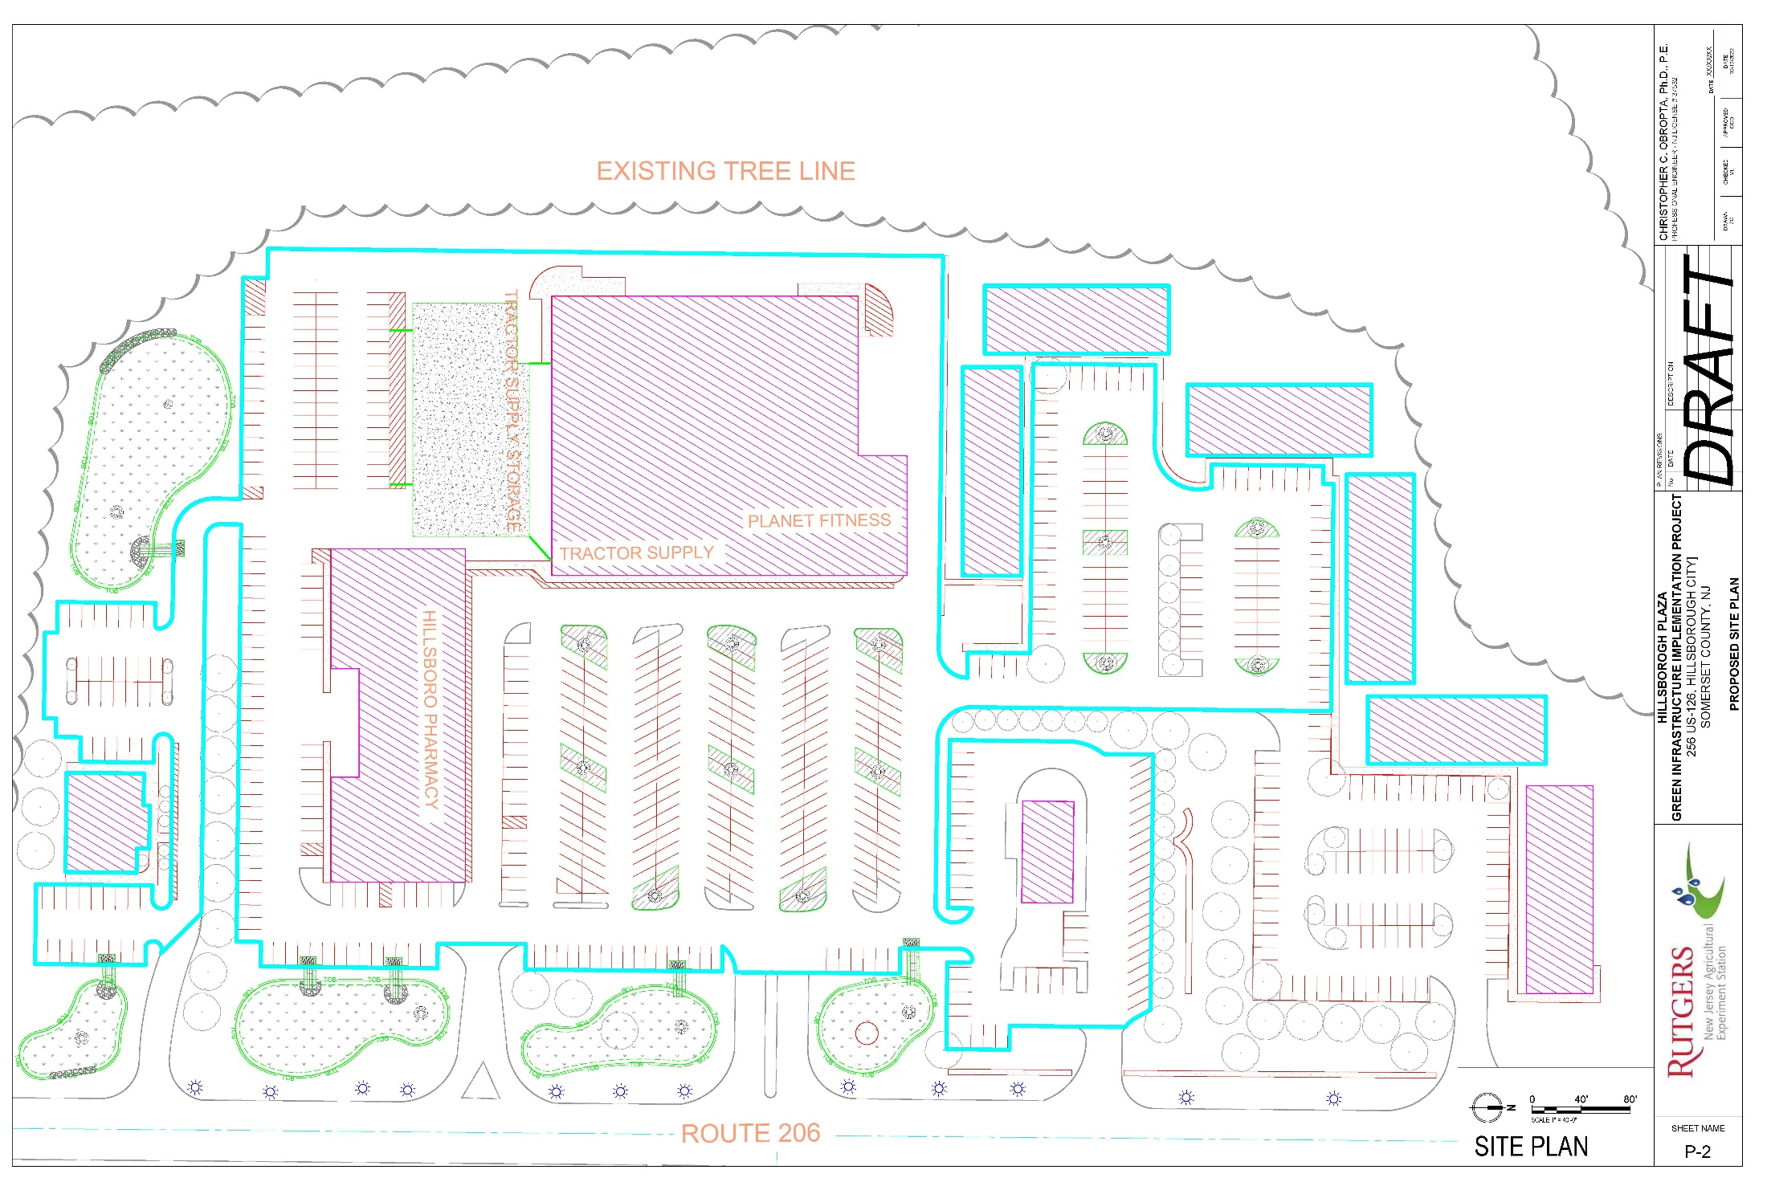
All of the Green Infrastructure Practices

Slide 41
100-Year Storm Analysis (8.25 inches)
11.6 acres
294,756 ft³ of runoff for 7.0 inches rain
46,834 m²
8,347 m³ of runoff for 178 mm storm

Slide 42
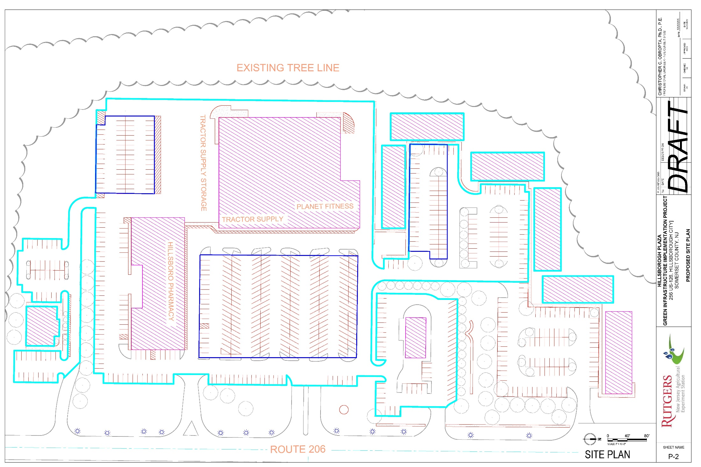
2.4 acres of underground storage system provides 351,208 ft³ of storage
9,712 m² of underground storage provides
9,945 m³ of storage
64,800 ft (19,750 m) of two-foot (0.6 m) diameter pipe
Notes:
2.6 million gallons of storage. If you increase the pipe size from 24” to 48”, we can store three times as much water = 8.5 million gallons.

Slide 43
Green and Gray Infrastructure Practices
Notes:
2.6 million gallons of storage. If you increase the pipe size from 24” to 48”, we can store three times as much water = 8.5 million gallons.

Slide 44
EXISTING CONDITIONS (3/4th of the site)
(NEW JERSEY WATER QUALITY PEAK DISCHARGE 1.25”)
Drainage Area = 8.7 acres
Runoff Volume = 32,297 ft³

Slide 45
PROPOSED CONDITIONS (RAIN GARDENS)
(NEW JERSEY WATER QUALITY PEAK DISCHARGE 1.25”)
Drainage Area = 9.8 acres
Runoff Volume = 33,785 ft³
Volume Captured and Infiltrated = 33,785 ft³
Maximum Depth = 0.35 ft

Slide 46
EXISTING CONDITIONS (1/4th of the site)
(NEW JERSEY WATER QUALITY PEAK DISCHARGE 1.25”)
Drainage Area = 2.9 acres
Runoff Volume = 10,891 ft³

Slide 47
PROPOSED CONDITIONS (PERVIOUS CONCRETE)
(NEW JERSEY WATER QUALITY PEAK DISCHARGE 1.25”)
Drainage Area = 2.9 acres
Runoff Volume = 10,891 ft³
Volume Captured and Infiltrated = 10,891 ft³

Slide 48
UNDERGROUND STORAGE SYSTEM FOR REMAINDER OF 100-YEAR STORM

Slide 49
3.83
3.50
2.50
24 in
6 in
0.50
0.00

Slide 50
Remaining Questions
Is it possible to route all the stormwater runoff for the 1.25-inch storm to the green infrastructure practices?
Is it possible to bypass the larger storms to the underground storage system?
How long do we hold the larger storms before we can safely release the stormwater?
If we over-design the system, can we get stormwater flows from nearby areas to this location for storage?
How many developed areas must get this treatment to reduce flooding downstream?
What is the cost?

