Slide 1
Complying with New Jersey Stormwater Regulations Workshop
November 1, 2017
Roxbury Senior Center
72 Eyland Avenue, Succasunna NJ

Slide 2
Asking the Right Questions in Stormwater Review
Rutgers Cooperative Extension
Water Resources Program
water.rutgers.edu
Christopher C. Obropta, Ph.D., P.E.
obropta@envsci.rutgers.edu

Slide 3
Water Resources Program
Our Mission is to identify and address community water resources issues using sustainable and practical science-based solutions.
The Water Resources Program serves all of New Jersey, working closely with the County Extension Offices.

Slide 4
Partners

Slide 5
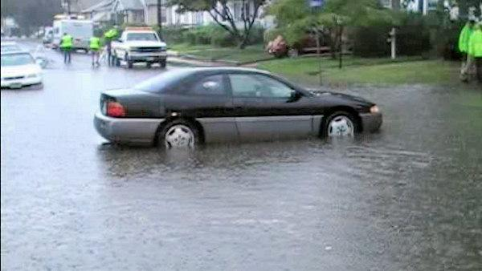
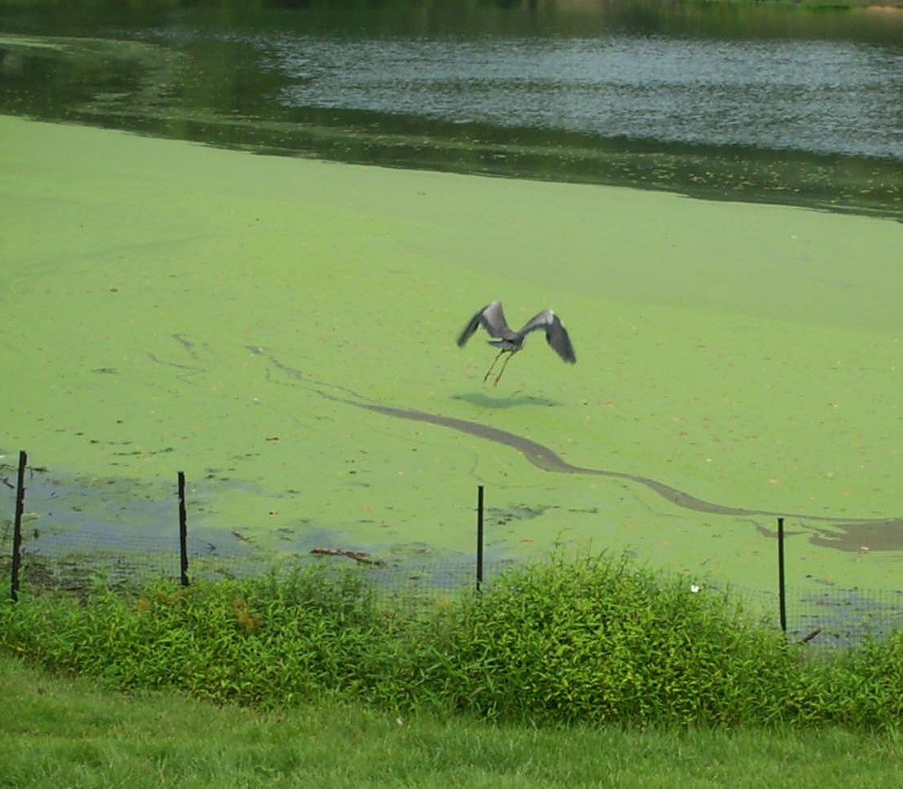
New Jersey Facts
New Jersey is 8,723 square miles
Population is 8,864,590 (1,171/mi²)
1,055 square miles of impervious cover = 12.1%
1” of rain = 18.2 billion gallons
90% of NJ’s rivers are impaired
Localized flooding is problem in most communities
Erosion and scouring of our streams
Notes:
Let’s learn a little bit about New Jersey.

Slide 6
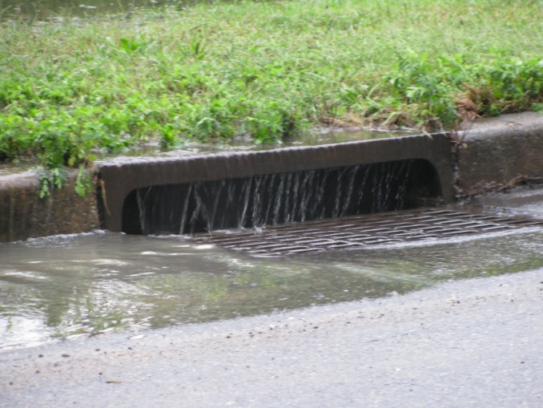
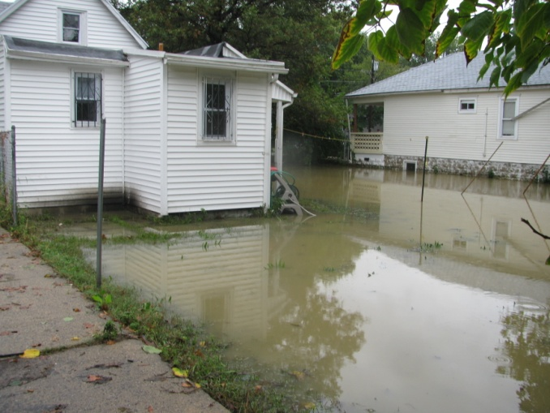
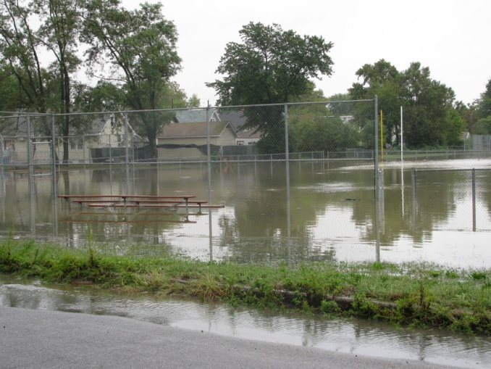
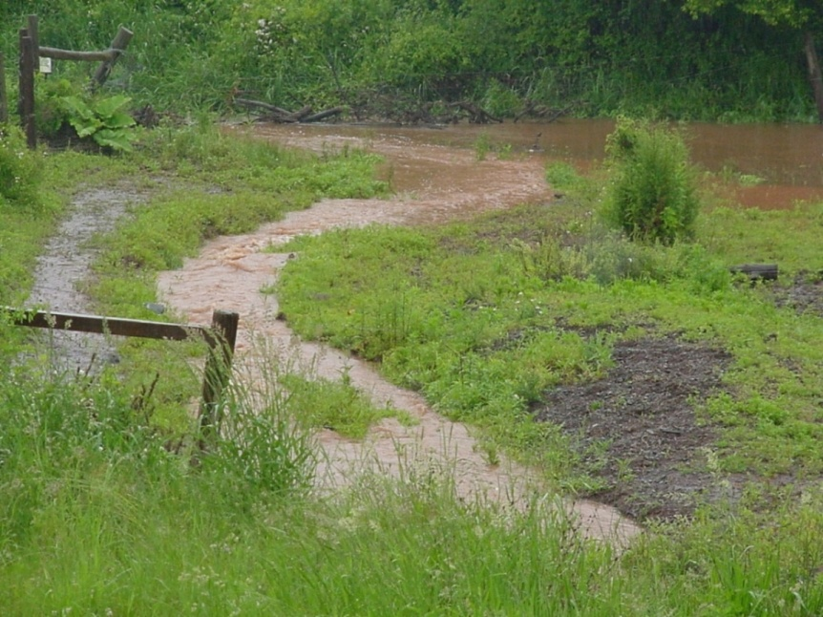
Problem: Stormwater Runoff
Stormwater is the water from rain or melting snows that can become “runoff,” flowing over the ground surface and returning to lakes and streams.
Notes:
The main problem is the lack of stormwater management.

Slide 7
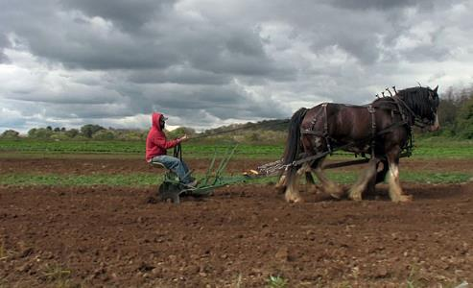
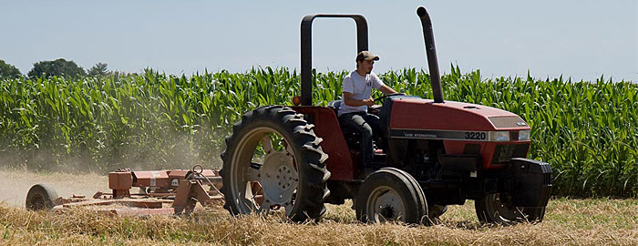
Causes of Water Resources Problems in New Jersey
1. Agriculture Land Uses
Notes:
One cause of the problem is agriculture land uses. We have about 10,000 production farmers in New Jersey, only about 13% of our land use is agriculture.

Slide 8
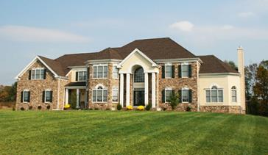
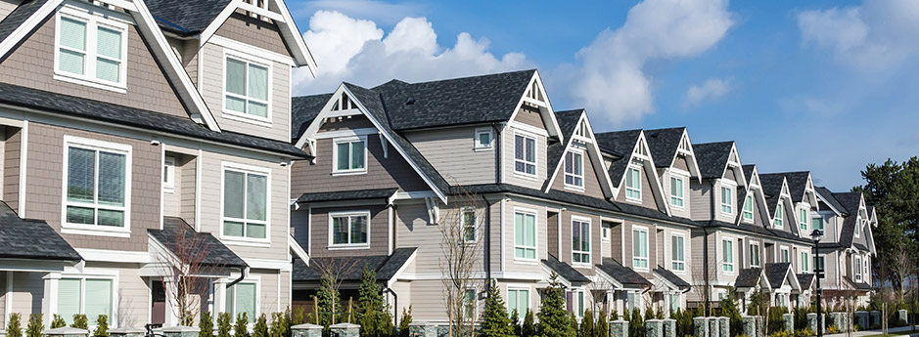
Causes of Water Resources Problems in New Jersey
2. Urban/Suburban Land Use New Development
Notes:
Another cause of the problem is new development. NJ is the most densely populated state in the nation. Many more people want to live here or stay here so more housing is needed.

Slide 9
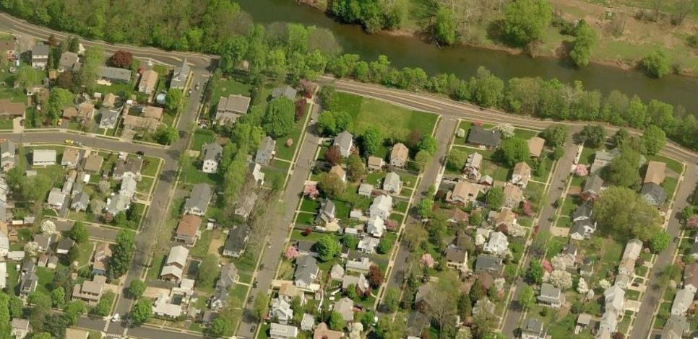
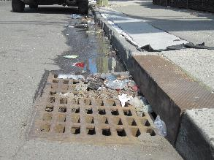
Causes of Water Resources Problems in New Jersey
3. Urban/Suburban Land Use Existing Development
Notes:
The final cause of the problem is existing development that occurred prior to NJ requiring stormwater management.

Slide 10
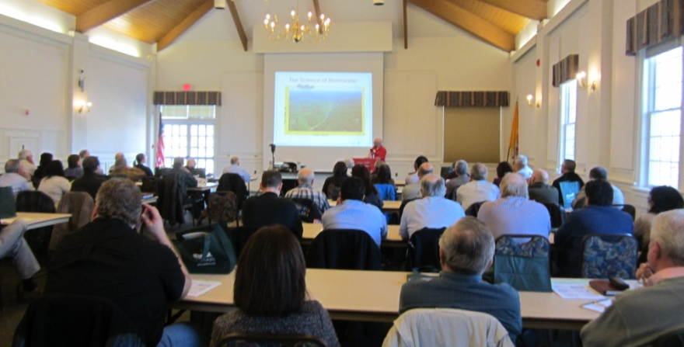
Addressing Impacts from New Development
Existing regulations may be adequate to minimize impacts
Existing regulations are not being enforced by municipalities
Training needs to be provided to help municipalities understand how to ensure new development are complying
Outreach needs to be provided to help municipalities get started
Notes:
The Water Resources Program developed an educational program called “Asking the Right Questions Program” which focuses on ensure local compliance with the NJ Stormwater Management Regulations.

Slide 11
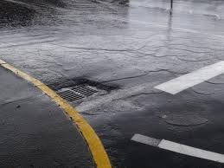
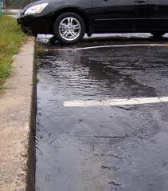
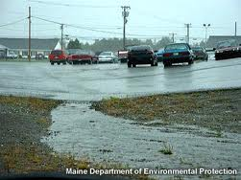
Addressing Impacts from Existing Development
It is all about controlling runoff from impervious surfaces
Notes:
But even if all the new development is designed with the proper stormwater management, existing water quality and flooding problems are not going to go away. There are some regulations that address better managing stormwater runoff from existing development (MS4 permits and TMDL requirements). Each of the 565 municipalities in NJ has an MS4 permit and NJDEP can incorporate TMDL requirements into these permits.

Slide 12
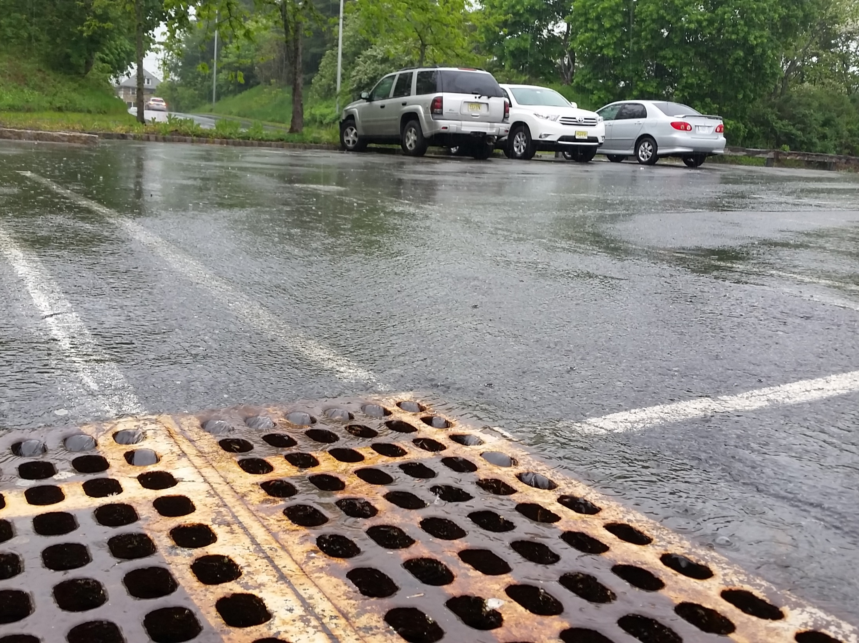
1st – New Development Asking the Right Questions in Stormwater Review

Slide 13
Important to Remember
The approval of a developer’s stormwater management plans lies solely with the municipality.
Municipalities are required under their Municipal Separate Storm Sewer System (MS4) General Permit to enforce statewide basic requirements for post-construction stormwater management in new development and redevelopment.

Slide 14
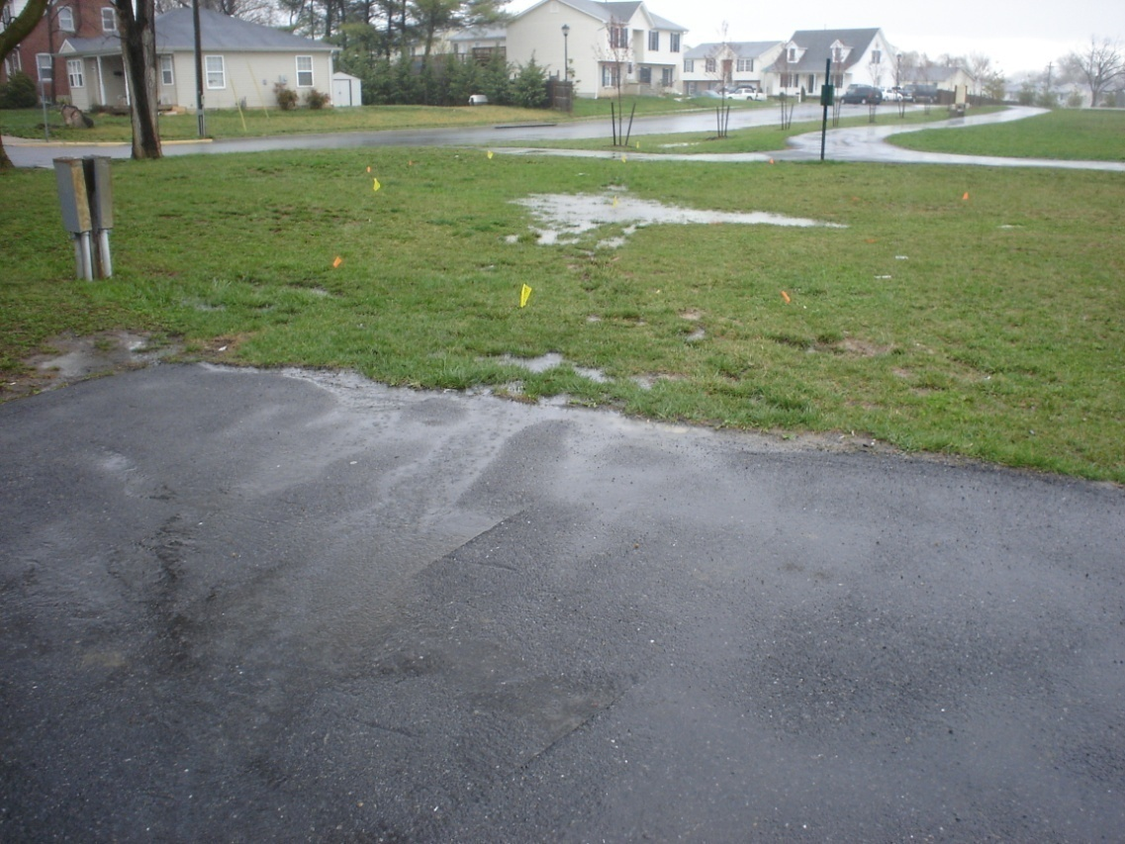
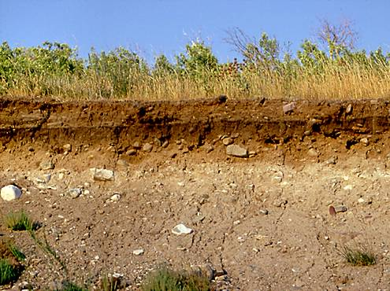
What happens to the rain?
It infiltrates into soils…
It runs off of rooftops and pavement…
It evaporates…
It is absorbed by plants…

Slide 15
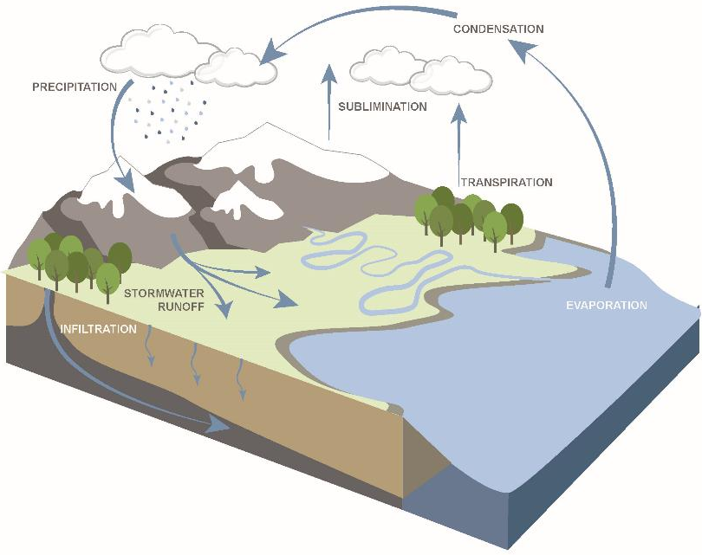
The Natural Hydrologic Cycle
Notes:
Let’s talk about the natural Water Cycle

Slide 16
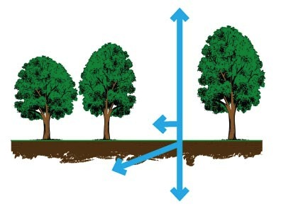
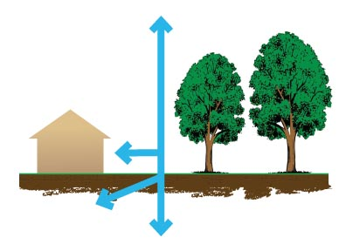
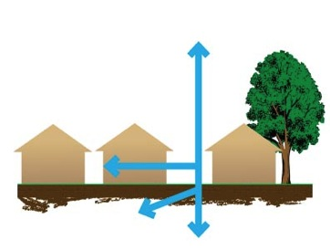
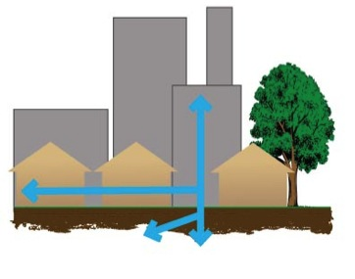
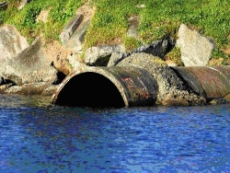
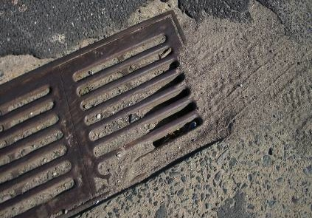
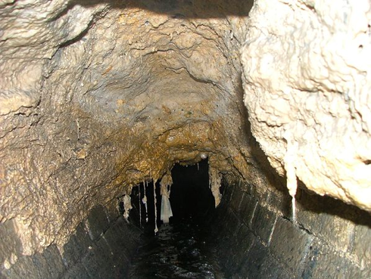
The Impact of Development on Stormwater Runoff
30%
55%
10%
20%
More development
More impervious surfaces
More stormwater runoff
Notes:
You have all seen this slide or some version of this slide before. Development adds impervious surfaces to take us from 10% stormwater runoff to 20% (low density residential) to 30% (medium density residential) to 55% (urban cities). You have all seen this slide or some version of this slide before.

Slide 17
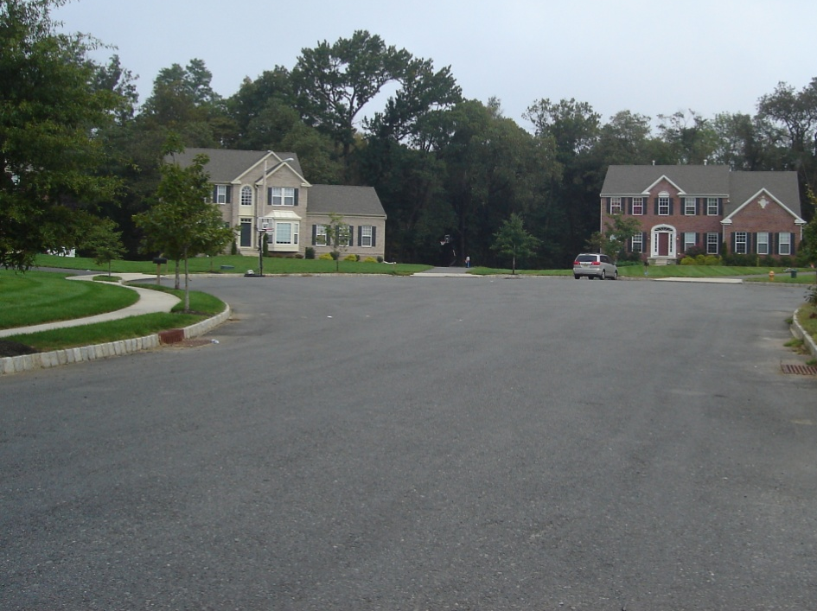
What is impervious cover?
Roads, rooftops, parking lots, and other hard surfaces that do not allow stormwater to soak into the ground.
provides a surface for accumulation of pollutants
leads to increased polluted runoff and flooding
inhibits recharge of groundwater

Slide 18
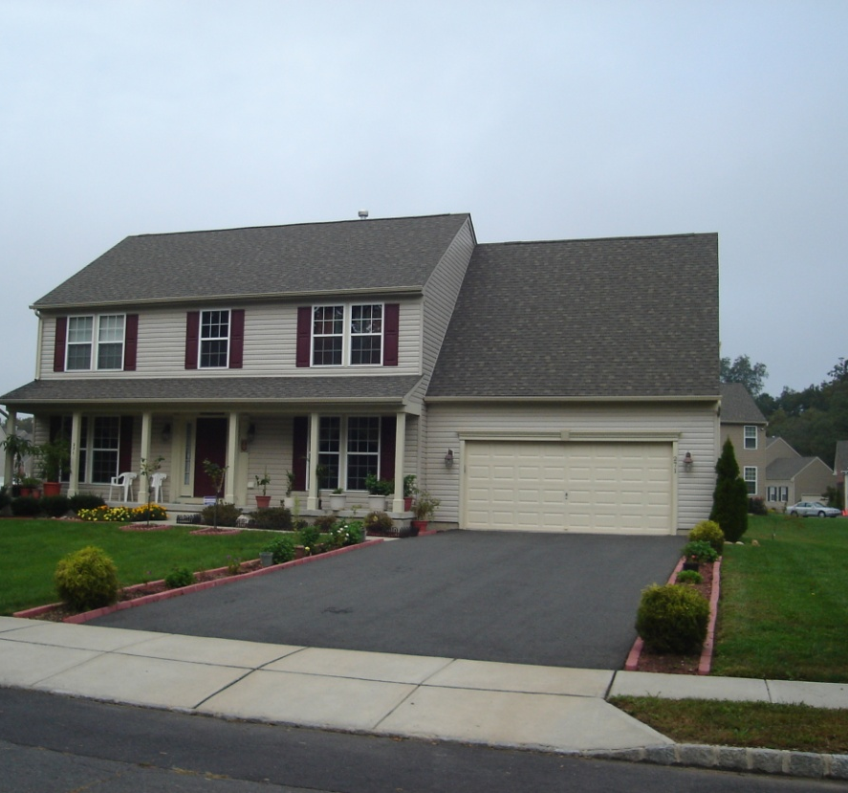
Increases in Impervious Cover Leads to:
More stormwater runoff volume
Higher peak stormwater runoff rates
Increased nonpoint source pollution
Less groundwater recharge

Slide 19
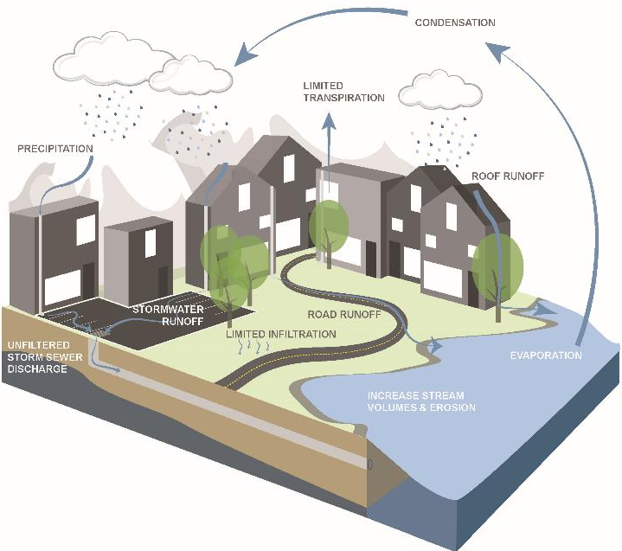
The sub/urban Hydrologic Cycle
Notes:
Now we have taken the natural water cycle and transformed it into an urban water cycle with much less infiltration and transpiration and more runoff.

Slide 20
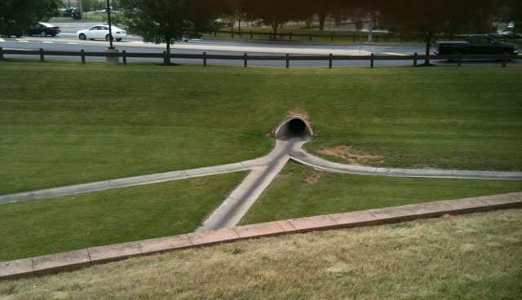
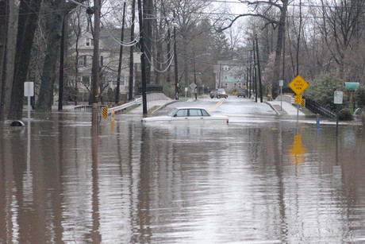
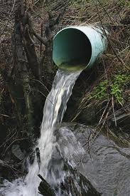
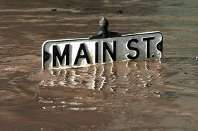
History of Stormwater Management

Slide 21
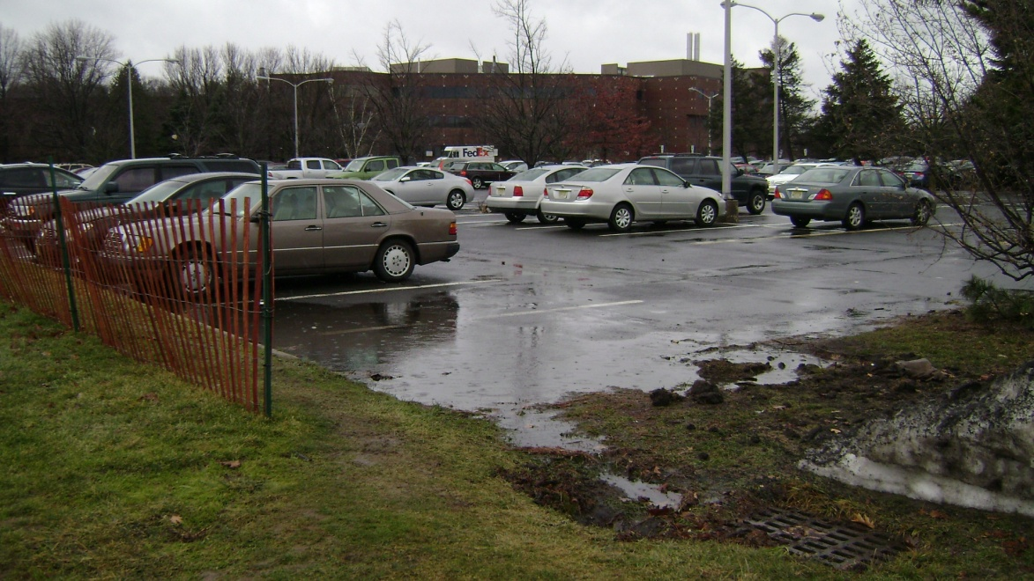
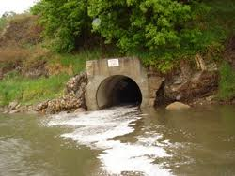
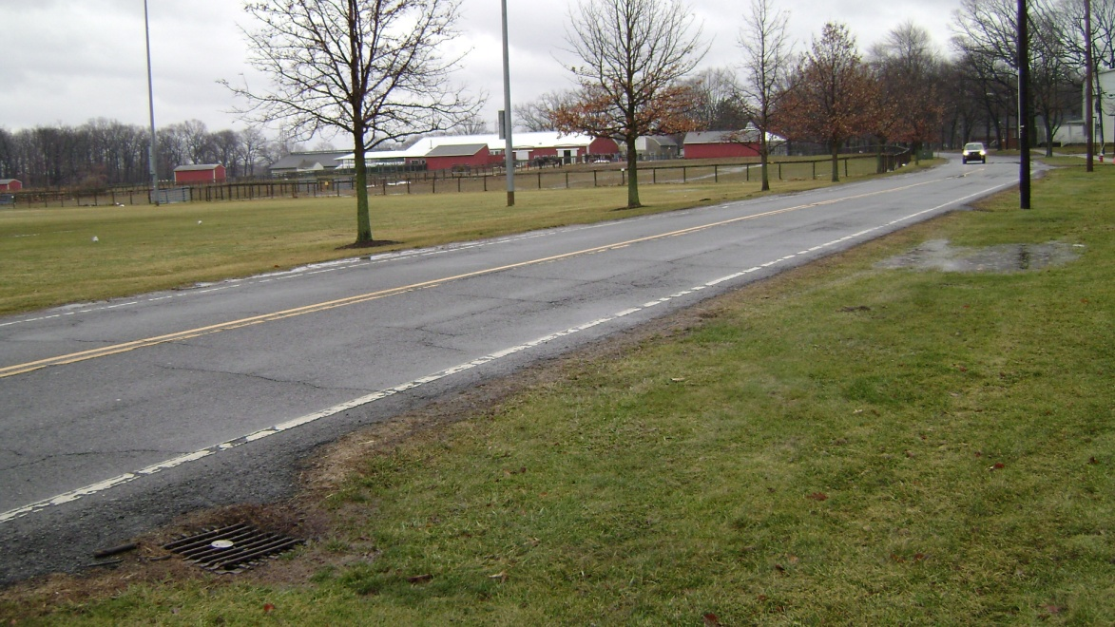
1st Attempt at Stormwater Management
Capture all runoff, pipe it, and send it directly to the river . . .prior to mid 1970’s

Slide 22
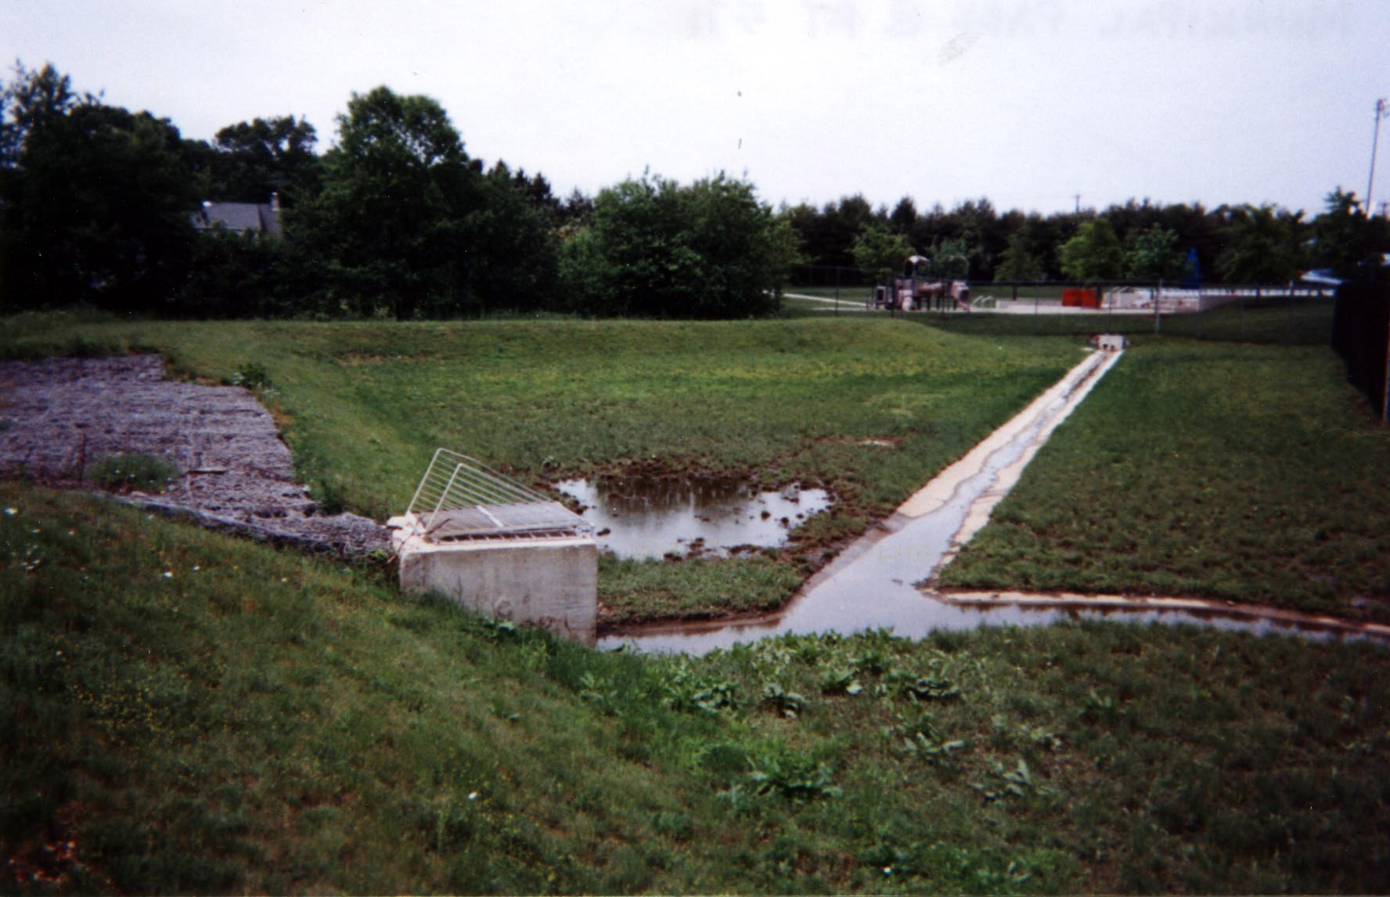
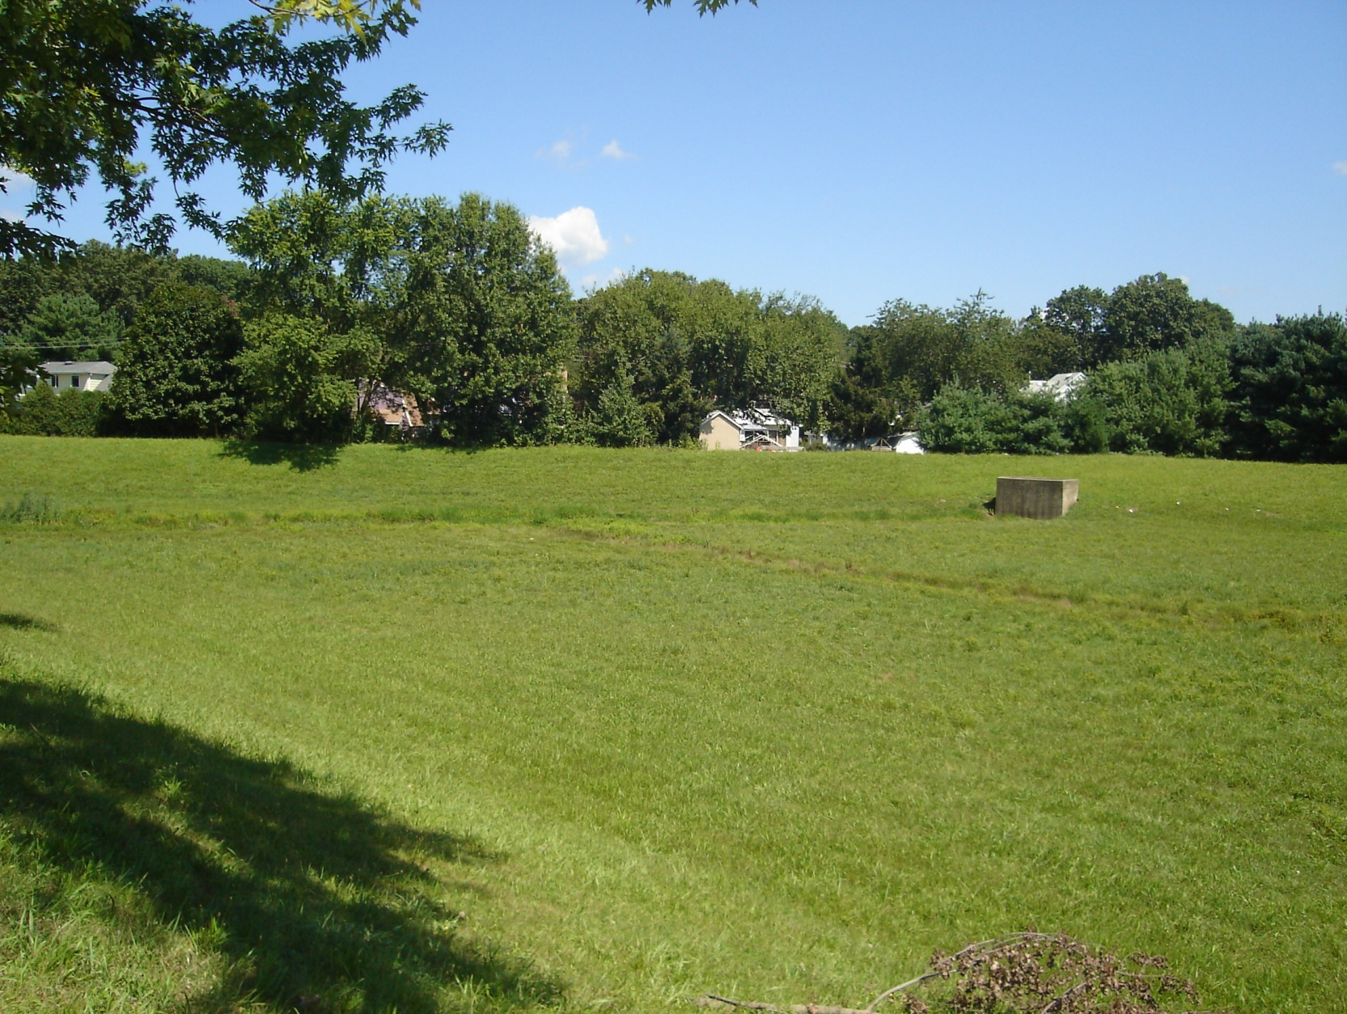
2nd Iteration of Stormwater Management
Capture runoff, detain it, release it slowly to the river…mid 1970’s to 2004
Detain peak flow during large storm events
Reduce downstream flooding during major storms
Use concrete low flow channels to minimize erosion, reduce standing water, quickly discharge low flows
Does not manage runoff from smaller storms
Directly discharges stormwater runoff to nearby stream, waterway, or municipal storm sewer system (at a controlled/managed rate)

Slide 23
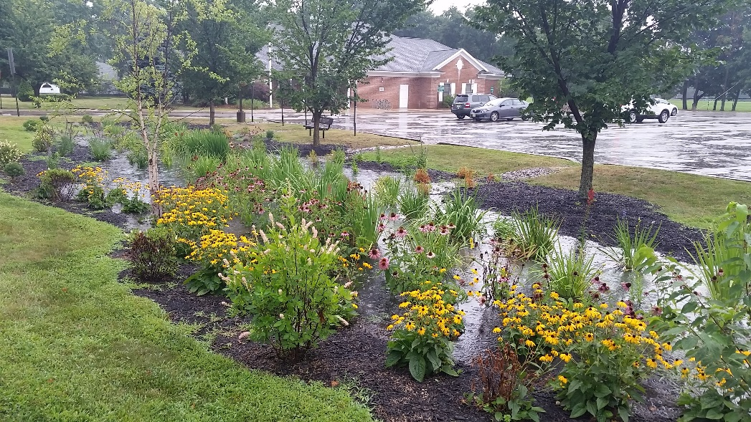
3rd Generation of Stormwater Management
Reduce peak flows …and….
Maintain infiltration and groundwater recharge
Reduce pollution discharged to local waterways

Slide 24
Stormwater Management Key Objectives
Protect communities from increases in stormwater volume and peak flows as a result of new development
Maintain groundwater recharge
Protect waterways from pollution carried in stormwater runoff

Slide 26
New Jersey Stormwater Management Rules
Rules apply to any “Major Development” defined as a project disturbing more than 1 acre or increasing impervious surfaces by ¼ acre or more
Design and Performance Standards established in NJAC 7:8-5, for:
Nonstructural Stormwater Management Strategies
Stormwater Quantity
Groundwater Recharge
Stormwater Quality
Stormwater Maintenance Plan

Slide 27
Nonstructural Strategies
Plan the project using Low Impact Development (LID) Principles
Collect, infiltrate and where possible reuse stormwater near its source
Capture runoff from small storm events in vegetated systems to protect water quality and promote recharge
Minimize and disconnect impervious surfaces

Slide 28
Water Quantity Performance Standards
Water Quantity
Demonstrate that post-development 2, 10, and 100-year storm event hydrographs do not exceed pre-development hydrographs
or
Demonstrate that hydrograph peaks will not increase and that increase in volume or change in timing won’t increase flood damage downstream
or
Design BMPs so that 2, 10, and 100-year pre-development hydrographs are reduced to 50%, 75%, and 80%, respectively
2-year rainfall (3.3 inches)
10-year rainfall (5.0 inches)
100-year rainfall (8.3 inches)
SOURCE: NJ Stormwater Management Rules and BMP Manual

Slide 29
Groundwater Recharge Performance Standards
Groundwater Recharge
Maintain 100% of average annual groundwater recharge volume
or
Infiltrate increase in the post development runoff volume for the 2-year storm
SOURCE: NJ Stormwater Management Rules and BMP Manual

Slide 30
Water Quality Performance Standards
Water Quality
Install BMPs to reduce at least 80% of total suspended solids (TSS) loads
Install BMPs to provide nutrient removal to maximum extent feasible
BMP TSS Removal Rate
Bioretention 90%
Constructed Wetlands 90%
Forested Buffers 70%
Extended Detention Basin 40-60%
Infiltration Structure 80%
Sand Filter 80%
Vegetative Filter Strip 50%
Wet Pond 60-90%
SOURCE: NJ Stormwater Management Rules and BMP Manual

Slide 31
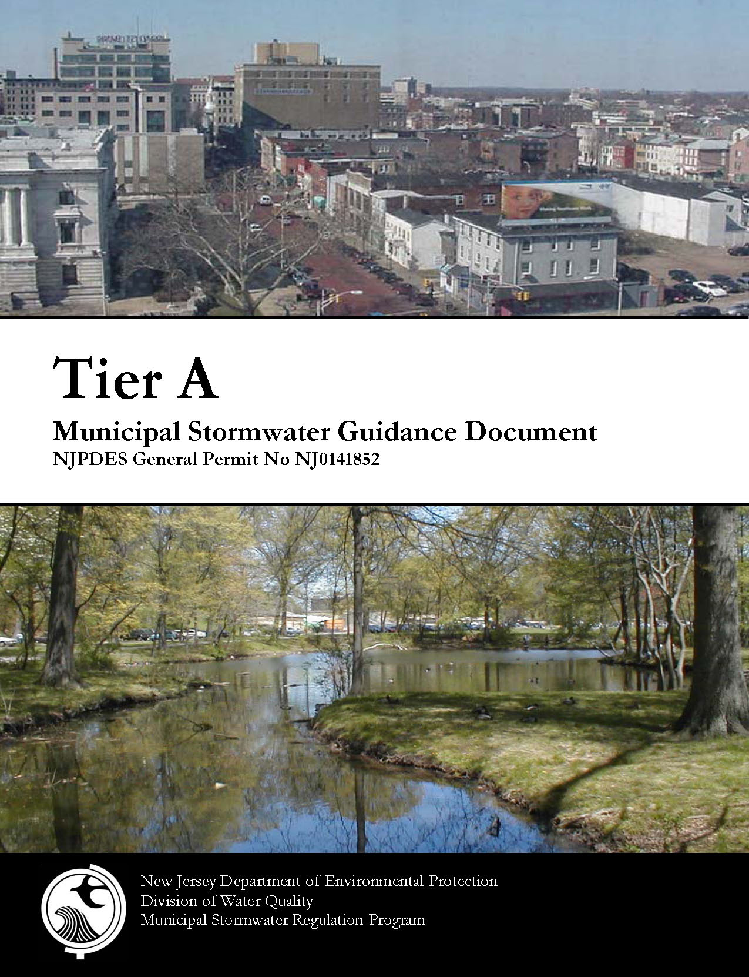
NJ Stormwater Guidance
Stormwater Management Rules (N.J.A.C. 7:8)
For more information, visit: www.njstormwater.org

Slide 32
Bottom line - what does the developer really need to do?
Maintain groundwater recharge on the site
Reduce sediment and nutrient runoff from the site
Reduce the peak stormwater runoff rates from the site
How should a developer do this?
1st Use Nonstructural Strategies to achieve 1, 2, and 3

Slide 33
Nine Nonstructural Strategies
1. Protect areas that provide water quality benefits or areas particularly susceptible to erosion and sediment loss
2. Minimize impervious surfaces and break up or disconnect the flow of runoff over impervious surfaces
3. Maximize the protection of natural drainage features and vegetation
4. Minimize the decrease in the "time of concentration" from pre-construction to post-construction
5. Minimize land disturbance including clearing and grading
6. Minimize soil compaction
7. Provide low-maintenance landscaping that encourages retention and planting of native vegetation and minimizes the use of lawns, fertilizers and pesticides
8. Provide vegetated open-channel conveyance systems discharging into and through stable vegetated areas
9. Provide other source controls to prevent or minimize the use or exposure of pollutants at the site to prevent or minimize the release of those pollutants into stormwater runoff
Notes:
Examples will be discussed for items in bold print

Slide 34
9 Strategies to 4 Categories
Vegetation and Landscaping
Preservation of natural areas (forested areas, riparian corridors, high recharge areas)
Native ground cover (limit turf grass areas)
Vegetative filters and buffers (protect them or plant new ones)
Minimizing Site Disturbance
Fit the development into the terrain
Minimize clearing and grading
Minimizing soil compaction
Build on low permeability soil areas
Impervious Area Management
Minimum street widths and sidewalks
Limit parking and driveway areas
Use pervious paving materials
Disconnect impervious surfaces from draining directly to waterways
Vegetated roofs
Time of Concentration Modifications (slow down runoff)
Surface roughness changes
Slope reduction
Vegetated conveyances

Slide 35
#1 Protect areas that provide water quality benefits or areas particularly susceptible to erosion and sediment loss

Slide 36
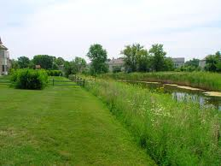
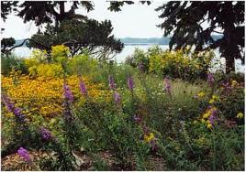
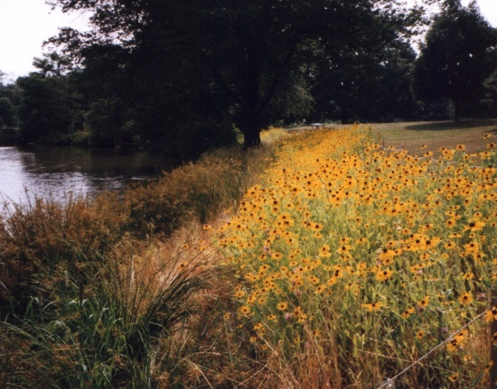
Vegetative Buffers

Slide 37
#2: Minimize impervious surfaces and break up or disconnect the flow of runoff over impervious surfaces

Slide 38
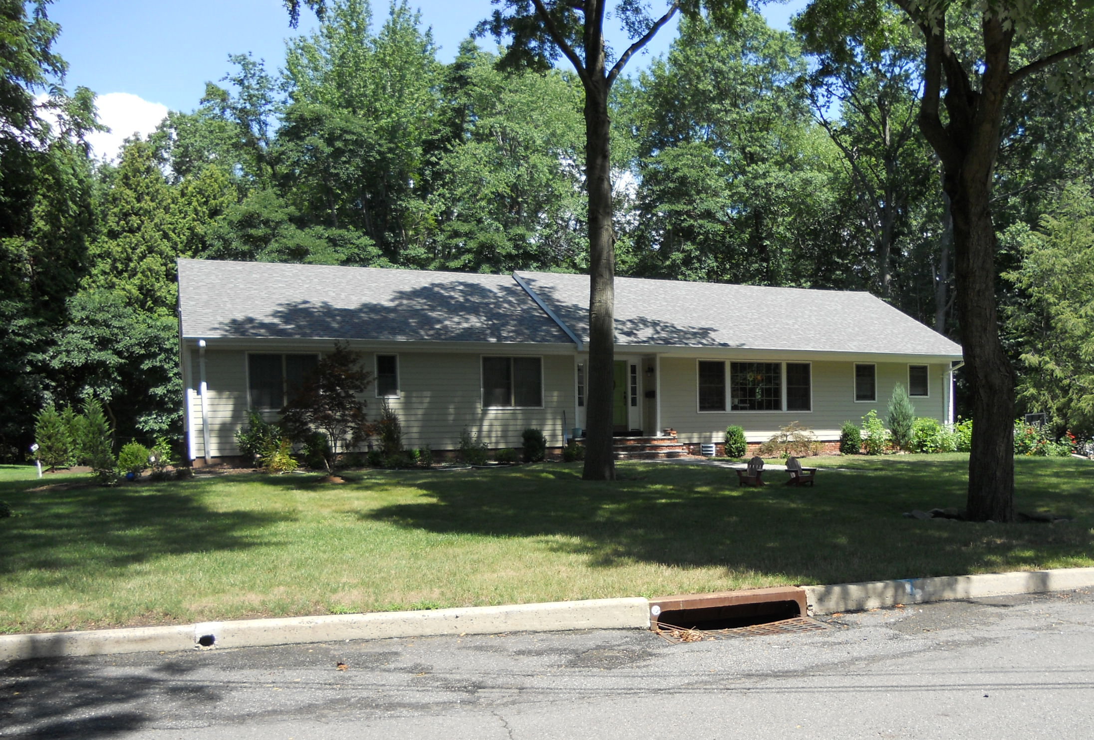
Disconnected Impervious Surfaces

Slide 39
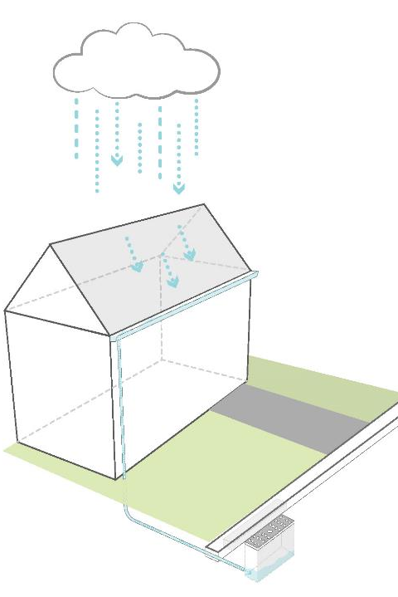
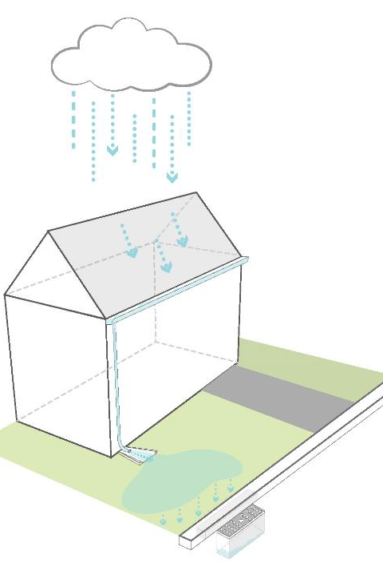
The Solution…
Rooftop runoff is now “disconnected” from flowing directly into the storm sewer system
PLACE A STORMWATER BEST MANAGEMENT PRACTICE (BMP) BETWEEN IMPERVIOUS AREAS AND THE STORM SEWER SYSTEM

Slide 40
For 1.25 inch storm, 3,811 cubic feet of runoff = 28,500 gallons
Total drainage area = 3 acres
1 acre directly connected impervious cover
2 acres pervious cover
Runoff Direction
Stormwater
Inlet

Slide 41
For 1.25 inch storm, 581 cubic feet of runoff = 4,360 gallons
Total drainage area = 3 acres
1 acre directly connected impervious cover
2 acres pervious cover
Runoff
Direction
Stormwater
Inlet

Slide 42
 | Volume of Runoff
Design Storm | Connected (gallons) | Disconnected (gallons) | Percent Difference
1.25 inches (water quality storm) | 28,500 | 4,360 | 85%
Impervious area is now “disconnected” from flowing directly into the storm sewer system

Slide 43
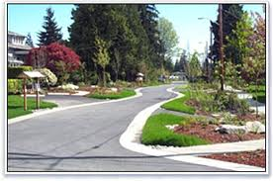
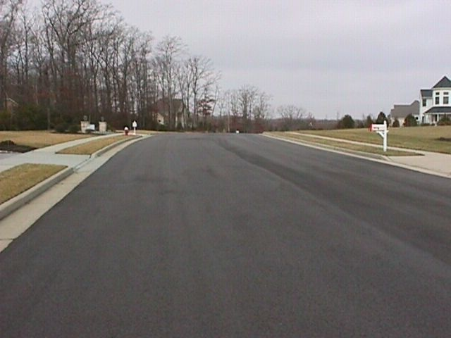
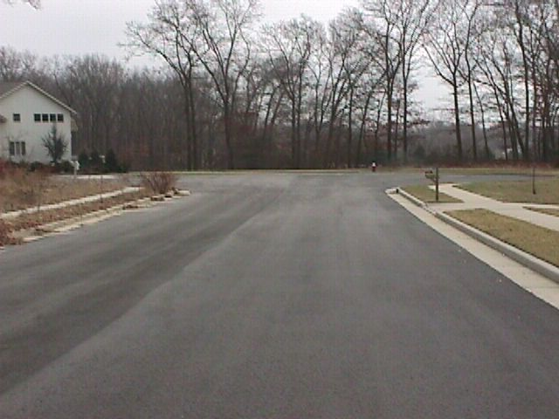

Slide 45
#5 Minimize land disturbance including clearing and grading

Slide 46
Preserving Natural Lands
Not Preserving Natural Lands

Slide 47
#7 Provide low-maintenance landscaping that encourages retention and planting of native vegetation and minimizes the use of lawns, fertilizers and pesticides

Slide 50
#8 Provide vegetated open-channel conveyance systems discharging into and through stable vegetated areas

Slide 51
Vegetated Conveyances

Slide 52
No. | Nonstructural Strategy | Yes | No
1. | Protect areas that provide water quality benefits or areas particularly susceptible to erosion and sediment loss
2. | Minimize impervious surfaces and break up or disconnect the flow of runoff over impervious surfaces
3. | Maximize the protection of natural drainage features and vegetation
4. | Minimize the decrease in the pre-construction time of concentration
5. | Minimize land disturbance including clearing and grading
6. | Minimize soil compaction
7. | Provide low maintenance landscaping that encourages retention and planting of native vegetation and minimizes the use of lawns, fertilizers, and pesticides
8. | Provide vegetated open-channel conveyance systems discharge into and through stable vegetated areas
9. | Provide preventative source controls
Explain why any one of these is “NO.” Engineering, environmental and/or safety reasons are only acceptable.

Slide 53
Bottom line - what does the developer really need to do?
Maintain groundwater recharge on the site
Reduce sediment and nutrients runoff from the site
Reduce the peak stormwater runoff from the site
How should a developer do this?
2nd Focus on incorporating systems that address water quality and groundwater recharge

Slide 54
Nonpoint Source Pollution (NPS)
NPS is pollution associated with stormwater runoff
NPS occurs when runoff collects pollutants on its way to a collection system or water body
NPS pollution cannot be traced to a direct discharge point such as a wastewater treatment facility

Slide 55
Examples of NPS
Oil and grease from cars
Fertilizers
Animal waste
Grass clippings
Septic systems
Sewage leaks
Household cleaning products
Litter
Agriculture
Sediment

Slide 56
Impact of NPS
Fish and wildlife
Recreational water activities
Commercial fishing
Tourism
Drinking water quality

Slide 57
Groundwater Recharge Requires…
Healthy soils
Permeability
Hydraulic conductivity
Vertical separation from seasonable high water table or groundwater table
Suitable distance from foundations, basements and septic systems

Slide 58
Groundwater Recharge…
Safe Distance from Structures
Minimum Distance from Seasonal High Water Table

Slide 59
Bioretention Systems

Slide 60
Manufactured Treatment Devices (off-line devices)
http://www.njstormwater.org/treatment.html

Slide 61
Table 2: TSS Removal Rates for BMPs
Best Management Practice TSS Percent Removal Rate
Bioretention Systems 90
Constructed Stormwater Wetland 90
Extended Detention Basin 40-60
Infiltration Structure 80
Sand Filter 80
Vegetative Filter Strip 60-80
Wet Pond 50-90
Manufactured Treatment Device See N.J.A.C. 7:8-5.7(d)

Slide 62
Bottom line - what does the developer really need to do?
Maintain groundwater recharge on the site
Reduce sediment and nutrients runoff from the site
Reduce the peak stormwater runoff from the site
How should a developer do this?
3rd Design systems that reduce peak stormwater runoff rates and meet water quantity requirements.

Slide 63
WATER QUANTITY (NJAC 7.8-5.4(a)3)
Has the applicant calculated stormwater runoff using NJDEP approved assumptions and factors?
These assumptions and factors can be found in the regulations under section NJAC 7:8-5.6. The Township Engineer or Review Engineer should be able to verify that the calculations were done correctly.
If yes, go to Question #2. If no, application is incomplete at this time.

Slide 64
WATER QUANTITY (NJAC 7.8-5.4(a)3)
2. Has the applicant calculated the pre and post-construction peak runoff for the 2-year, 10-year, and 100-year storm events?
If yes, has the applicant demonstrated compliance with ONE of the following requirements?
Has the applicant submitted adequate hydrologic and hydraulic analyses demonstrating the post-construction runoff hydrographs (2-yr, 10-yr, and 100-yr) do not exceed the corresponding pre-construction hydrographs?
Has the applicant submitted adequate hydrologic and hydraulic analyses demonstrating that there is no increase as compared to the pre-construction condition in the peak runoff rates leaving the site (2-yr, 10-yr, and 100-yr) and that the increase volume or change in timing will not increase flood damage at or downstream of the project site.
Has the applicant submitted adequate hydrologic and hydraulic analyses demonstrating that the post-construction peak runoff rates (2-yr, 10-yr, and 100-yr) are 50%, 75%, and 80% respectively of the pre-construction runoff rates.
If the applicant has NOT demonstrated compliance with one of the requirements outlined above, the application is incomplete at this time.

Slide 65
Summary
The best way for an applicant to meet the NJ Stormwater Management regulations is to:
Incorporate nonstructural strategies
Address water quality and groundwater recharge requirements
Ensure that proposed designs meet water quantity requirements

Slide 66
How do we integrate these tools into the review process?
All questions should be publicly available for all applicants, review engineers, and residents
Members of the planning and/or zoning boards and/or environmental commission should be prepared to ask these questions of the Township’s review engineer and applicant
Understand that these questions outline the minimum requirements as defined in the NJ Stormwater Management Rules

Slide 67
E-learning Tool Available Online
A FREE interactive E-learning tool is available online http://water.rutgers.edu/E-learning.html
The tool is intended to help you understand if a developer is in compliance with the NJ Stormwater Management Regulations so you can be comfortable in approving or rejecting the developer’s plan

Slide 68
Questions?

