Slide 1
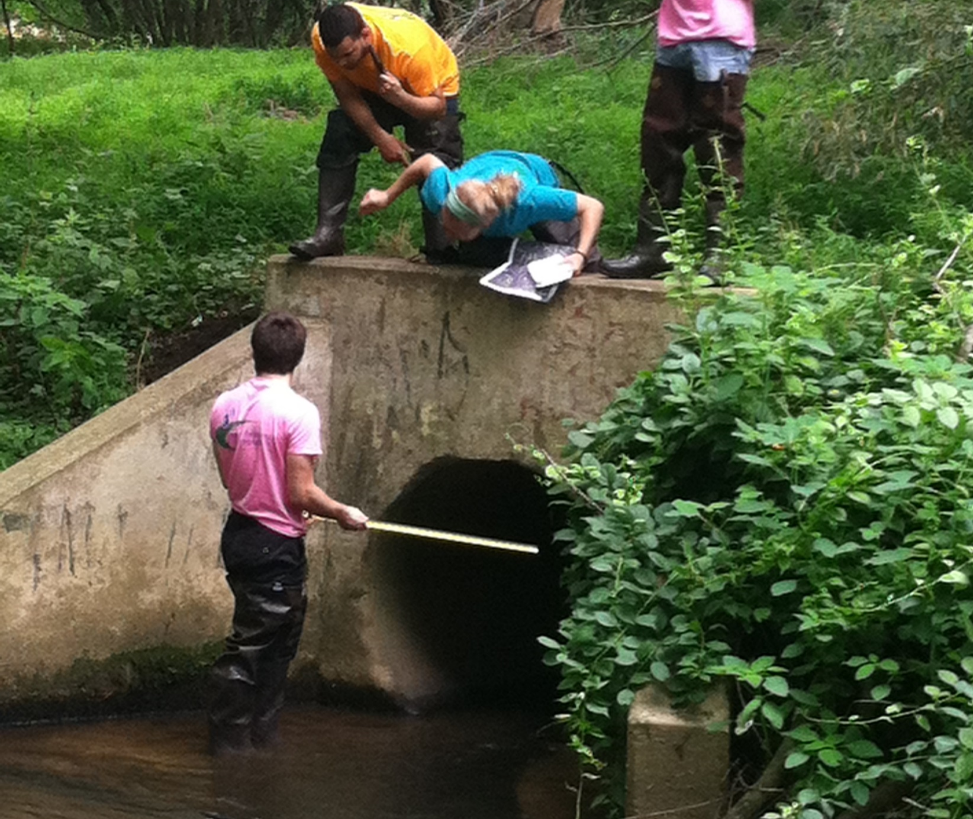
Inventory and Assessment of Stormwater Infrastructure
Notes:
This workshop will provide instruction on how to identify and assess stormwater infrastructure in your community. The development of this tool was funded by the New Jersey Department of Environmental Protection. Additionally, the New Jersey Sea Grant Consortium and the New Jersey Agricultural Experiment Station provided funding to partially support the creators of this presentation and eLearning Tool

Slide 2
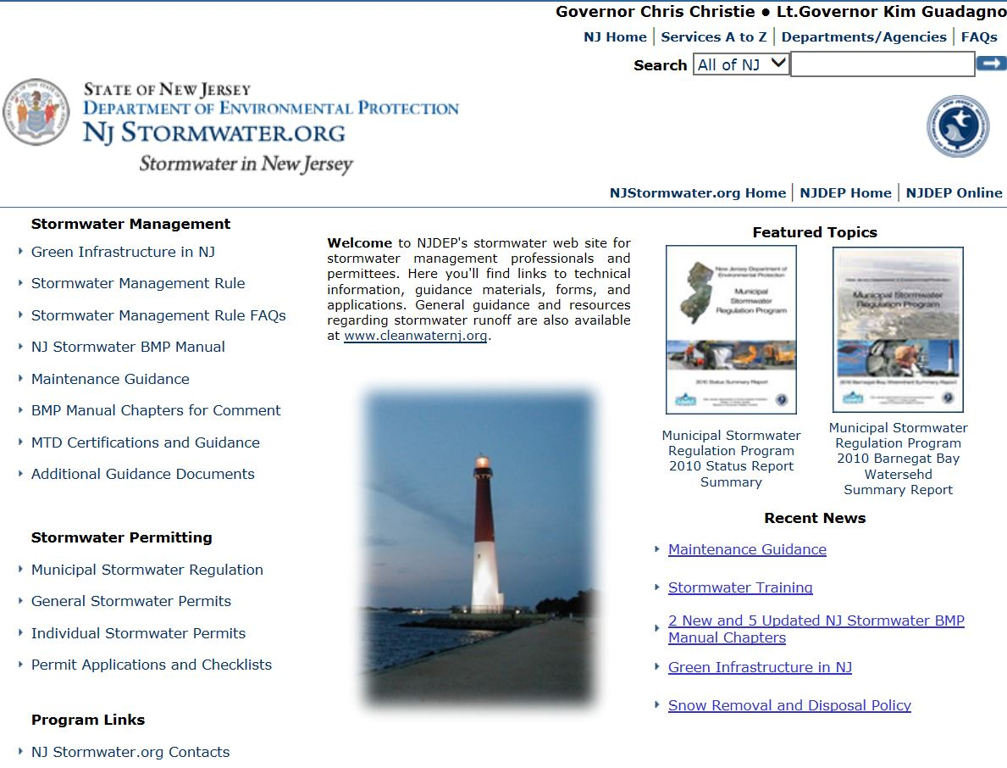
Notes:
Before we begin, there are some very important online resources available to help with stormwater management. Here is the New Jersey Department of Environmental Protection website at www.Njstormwater.org. Under the Maintenance Guidance section, you will find “Field Manuals” for various stormwater management practices. Each Field Manual includes templates for basic design information, checklists, visual aids, reference documents, and maintenance records. This provides a systematic method to assist maintenance crews in performing field work and retaining records.

Slide 3
Identifying and Assessing
Stormwater Infrastructure
Before an assessment can be completed, stormwater infrastructure must be located and identified such as:
Detention Basins
Retention Basins
Other Stormwater Best Practices Management (BMPs)
Manufactured Treatment Devices (MTDs)
Catch Basins
Stormwater Piping
Outfalls
Notes:
Before an assessment can be completed, stormwater infrastructure must be located and identified such as: Detention Basins, Retention Basins, Other Stormwater Best Practices Management (BMPs), Manufactured Treatment Devices (MTDs), Outfalls, Catch Basins, and Stormwater Piping

Slide 4
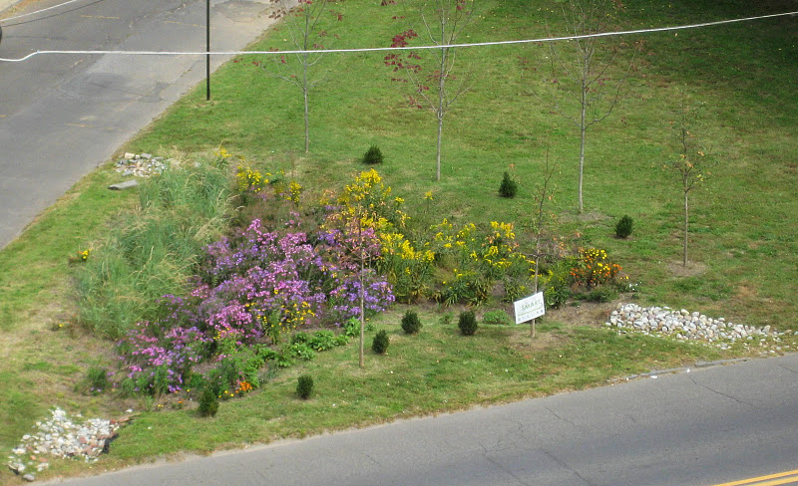
Other Stormwater Management Practices
Bioretention Systems
Notes:
There are other stormwater best management practices (BMPs) that should be included in a municipal stormwater inventory such as bioretention system also known as rain gardens. These are vegetative systems that are designed to capture, treat and infiltrate stormwater runoff. The plants uptake the nutrients in stormwater runoff. The microbes in the mulch and soil also work to reduce pollutants.

Slide 5
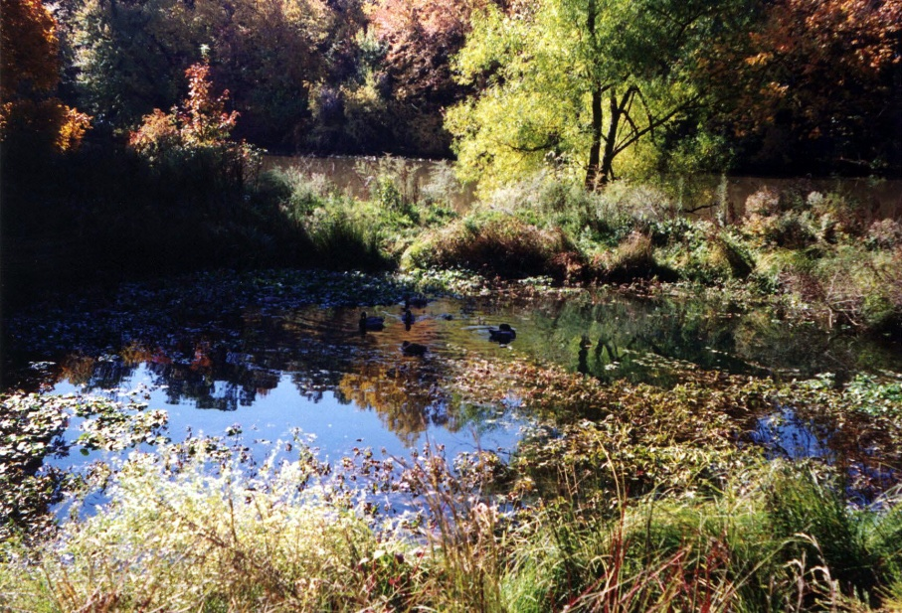
Other Stormwater Management Practices
Constructed Wetlands
Notes:
While constructed wetlands for stormwater management are not typically used in New Jersey, these systems do a great job at removing pollutants from stormwater runoff.

Slide 6
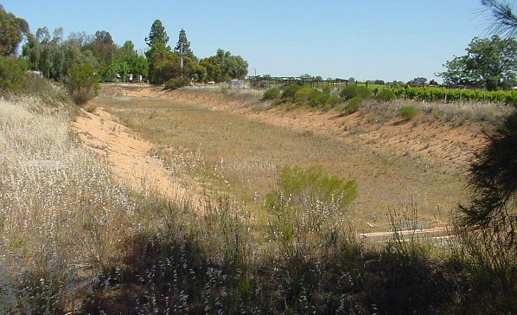
Other Stormwater Management Practices
Infiltration Basin
Notes:
An infiltration basin is very similar to a bioretention system except it is typically planted with only one species of vegetation such as turf grass.

Slide 7
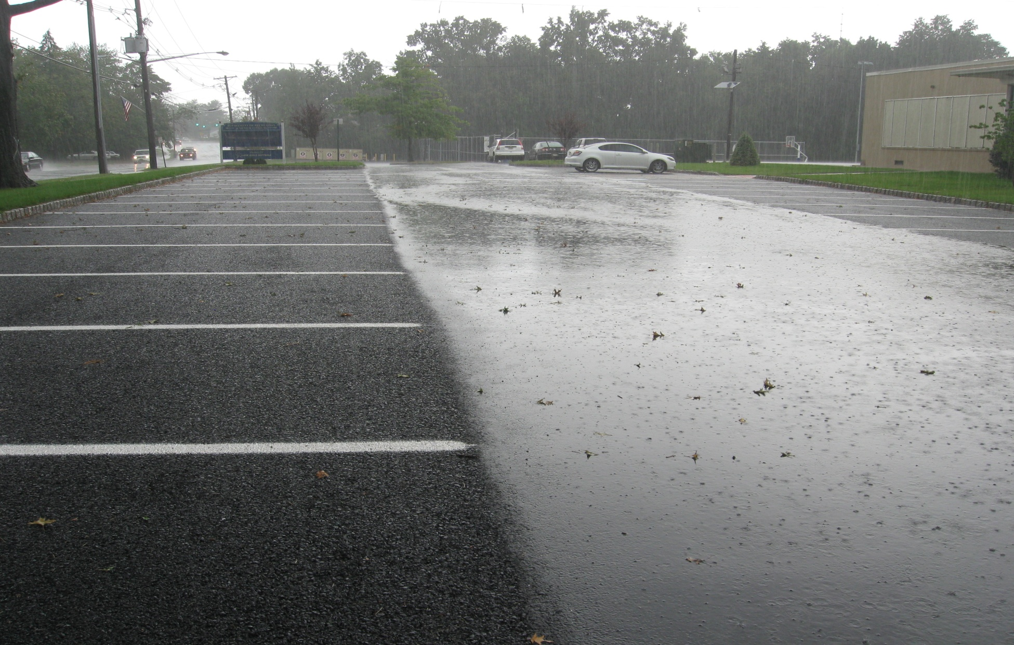
Other Stormwater Management Practices
Pervious Paving Systems
Notes:
Pervious paving systems include porous asphalt, pervious concrete, permeable pavers, and grass paver systems. These systems are design to allow stormwater to pass through the surface and be stored in a stone reservoir and slowly infiltrated into the underlying aquifer or released slowing to a local storm sewer system or directly to the waterway. In this photograph, the parking spots are porous asphalt while the cartway is regular asphalt.

Slide 8
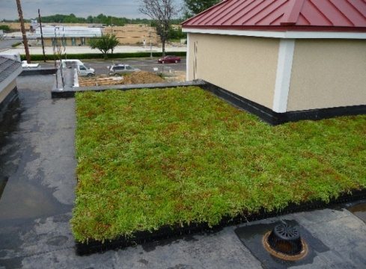
Other Stormwater Management Practices
Parker Urban Greenscapes. 2009.
Rooftop Vegetated Cover
Notes:
Green roofs are another BMP that is designed to capture stormwater. These system are often associated with new construction since they are heavy and require the roof to be designed specifically to handle the additional weight.

Slide 9
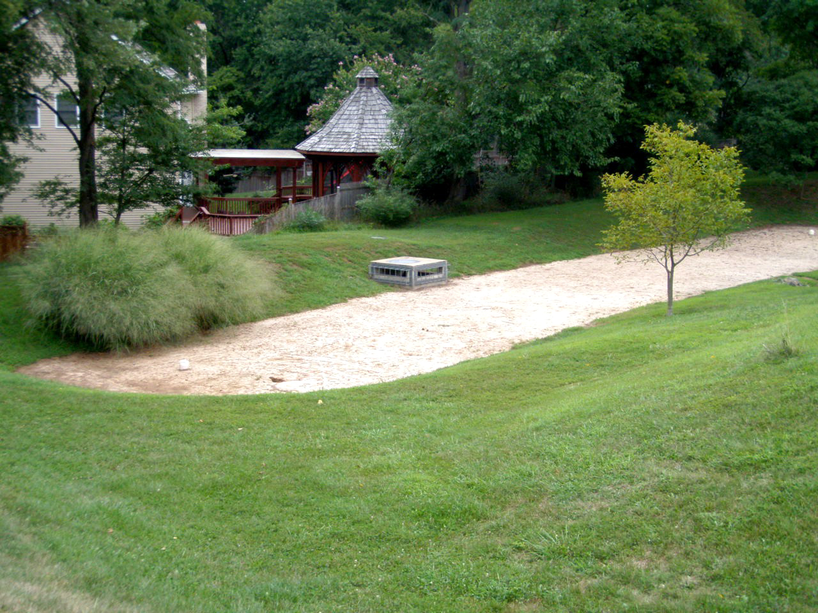
Other Stormwater Management Practices
Sand Filters
Notes:
Sand filters are very similar to infiltration basins except there is no vegetation.

Slide 10
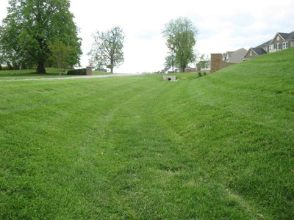
Other Stormwater Management Practices
Grass Swales
Notes:
Grass swales are systems that transport water from one location to another while filtering out sediment and other pollutants.

Slide 11
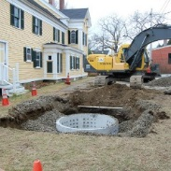
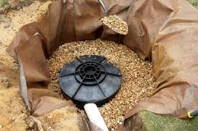
Other Stormwater Management Practices
Dry Wells
Notes:
Dry wells are a common BMP in New Jersey. These are basically underground systems design to infiltrate stormwater runoff. People like these systems because they are out of sight and can be very effective at infiltrating runoff at a low cost.

Slide 12
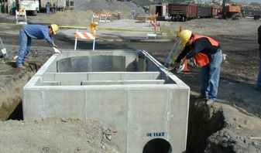
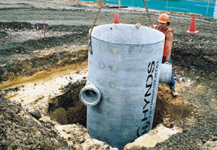
Other Stormwater Management Practices
Manufactured Treatment Devices (MTDs)
Notes:
Finally, there are manufactured treatment devices that are designed to mainly reduce sediment loading to local waterways. Since all of these BMPs require maintenance, they should be include in the municipal stormwater inventory.

Slide 13
The Benefits of Stormwater Infrastructure Inventory and Assessment
Identify maintenance needs
Reduce replacement and repair needs
Reduce liability
Support development of alternative maintenance programs
Translate into reduced long-term costs
Notes:
Inventorying and assessing municipal stormwater infrastructure provides many benefits. It promotes maintenance by allowing municipalities to identify and prioritize issues before they become larger problems. Regular maintenance improves system function and reduces replacement and repair needs. Properly maintained stormwater infrastructure can reduce flooding, improve water quality, support compliance with federal and state environmental law, and reduce safety issues and associated liability. Inventorying and assessing infrastructure also can identify opportunities for alternative maintenance programs. These benefits can translate into reduced long-term costs.

Slide 14
Improved Maintenance Results
Reduced pollution of local waterways
Reduced stream channel erosion
Reduced flooding
Enhanced climate resiliency
Notes:
Inventory and assessment of stormwater infrastructure supports improved maintenance and more efficient use of resources. Improved maintenance also provides quality of life benefits such as: reduced pollution of local waterways, reduced stream channel erosion, fewer localized flooding events, and enhanced climate resiliency.

Slide 15
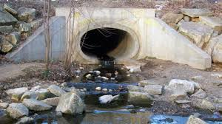
State Regulations: Outfall Mapping and Illicit Connections
Notes:
Most municipalities in New Jersey have a Municipal Separate Storm Sewer System permit (MS4) from the New Jersey Department of Environmental Protection (NJDEP). For most municipalities (Tier A) this requires them to develop a map showing the location of the end of all MS4 outfall pipes. As part of the MS4 permit, each municipality is required to develop and implement a program to detect and eliminate illicit connections. Illicit connections include discharges of any number of pollutant sources to the storm sewer including the connection of a sanitary sewer pipe to the storm sewer pipe, thereby discharging untreated wastewater into the local stream.

Slide 16
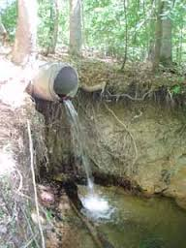
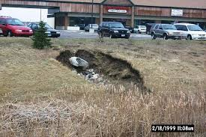
State Regulations: Outfall Pipe Stream Scouring Remediation
Notes:
Under the MS4 permit, each municipality is required to develop and implement a stormwater outfall pipe scouring detection, remediation and maintenance program. One unstable or over-loaded stormwater outfall can do a lot of damage to a local waterway.

Slide 17
What Other Stormwater Facilities to Inventory
Stormwater management basins
Outfalls pipes
Subsurface retention/detention systems
Manufactured treatment devices (MTDs)
Green infrastructure
Notes:
Under the MS4 permits, the municipality must ensure that privately owned stormwater facilities are being maintained unless the facility is subject to another NJPDES stormwater permit. Without a proper inventory, proper maintenance is difficult to ensure. Therefore, it is important that the municipality inventory its stormwater facilities as well as those they do not own or operate. Regulatory requirements aside, lack of maintenance of these privately owned systems could have a negative effect on the municipality’s stormwater system, water quality and the residents of the community. NJDEP is proposing changes to the MS4 permit to require a digital inventory using GPS technology. The above features are likely to be required. While these would be the minimum permit requirements, municipalities will benefit from developing a comprehensive inventory of all stormwater facilities, including those listed here.

Slide 18
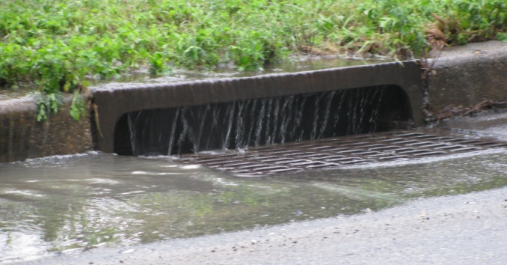
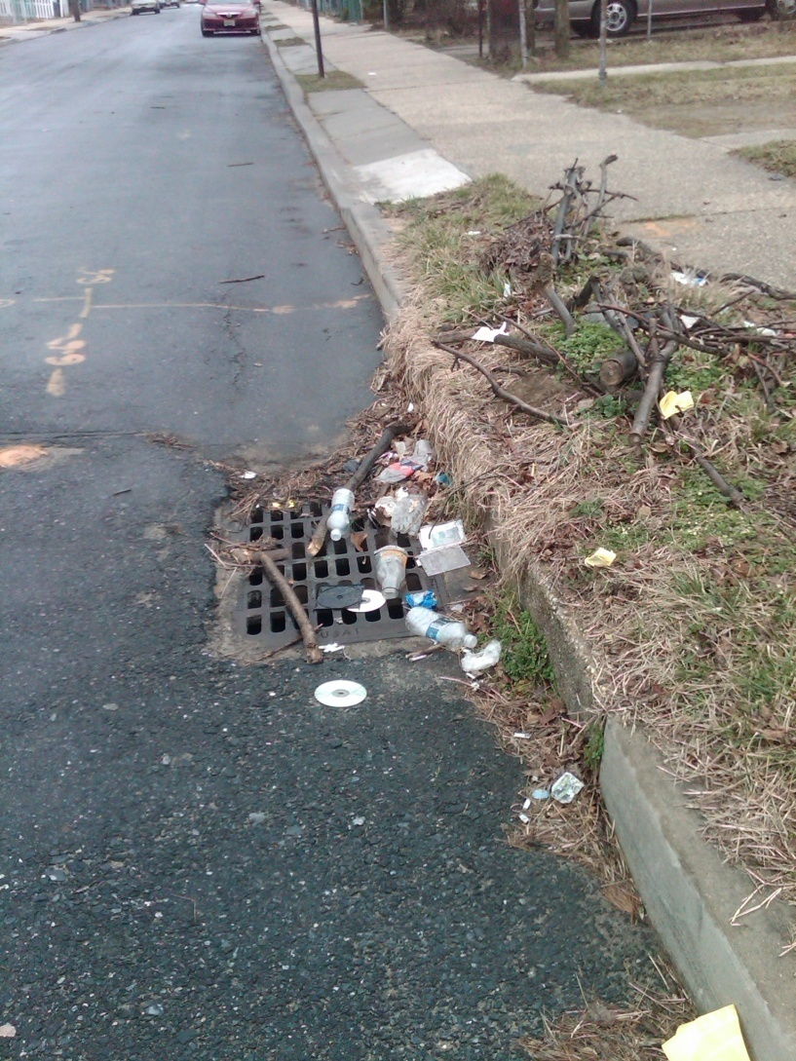
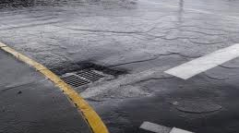
Beyond State Regulations –
Mapping Catch Basins and Piping
Notes:
Many municipalities have expanded their mapping to include catch basins and stormwater piping. The MS4 permit requires the municipality to clean every catch basin on an annual basis; therefore catch basin mapping is very important and makes scheduling catch basin cleaning much easier. Mapping pipes (size and direction) is important to address localized flooding. Often flooding during smaller storm events can be remediated by cleaning or replacing one or two pipes. The mapping helps facilitate these procedures.

Slide 19
Minimum Information Collected in an Inventory
Type of Stormwater Facility
Coordinates in accordance with NJDEP GIS Protocol
Road Name
Owner
Tax Map Number
Block and Lot
Unique Identification Number
Notes:
For each inventoried stormwater facility, minimum common data should be collected. NJDEP is proposing changes to the MS4 permit to require a digital inventory using GPS technology. The above attributes are likely to be required as part of the inventory. While these would be the minimum permit requirements, municipalities will benefit from collecting additional information about each stormwater facility inventoried. The municipality also should assign a unique identification number so that the information can be incorporated into a searchable database or geographic information system (GIS).

Slide 20
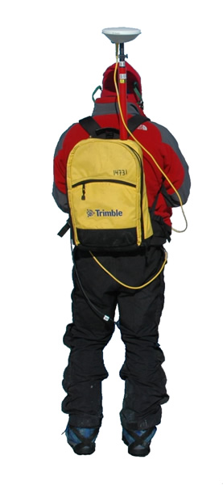
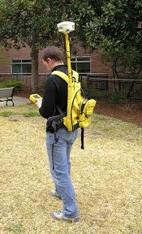

Mapping
Notes:
Although mapping of stormwater facilities can be very labor intensive, modern technology has made it relatively easy. Some municipalities already have engineering plans of stormwater systems that can easily be converted into an inventory of stormwater facilities. For many municipalities, this would be a conversion of existing data into a GIS database with some level of field verification. The harder part of this effort is assessing the condition of the stormwater facilities.

Slide 21
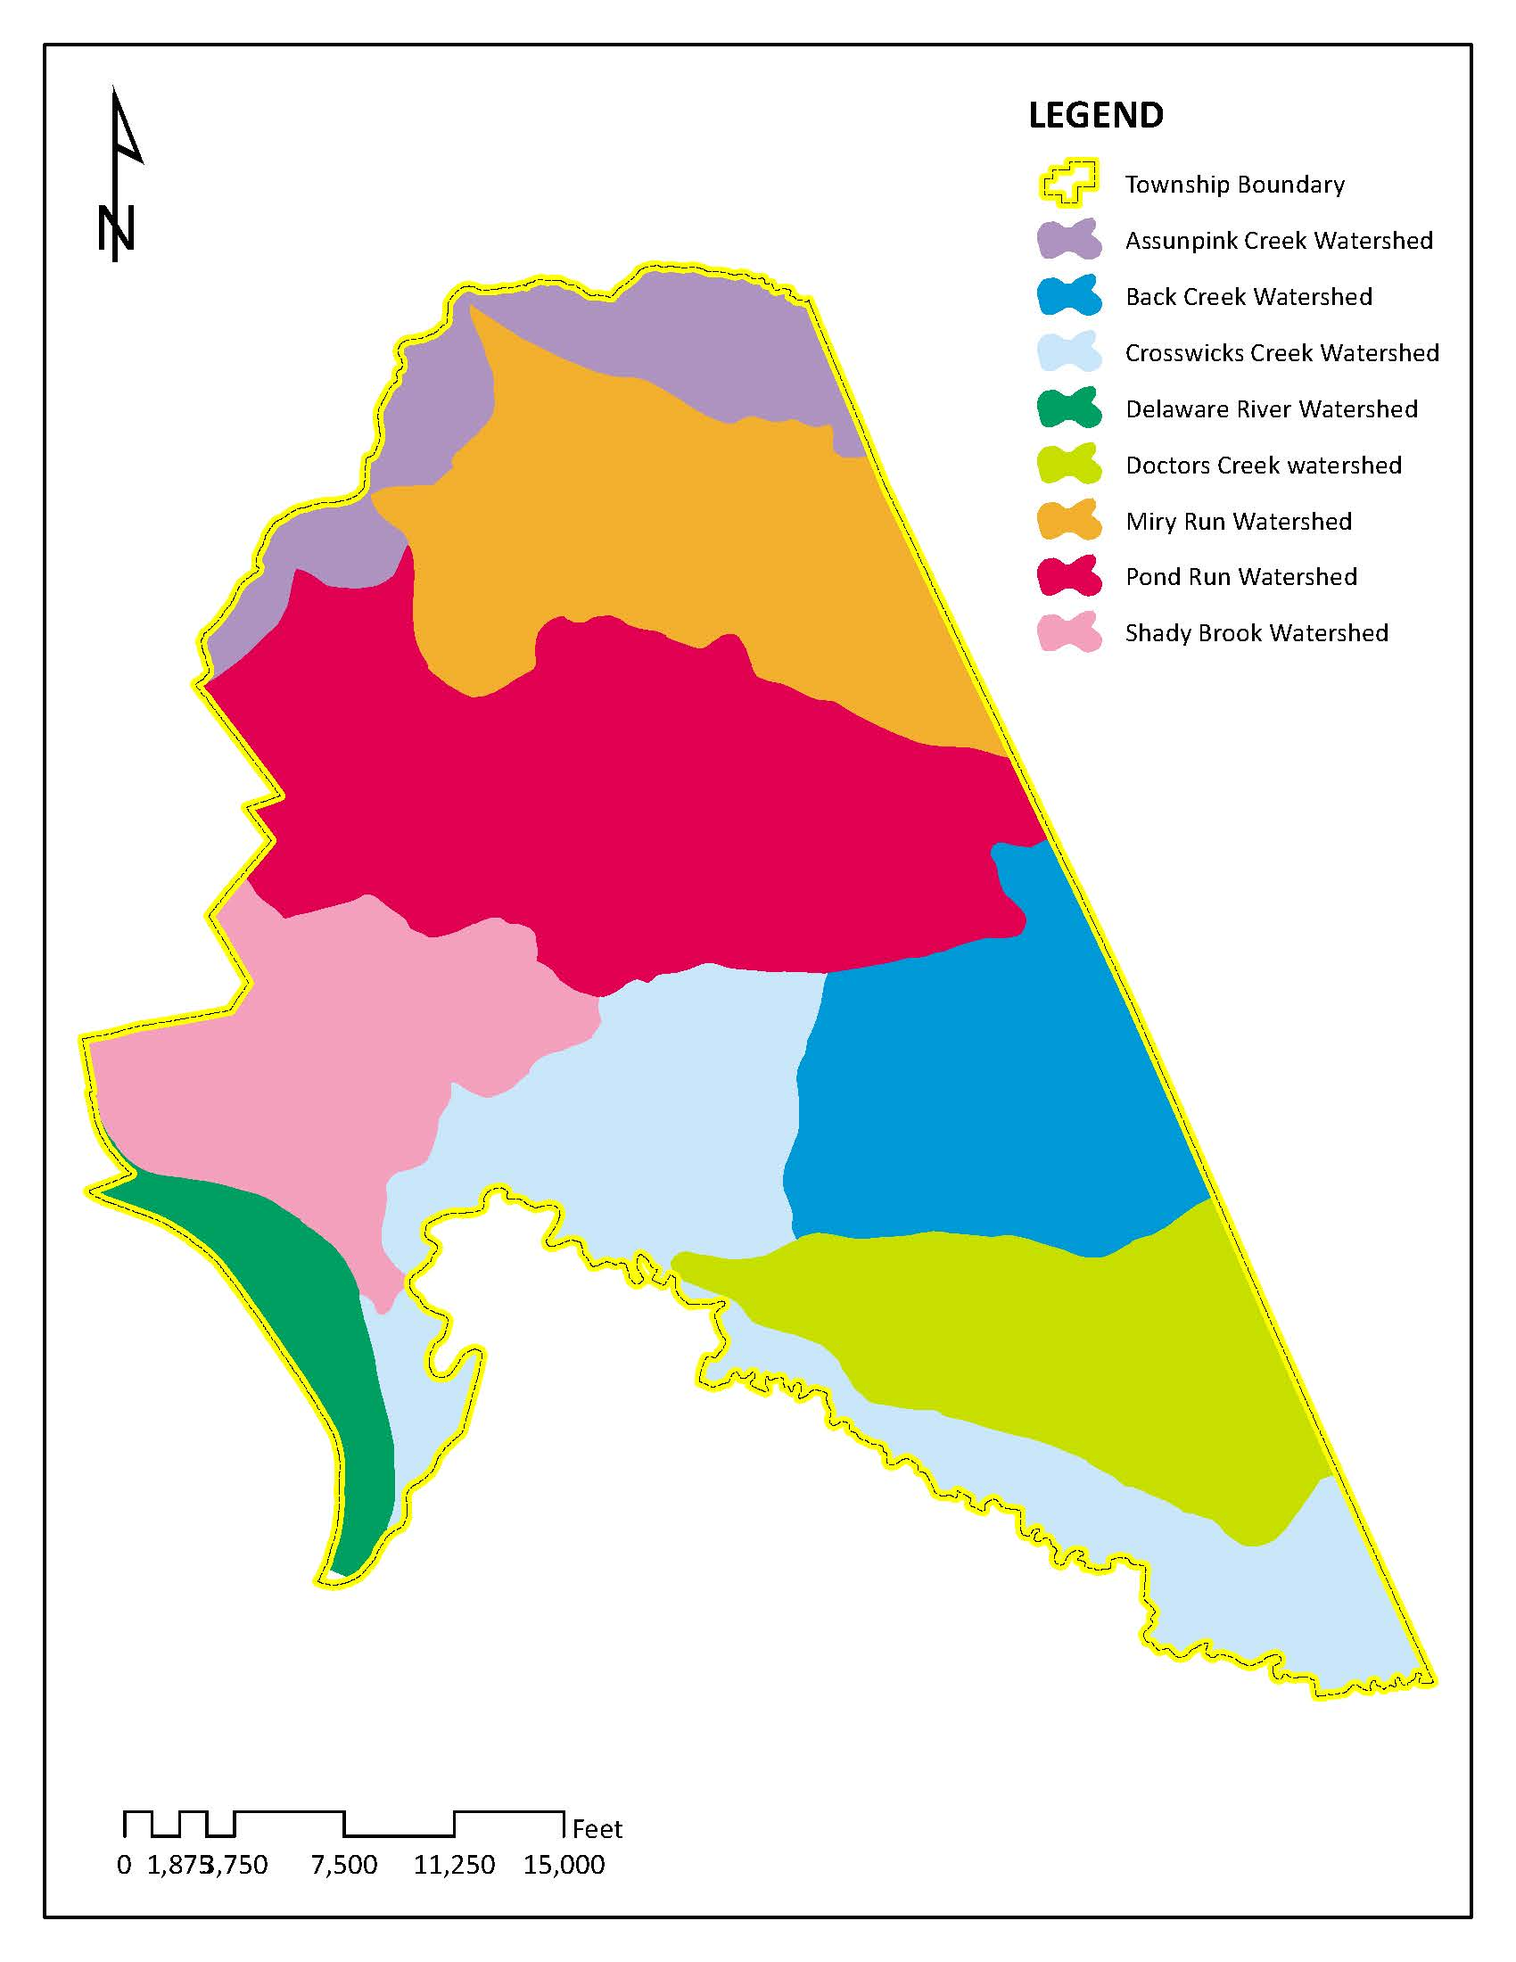
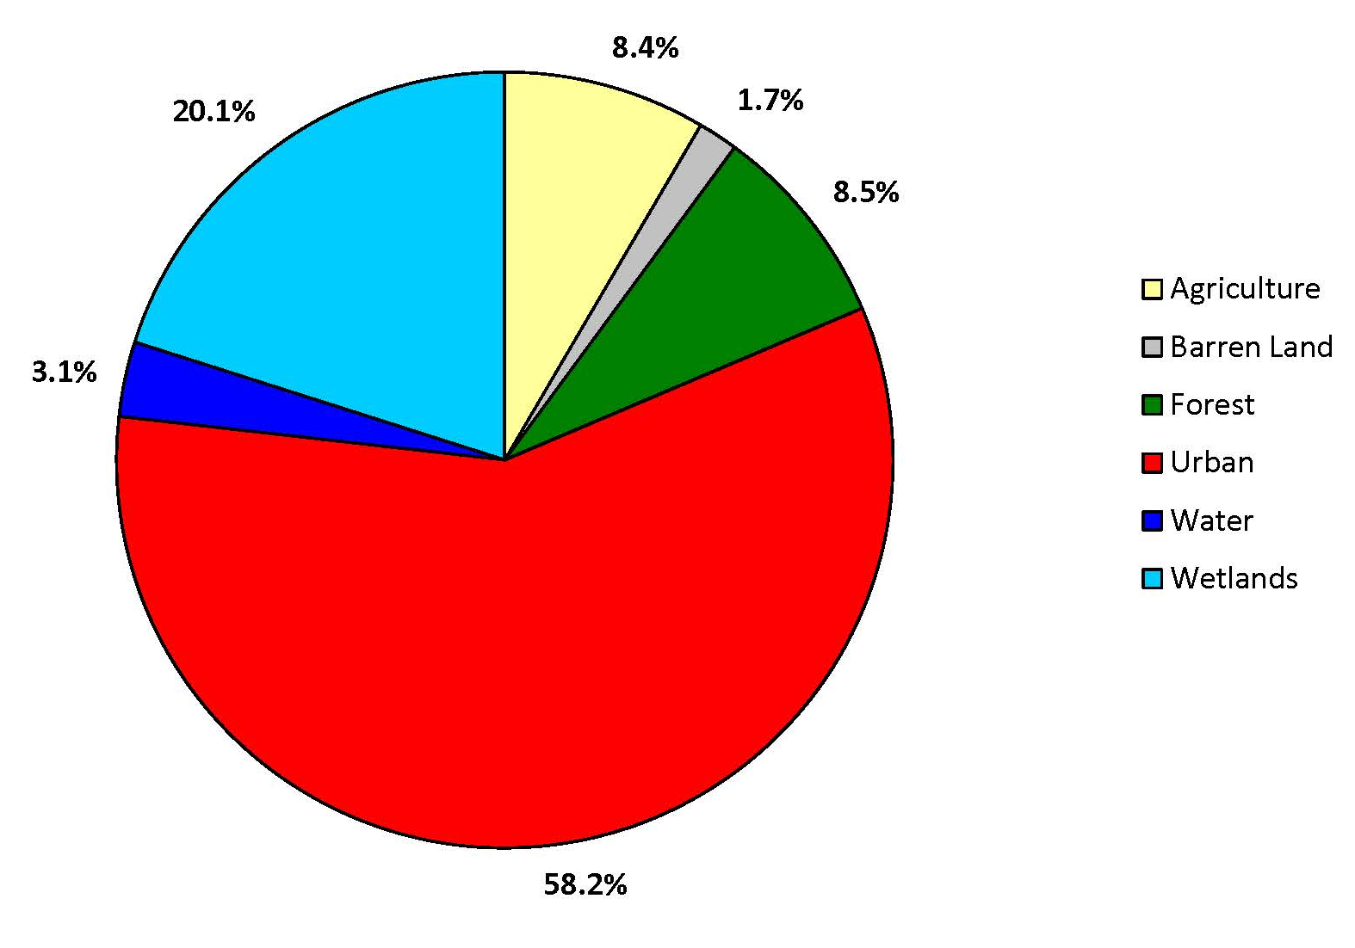
Inventory and Assessment Case Study: Hamilton Township
Notes:
Hamilton Township is located in Mercer County. It is a large township 40 square miles in size with a population of approximately 89,000. It has predominately urban land uses (58%) and has over 22% impervious cover. Hamilton is suffering from frequently localized flowing and the eight rivers that flow through town are all impaired.

Slide 22
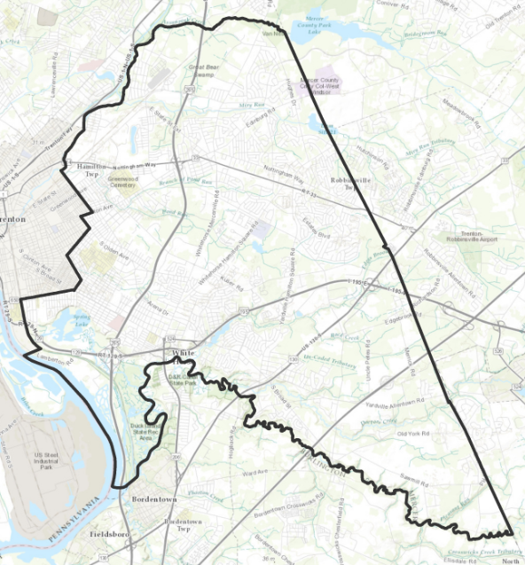
Hamilton Township
Notes:
Hamilton Township decided it was necessary to inventory and assess its detention basins and stormwater outfalls.

Slide 23
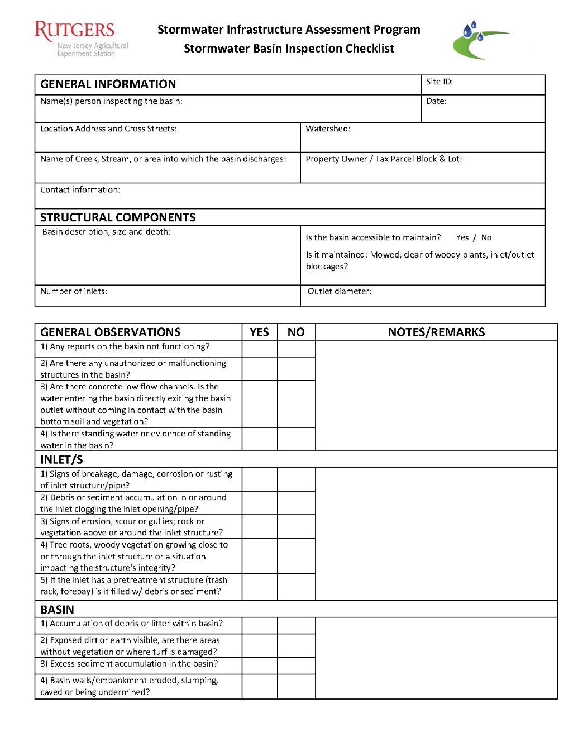
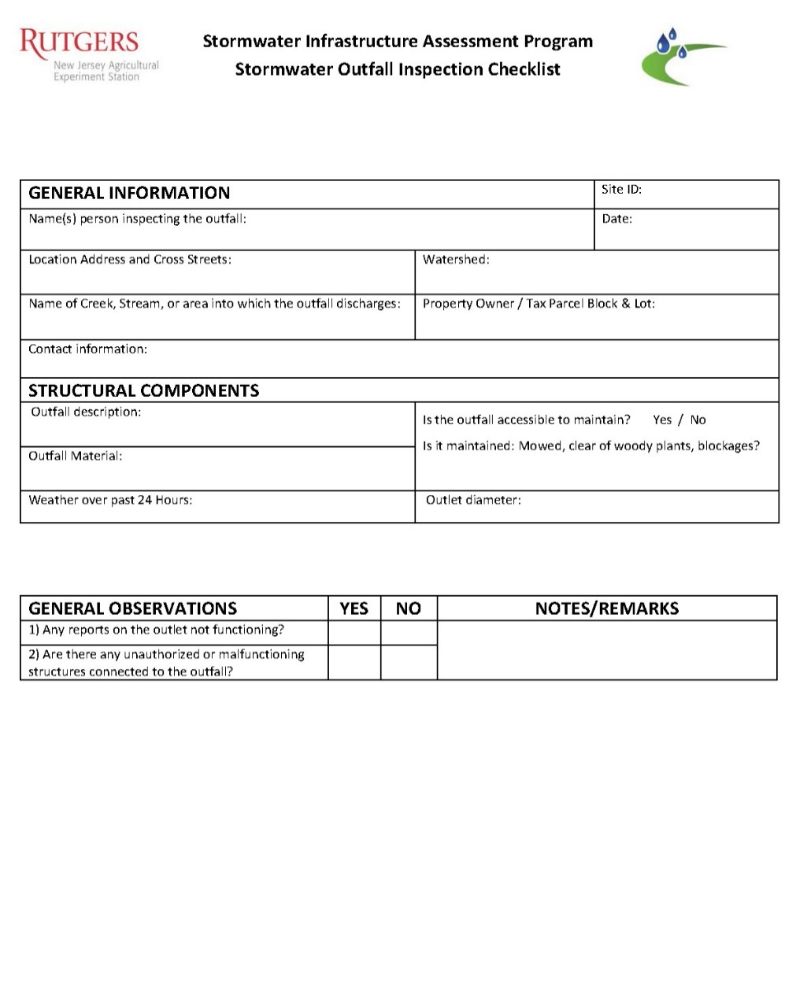
Inventory Forms
Notes:
Detention basin and stormwater outfall inventory forms were created specifically for this projects. The New Jersey Department of Environmental Protection website at www.Njstormwater.org has Field Manuals under the Maintenance Guidance section, which contain inspection checklists.

Slide 24
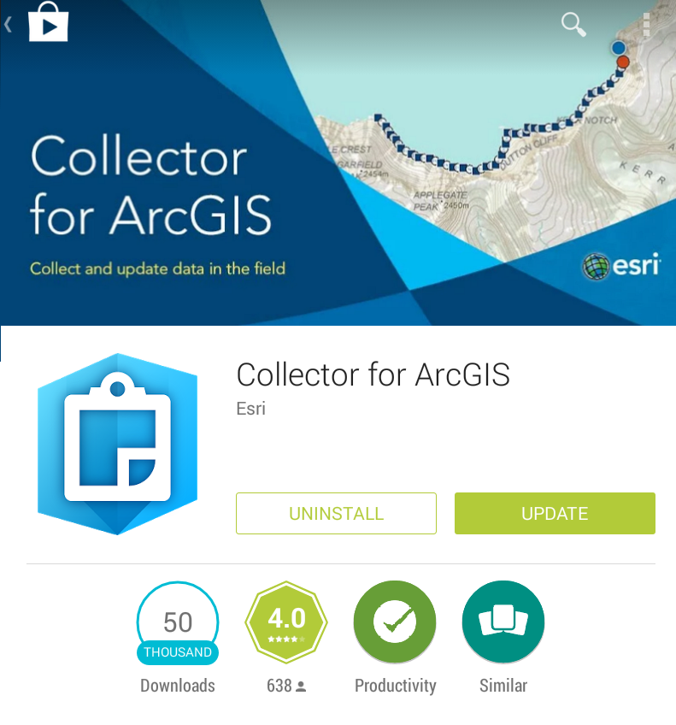
Assessment Tool
Esri Collector Application
Mobile application
No equipment to purchase
Android and Apple Compatible
Easy to use
Easy to upload and share
Available offline
Notes:
The Rutgers Cooperative Extension (RCE) Water Resources Program developed an App to help facility the collection of these data. This App was loaded on tablets and taken into the field. When the inspector returned to the office, all the information was downloaded into an online geographic information system (GIS).

Slide 25

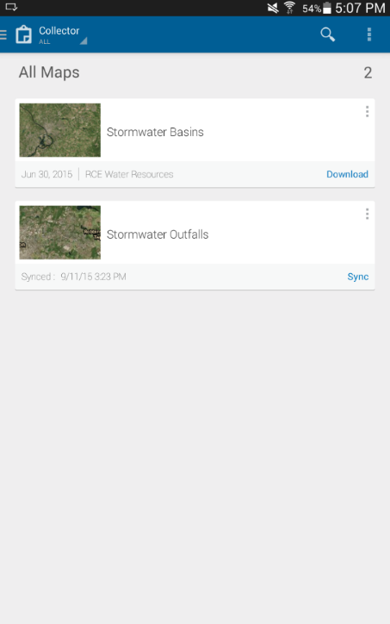
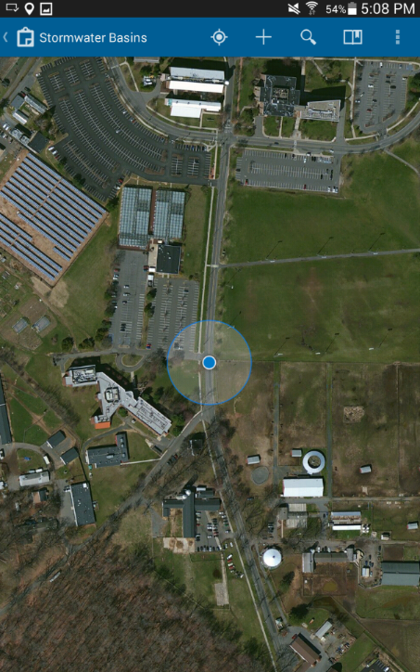
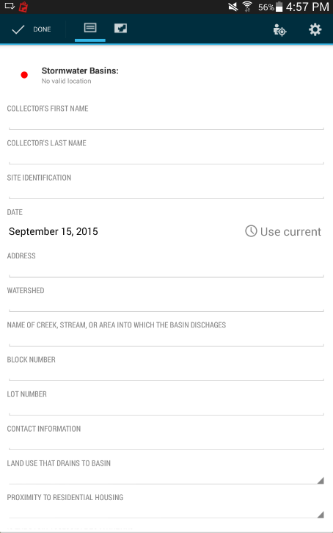
Using the Collector Application in four simple steps
1) Launch Collector
2) Choose Application
3) Tag Location
4) Answer Questions
Notes:
There are four simple steps in using the App.

Slide 26
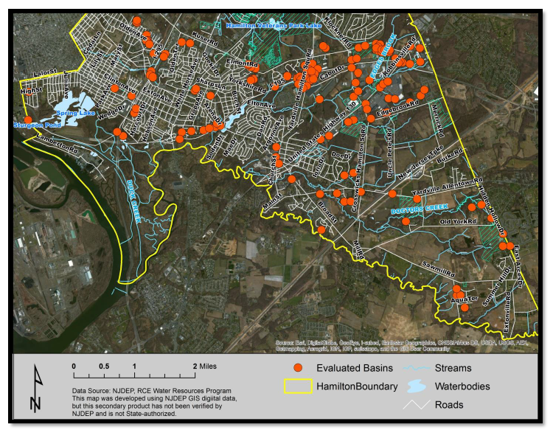
Case Study: Hamilton Township
Notes:
As of 2016, over 300 detention basins have been identified, mapped, and assessed in Hamilton Township. Efforts over the past three years have focused on establishing a baseline condition of these stormwater facilities. It is important that that these systems function as designed to prevent damage to property and minimize flooding. Owners and operators of these basins need to be made aware of their responsibilities in cleaning and maintaining these systems. And, in some cases, significant efforts may be needed to repair damaged and or non-functioning systems.

Slide 27
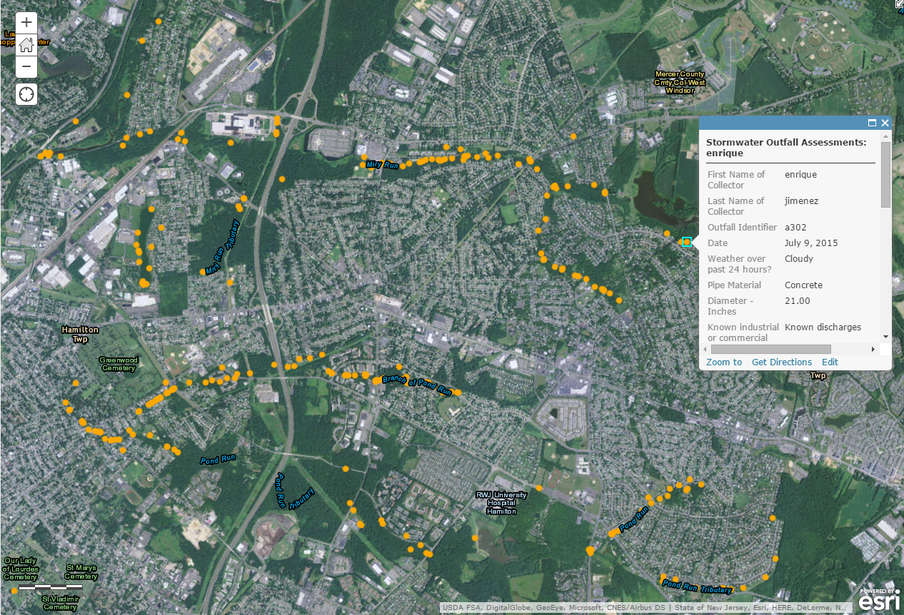
Case Study: Hamilton Township Results
A webmap that combines the geographic information with the answered question.
Notes:
The final product of the inventories is a GIS map that has all the survey data linked to it. Once all the stormwater infrastructure is mapped and assessed, Hamilton Township was able to schedule for regular inspections as well as a plan to systematically provide repairs and maintenance. As part of the Township’s MS4 stormwater permit, it is important that efforts are made to identify and notify property owners of any issues and provide information on routine maintenance procedures and repairs.

Slide 28
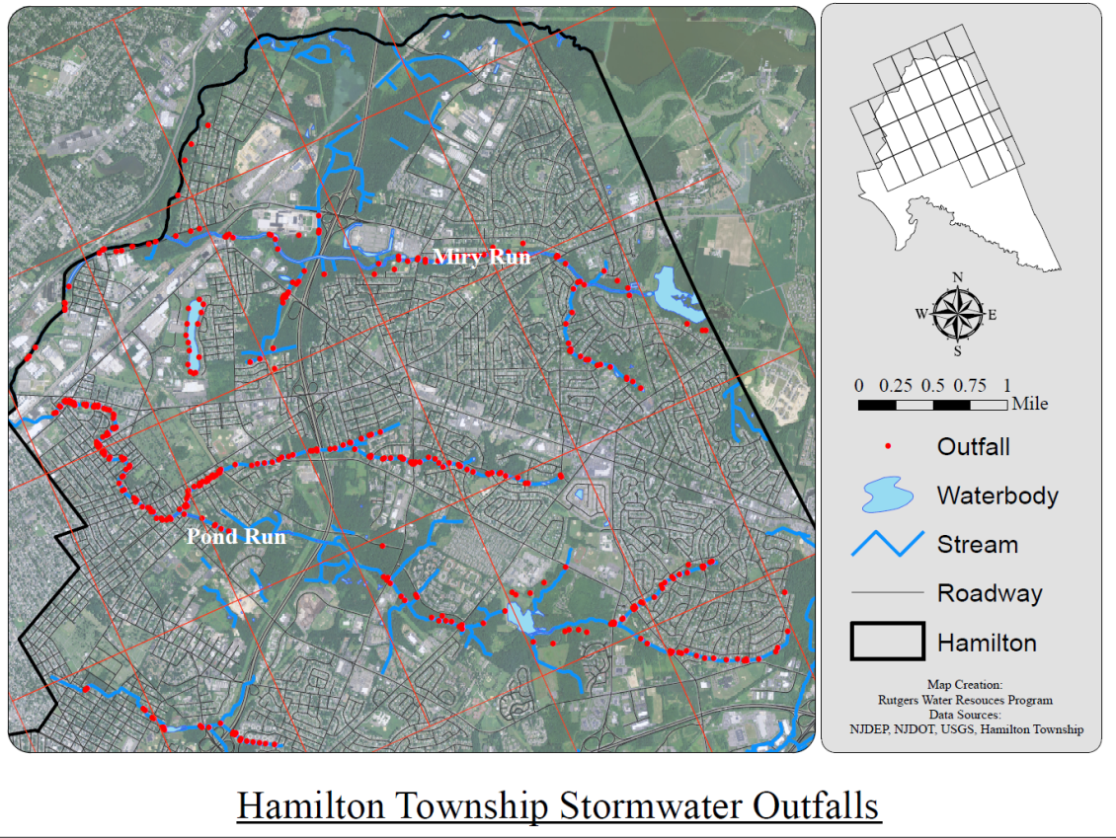
Case Study: Hamilton Township Benefits
Notes:
Hamilton Township has been evaluating issues with flooding and stormwater management at critical locations. These efforts provided an opportunity to better understand the current drainage issues, ensure compliance with MS4 permitting, and develop cost-effective solutions to the problems. Inventorying and assessing the stormwater outfalls that discharge directly into waterways provided Hamilton Township with the information needed to begin correcting ongoing localized problems. The township is beginning to educate and engage local officials and property owners in how innovative strategies can be adopted as a solution to flooding.
These efforts target key flood zones to identify the problems and develop an individualized response effort to begin addressing and correcting the ongoing problems. Let’s look at some of the issues that arose in Hamilton Township when assessing detention basins and stormwater outfalls.

Slide 29
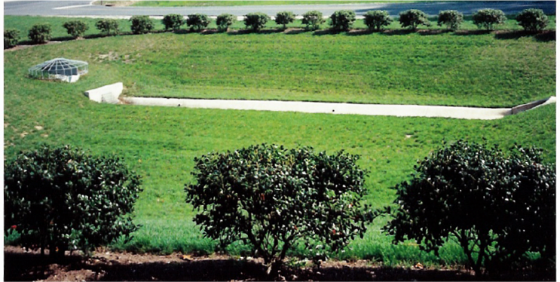
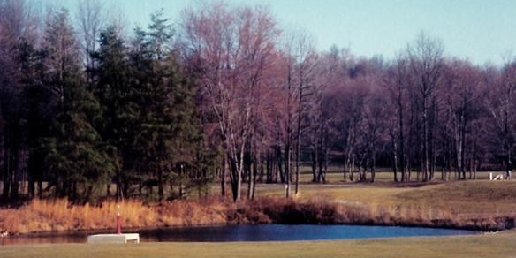
Detention Basin vs. Retention Basin
Does the basin hold a permanent pool of water?
NO – Detention
YES – Retention or Wet Pond
Notes:
There are generally two categories of stormwater management basins; basins that remain wet permanently (known as retention basins or wet ponds) and basins that go dry between storm events (known as detention basins).

Slide 30
Common Concerns with
Detention Basins
Embankment and outlet stabilization
Sedimentation
Outlet blockages
Broken or clogged low-flow channels
Standing water or wet soils
Floatables and debris
Weeds or woody vegetation
Notes:
During inventory and assessing stormwater infrastructure in Hamilton Township, some of the common problems associated with detention basins included erosion, sedimentation, outlet blockages, broken or clogged low-flow channels, standing water or wet soils, floatables and debris, and weeds or woody vegetation. Let’s review these common concerns in more detail.

Slide 31
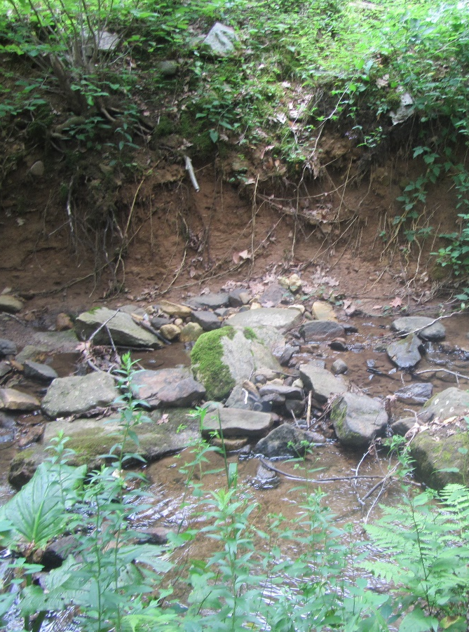
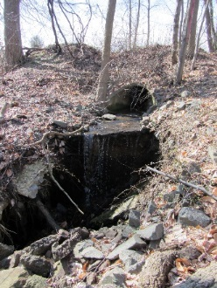
#1 Embankment and Outlet Stabilization
INSERT PHOTO HERE
Embankment Destabilization
Outlet Destabilization
Notes:
Since detention basin outfalls typically discharge water at a high velocity, soil around the outfalls can be eroded as shown in the picture on the right. The embankments of the detention basin can become eroded due to unstable soils and slopes.

Slide 32
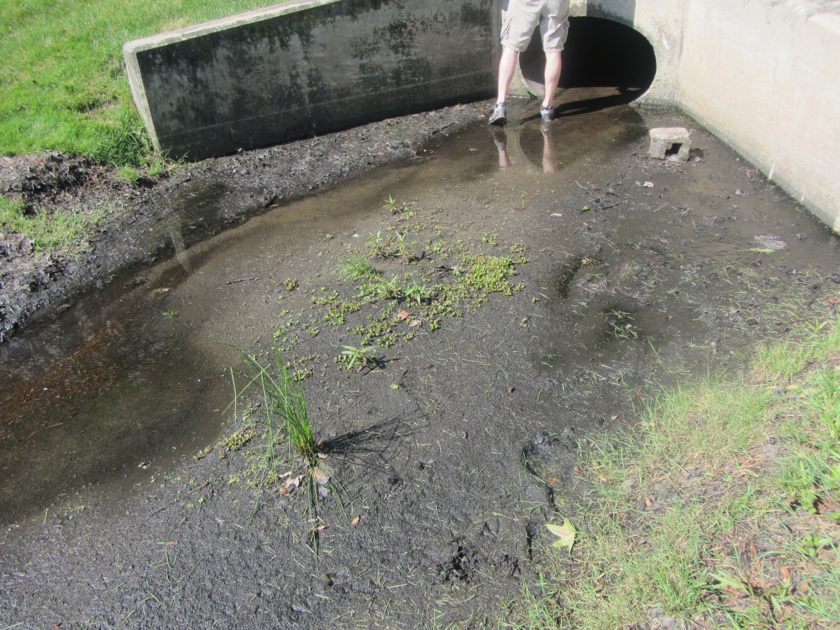
#2 Sedimentation
INSERT PHOTO HERE
Accumulation of sediment in basin
Notes:
Sediment can accumulate in detention basins near inlets. As the velocity of the stormwater entering the basin lessens, sediment settles out of the stormwater. This was a common problem in Hamilton Township. With the GIS database of their stormwater infrastructure, Hamilton Township is able prioritize outfalls for and improve infrastructure to alleviate flood zones.

Slide 33
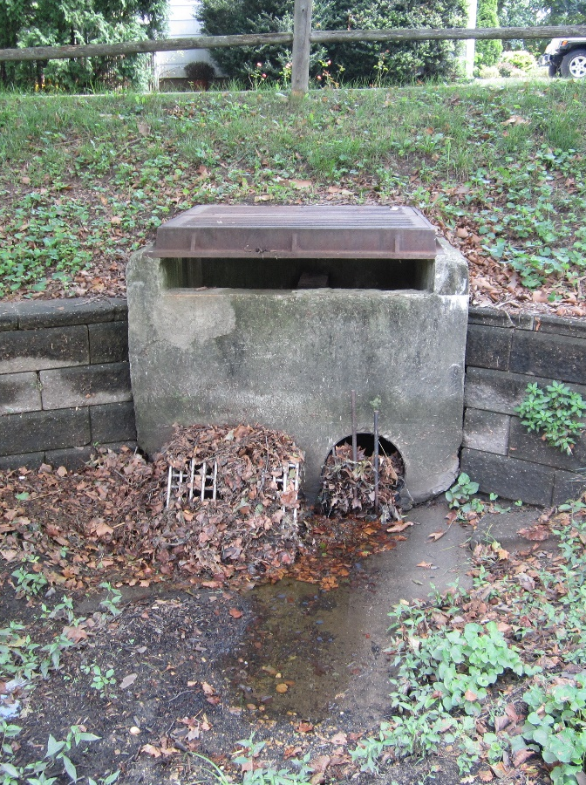
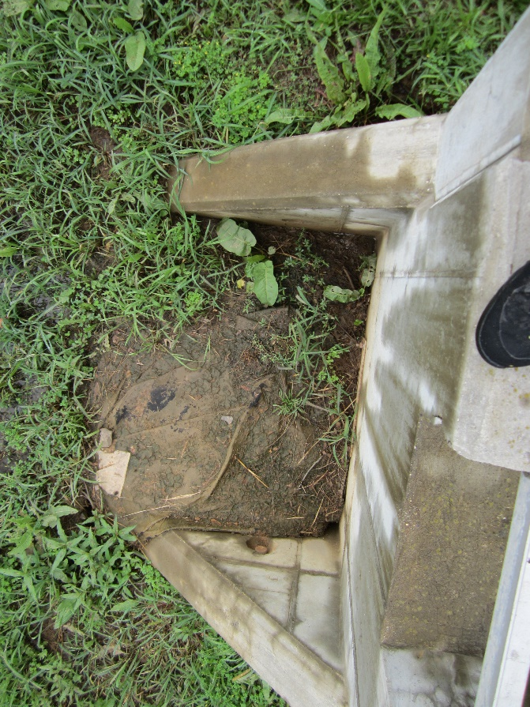
#3 Outlet Blockage
INSERT PHOTO HERE
INSERT PHOTO HERE
Outlet blockage by debris
Outlet blockage by sediment
Notes:
Detention basin outlets can be easily clogged with debris, leaves and brush if they are not regularly cleaned. The availability of the GIS map has assisted Hamilton Township schedule maintain needs of their facilities such as scheduling for more frequent cleaning of outfalls that clogged more often than others.

Slide 34
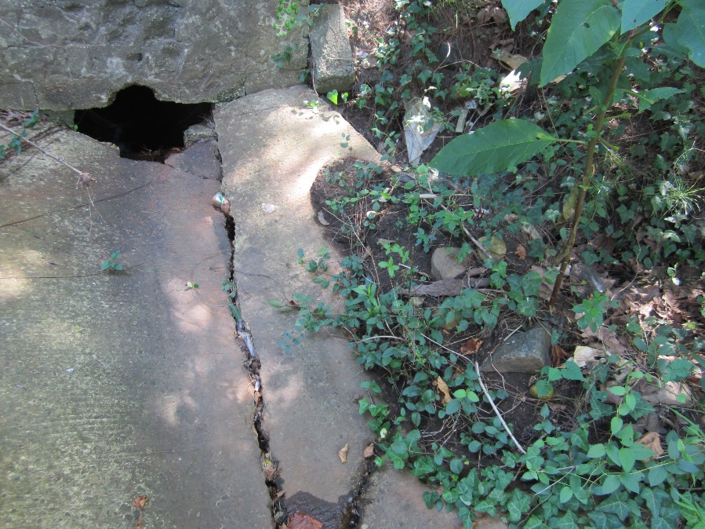
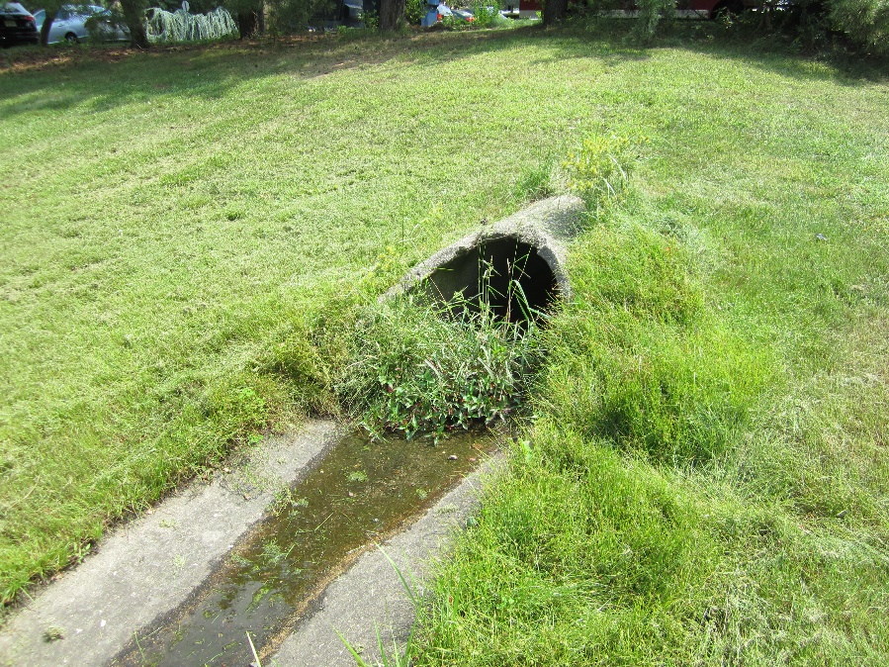
#4 Broken or Clogged Low-Flow Channels
INSERT PHOTO HERE
INSERT PHOTO HERE
Broken low-flow channel
Clogged low-flow channel
Notes:
The concrete low-flow channel can deteriorate over time and crack. These channels also can be clogged with sediment and vegetation.

Slide 35
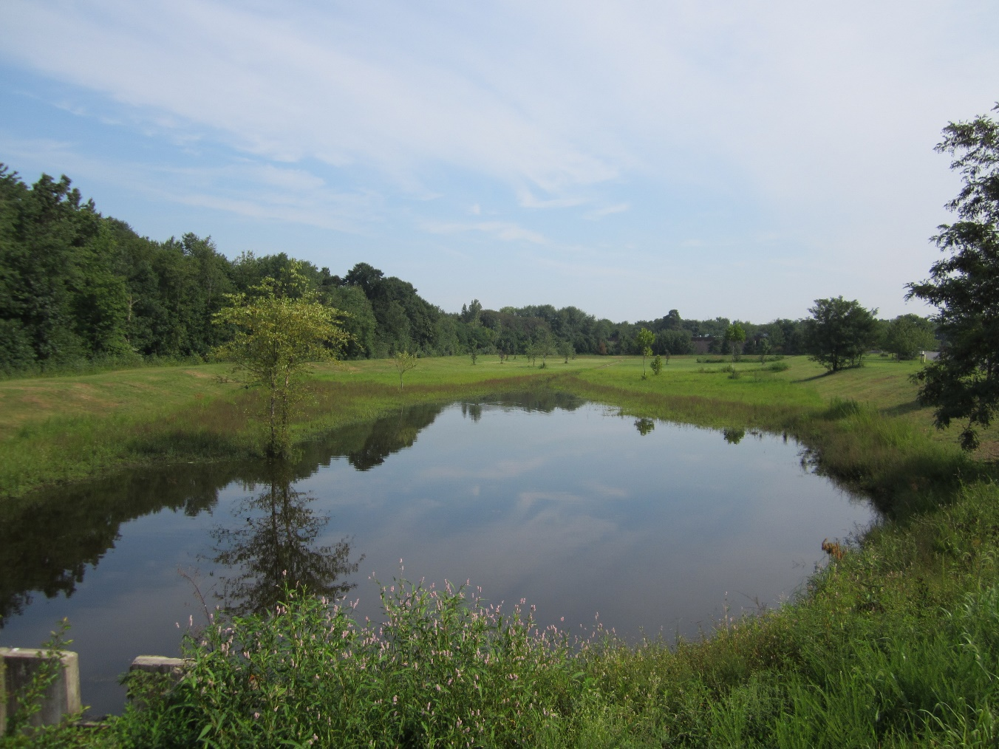
#5 Standing Water or Wet Soils
INSERT PHOTO HERE
Standing water in detention basin
Notes:
When detention basins fail, standing water problems can be created, resulting in mosquito breeding and loss of storage capacity. Several basins were found to have standing water in Hamilton Township. These basins have been repaired and are now functioning properly. The inventory and assessment process facilitated these repairs by prioritizing their facilities within the GIS map.

Slide 36
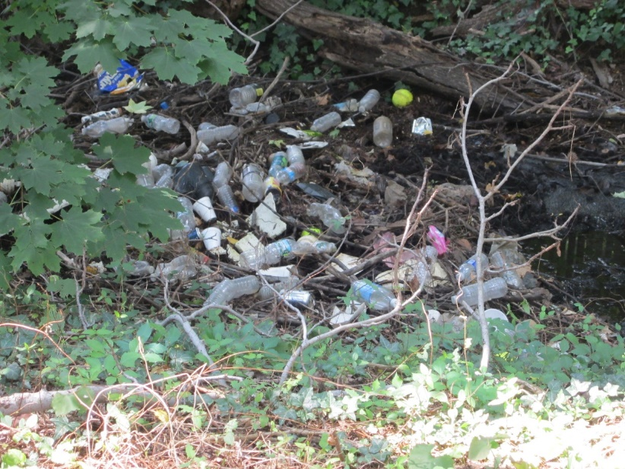
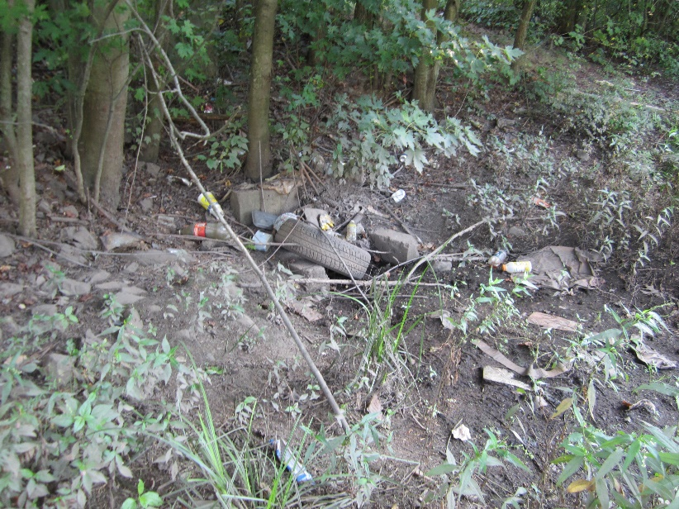
#6 Floatables and Debris
INSERT PHOTO HERE
INSERT PHOTO HERE
Accumulation of floatables in basin
Basin is a dumping ground
Notes:
Detention basins can become dumping grounds for trash and other debris. Floatables from upstream also can accumulate in detention basins.

Slide 37
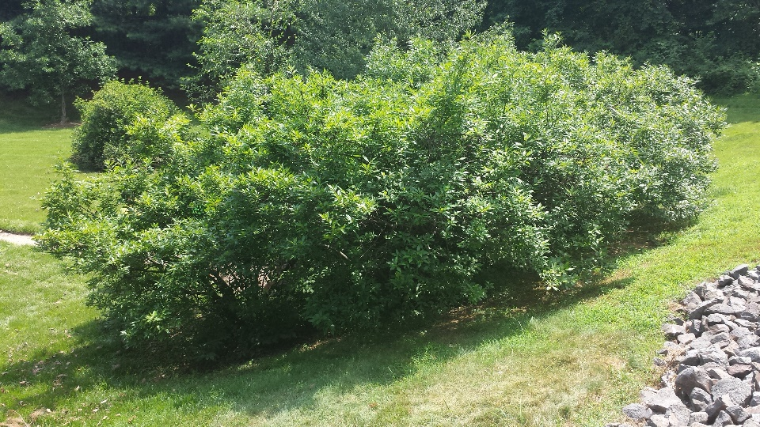
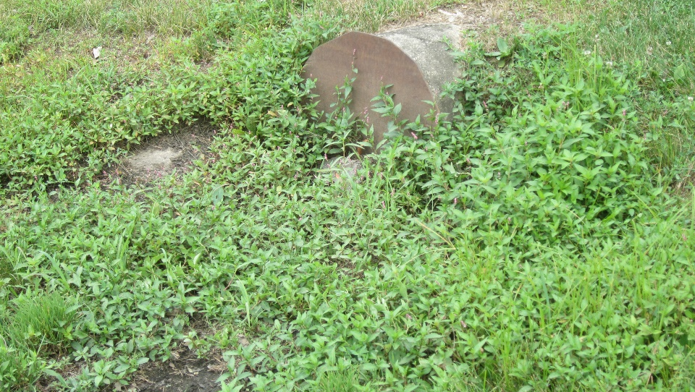
#7 Weeds and Woody Vegetation
INSERT PHOTO HERE
INSERT PHOTO HERE
Woody vegetation in basin
Invasive species have overtaken the basin
Notes:
It is important to remove weeds and woody vegetation from detention basins, which can result in the outlet becoming clogged.

Slide 38
Common Concerns
for Wet Ponds
Embankment and outlet stabilization
Outlet blockages
Sedimentation
Floatables and Debris
Lack of shoreline buffer
Excessive algal growth
Notes:
Many of the common problems associated with detention basins also are associated with wet ponds or retention basins such as erosion, sedimentation, outlet blockages, and floatables and debris. Other common problems are lack of shoreline buffer and excessive algal growth.

Slide 39
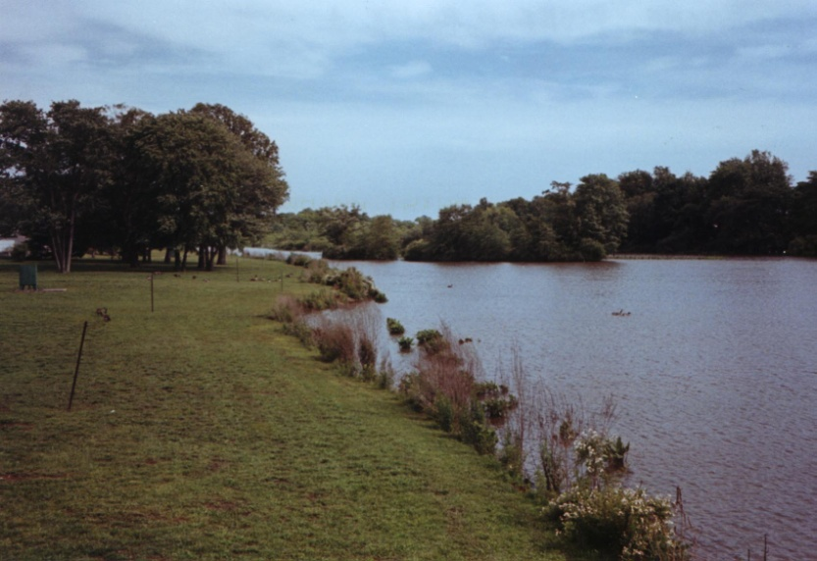
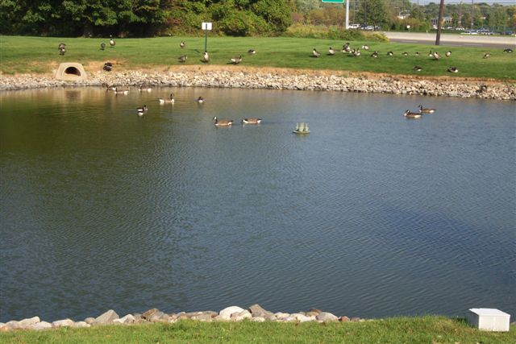
Shoreline Buffer
Notes:
A healthy vegetative buffer in needed around a wet pond to reduce the geese population and to filter pollutant runoff.

Slide 40
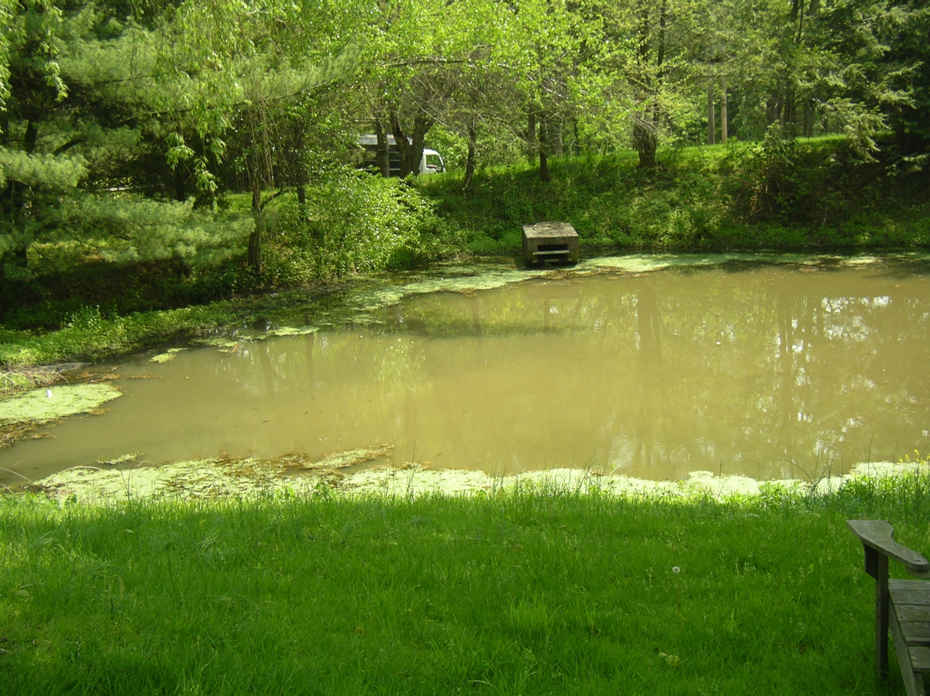

Excessive Algae Growth
Notes:
Since wet ponds are designed to intercept pollutants, the nutrients become trapped in the pond and cause excessive algal growth.

Slide 41

Wet Ponds in Good Condition
Notes:
Here are wet ponds that are in good condition.

Slide 42
Common Concerns
with Stormwater Outfalls
Stream erosion or scouring resulting from discharge
Poor pipe condition
Discharge of floatables
Discharge of excessive sediment
Color of the water discharging
Discharging during dry weather conditions
Outfall overgrown with vegetation
Structural integrity of headwall or other supporting structure
Notes:
In Hamilton Township, some of the common problems associated with stormwater outfalls included stream erosion or scouring resulting from discharge, poor pipe condition, discharge of floatables, discharge of excessive sediment, color of the water discharging, discharging during dry weather conditions, outfall overgrown with vegetation, and structural integrity of headwall or other supporting structure.

Slide 43


#1 Stream erosion or scouring resulting from discharge
Outfall is causing erosion
Outfall is causing scouring
Notes:
It is not uncommon to see erosion associated with an outfall pipe as shown here. Since water is exiting the pipe at a high velocity, scouring can also occur downstream of the outfall pipe entering the waterway. Typically, a stone scour hole and riprap are used to stabilize the area around the outfall to prevent erosion and scouring.

Slide 44

#2 Poor pipe condition
INSERT PHOTO HERE
Crumbling concrete outfall pipe or pipe sections falling into stream
Notes:
Most stormwater outfall pipes are made of reinforced concrete that can deteriorate over time. At times, section of outfall pipes can fall into the stream as the soil around the pipe is eroded away. A headwall with a riprap apron can be constructed to repair this situation and prevent future pipe sections from becoming undermined.

Slide 45


#3 Discharge of Floatables
Accumulation of floatables from outfall
Garbage in the stream
Notes:
Plastic bottles and other debris can enter a stormwater system and get discharged from the stormwater outfall. Street sweeping and retrofitting storm drain inlets to reduce the curb opening can be used to reduce this problem.

Slide 46



#4 Discharge of excessive sediment
Outfall pipes can discharge excessive sediment into the local waterway
Notes:
Stormwater outfalls can discharge excessive sediment to local waterways as shown here. This results in sediment accumulation in the stream, which reduces the stream’s capacity to convey stormwater from larger storms, causing flooding and smothering the aquatic habitat on the bottom of the stream. Hamilton Township is reducing this by ensuring that soil erosion and sediment control standards are being used for new construction and street sweeping is being conducted as required by the MS4 permit.

Slide 47

#5 Color of the water discharging
INSERT PHOTO HERE
Stormwater seems very cloudy – could be a cross connection with sanitary sewer pipe
Notes:
Discolored water coming from the stormwater outfall can mean a cross-connection with a sanitary sewer pipe. Water quality testing is recommended.

Slide 48

#6 Discharging during dry weather
Could be an illicit connection – water quality testing should be done
Notes:
Flows during dry weather means that the stormwater outlet is discharging groundwater that has seeped into the piping system or there is an illegal connection to the stormwater system. Water quality testing needs to be completed of this dry weather flow.

Slide 49


#7 Outfall overgrown with vegetation
Outfall capacity is limited due to overgrowth of vegetation
Notes:
Stormwater outfalls can become overgrown with vegetation which can limit their ability to discharge stormwater.

Slide 50

#8 Structural integrity of headwall
INSERT PHOTO HERE
Concrete headwall is crumbling
Notes:
The concrete headwalls associate with stormwater outfalls can deteriorate, creating a safety hazard as well as an environmental problem of an unstable outfall. Hamilton Department of Public Works can fix many of these problems themselves. The inventory and assessment of their outfalls and stormwater infrastructure allowed them to schedule this type of maintenance.

Slide 51


Inventory and Assessment Case Study: Hamilton Township
Notes:
Hamilton Township is directing efforts to educate and engage homeowners in the community to take action on their property to help reduce stormwater runoff. In utilizing the GIS inventory map for assessments, the Township is working to schedule and facilitate an informative work session to provide detailed information to stormwater basin owners about how these systems function and the maintenance required to keep them functioning. Township Public Works have installed demonstration rain garden projects to illustrate how this can be done. In addition, the Township has sponsored rain barrel workshops for local residents. Citizens are willing to participate in these efforts when given the “tools” and information they need to move forward.

Slide 52

E-learning Tool Available
A FREE interactive online E-learning tool is available http://water.rutgers.edu/E-learning.html
The tool showcase how municipalities can comply with the new MS4 permits

Slide 53
Questions?
Rutgers Cooperative Extension
Water Resources Program
water@envsci.rutgers.edu
Notes:
This workshop will provide instruction on how to identify and assess stormwater infrastructure in your community. The development of this tool was funded by the New Jersey Department of Environmental Protection. Additionally, the New Jersey Sea Grant Consortium and the New Jersey Agricultural Experiment Station provided funding to partially support the creators of this presentation and eLearning Tool

